Slide 1

CLF-C02
CLOUD PRACTITIONER
MASTER TRAINER SLIDES · WSQ
AWS Certified Cloud Practitioner (CLF-C02)
WSQ Course Code: TGS-2023039183
Conducted by Tertiary Infotech Academy Pte Ltd · UEN 201200696W
Version v13 · 31 July 2026
© 2026 Tertiary Infotech Academy Pte Ltd. All rights reserved. · www.tertiarycourses.com.sg

Slide 2
It is mandatory for you to take both AM, PM and Assessment digital attendance for WSQ funded courses.
• The trainer or administrator will show you the digital attendance QR code generated from SSG portal.
• Please scan the QR code from your mobile phone camera and submit your attendance.
• Digital Attendance (Mandatory)
AWS Certified Cloud Practitioner (CLF-C02) · TGS-2023039183
© 2026 Tertiary Infotech Academy Pte Ltd
1

Slide 3
About the Trainer
• About the Trainer
AWS Certified Cloud Practitioner (CLF-C02) · TGS-2023039183
© 2026 Tertiary Infotech Academy Pte Ltd
2

Slide 4
ICE-BREAKER
Let's Know Each Other
• Your name and organisation / role.
• Your experience with AWS or cloud services (if any).
• What you want to understand or achieve with AWS after this course.
AWS Certified Cloud Practitioner (CLF-C02) · TGS-2023039183
© 2026 Tertiary Infotech Academy Pte Ltd
3

Slide 5
Set your mobile phone to silent mode
• Actively participate in the class. No question is stupid.
• Respect each other view
• Exit the class silently if you need to step out for phone call, toilet break
• Ground Rules
AWS Certified Cloud Practitioner (CLF-C02) · TGS-2023039183
© 2026 Tertiary Infotech Academy Pte Ltd
4

Slide 6
Lesson Plan
• Day 1
• Digital Attendance (AM)
• Trainer and Learners Introduction
• Learning Outcomes
• Course Outline
• Topic 1: Cloud Concepts
• Topic 2: Security and Compliance
• Lunch Break
• Digital Attendance (PM)
• Topic 3: AWS Compute Services
• Topic 4: AWS Database and Storage Services
• End of Day 1
AWS Certified Cloud Practitioner (CLF-C02) · TGS-2023039183
© 2026 Tertiary Infotech Academy Pte Ltd
5

Slide 7
Lesson Plan
• Day 2
• Digital Attendance (AM)
• Topic 5: AWS Networking and Other Services
• Topic 6: AWS Analytics Services
• Lunch Break
• Digital Attendance (PM)
• Topic 7: Support
• Revision
• Course Feedback and TRAQOM Survey
• Digital Attendance (Assessment)
• Final Assessment
• End of Class
AWS Certified Cloud Practitioner (CLF-C02) · TGS-2023039183
© 2026 Tertiary Infotech Academy Pte Ltd
6

Slide 8
TSC Title: Cloud Computing
TSC Code: ICT-DIT-3020-1.1
Skills Framework
1
2
AWS Certified Cloud Practitioner (CLF-C02) · TGS-2023039183
© 2026 Tertiary Infotech Academy Pte Ltd
7

Slide 9
TSC Abilities:
• A1: Set up environment for the implementation of cloud solutions in accordance to user requirements
• A2: Run tests for cloud solutions to minimise integration-related issues
• A3: Detect issues with cloud solutions to identify solutions
• A4: Resolve cloud integration and implementation issues
• A5: Conduct implementation tests on cloud solutions to measure its effectiveness against defined metrics.
• A6: Escalate unresolved issues related to implementation of cloud solutions
• TSC Knowledge:
• K1: Security and quality standards
• K2: Diagnostic tools for cloud-related problems
• K3: Types of installation tests for cloud solutions
• K4: Technical solutions or techniques to resolve cloud integration-related issues
• K5: Database administration and maintenance tools and techniques
• Skills Framework TSC
AWS Certified Cloud Practitioner (CLF-C02) · TGS-2023039183
© 2026 Tertiary Infotech Academy Pte Ltd
8

Slide 10
Learning Outcomes
• LO1: Set up and test AWS cloud solutions in accordance to security standards.
• LO2: Detect and resolve AWS cloud integration issues related to AWS services.
• LO3: Conduct implementation tests and escalate unresolved AWS cloud issues.
AWS Certified Cloud Practitioner (CLF-C02) · TGS-2023039183
© 2026 Tertiary Infotech Academy Pte Ltd
9

Slide 11
TOPIC 1
Introduction to Cloud Concepts
AWS Certified Cloud Practitioner (CLF-C02) · TGS-2023039183
© 2026 Tertiary Infotech Academy Pte Ltd
10

Slide 12
TOPIC 3
Define methods of deploying and operating in the AWS Cloud.
AWS Certified Cloud Practitioner (CLF-C02) · TGS-2023039183
© 2026 Tertiary Infotech Academy Pte Ltd
11

Slide 13
TOPIC 6
AWS artificial intelligence and machine learning (AI/ML) services and analytics services.
AWS Certified Cloud Practitioner (CLF-C02) · TGS-2023039183
© 2026 Tertiary Infotech Academy Pte Ltd
12

Slide 14
TOPIC 6
Access AWS Skills Builder
• https://skillbuilder.aws/
• Builder ID Login:
• training@tertiaryinfotech.com
• training2@tertiaryinfotech.com
• training3@tertiaryinfotech.com
• training4@tertiaryinfotech.com
• training5@tertiaryinfotech.com
• PW: Tertiary@888
• https://skillbuilder.aws/
• Builder ID Login:
• training6@tertiaryinfotech.com
• training7@tertiaryinfotech.com
• training8@tertiaryinfotech.com
• training9@tertiaryinfotech.com
• training10@tertiaryinfotech.com
• PW: Tertiary@888
AWS Certified Cloud Practitioner (CLF-C02) · TGS-2023039183
© 2026 Tertiary Infotech Academy Pte Ltd
13

Slide 15
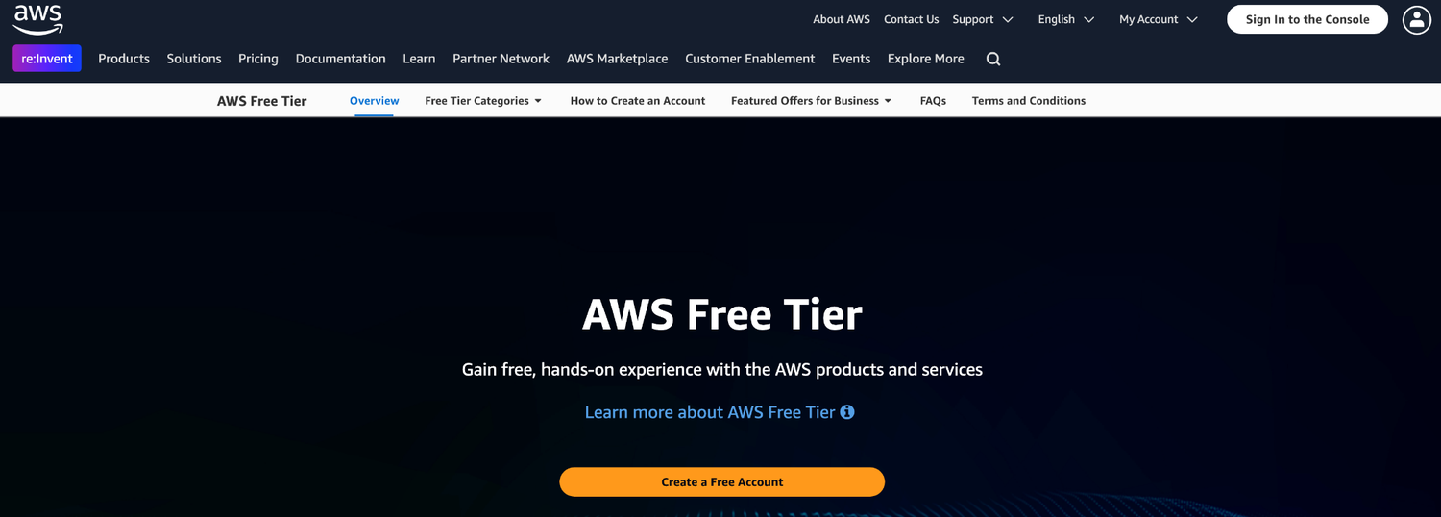
TOPIC 6
Sign Up Free Trial AWS Account
https://aws.amazon.com/free/
AWS Certified Cloud Practitioner (CLF-C02) · TGS-2023039183
© 2026 Tertiary Infotech Academy Pte Ltd
14

Slide 16
TOPIC 6
Download Sample Codes
• Download the sample codes use for this course below
• https://drive.google.com/drive/folders/1KKpRQ1HWw380u4uwp2xPVnv8vNoDdTVN
AWS Certified Cloud Practitioner (CLF-C02) · TGS-2023039183
© 2026 Tertiary Infotech Academy Pte Ltd
15

Slide 17
TOPIC 6
Written Assessment (Short Answer Questions) - 1 hr
• Practical Performance (PP) - 1 hr
• Assessment format: Open Book
• Open book assessment ONLY includes Slides, Learner Guide or any approved materials.
• Appeal process
• Final Assessment
AWS Certified Cloud Practitioner (CLF-C02) · TGS-2023039183
© 2026 Tertiary Infotech Academy Pte Ltd
16

Slide 18
TOPIC 6
Briefing for Assessment
Place phones & other materials under the table or on the floor
No photos or recording of assessment scripts
No discussion during assessment
1
2
3
Use black/blue pen for assessment [hard copies]
No usage of liquid paper or correction tape
Assessment scripts will be collected when the time is up
4
5
6
AWS Certified Cloud Practitioner (CLF-C02) · TGS-2023039183
© 2026 Tertiary Infotech Academy Pte Ltd
17

Slide 19
TOPIC 6
Criteria for Funding
Minimum attendance rate of 75% based on SSG Digital Attendance record.
Complete the assessment and be assessed as ‘Competent’
1
2
AWS Certified Cloud Practitioner (CLF-C02) · TGS-2023039183
© 2026 Tertiary Infotech Academy Pte Ltd
18

Slide 20
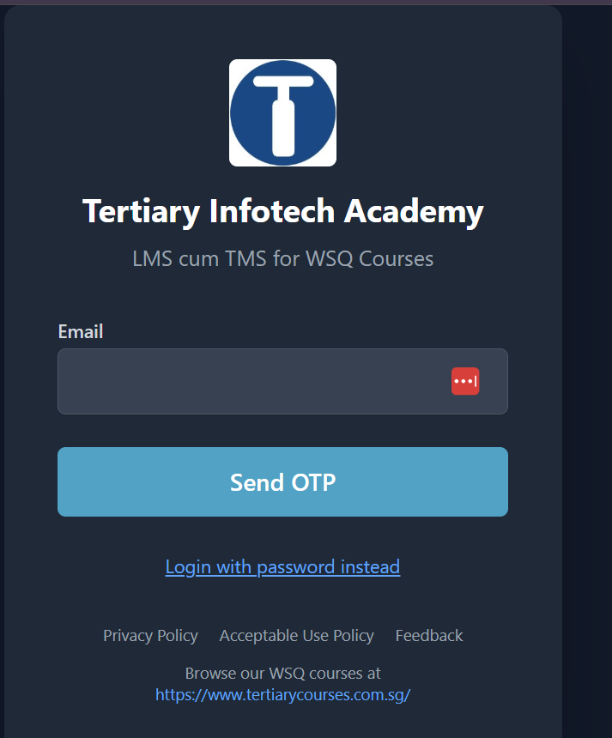
TOPIC 6
LMS/TMS
https://lms-tms.tertiaryinfotech.com
AWS Certified Cloud Practitioner (CLF-C02) · TGS-2023039183
© 2026 Tertiary Infotech Academy Pte Ltd
19

Slide 21
TOPIC 1
Cloud Concepts
AWS Certified Cloud Practitioner (CLF-C02) · TGS-2023039183
© 2026 Tertiary Infotech Academy Pte Ltd
20

Slide 22
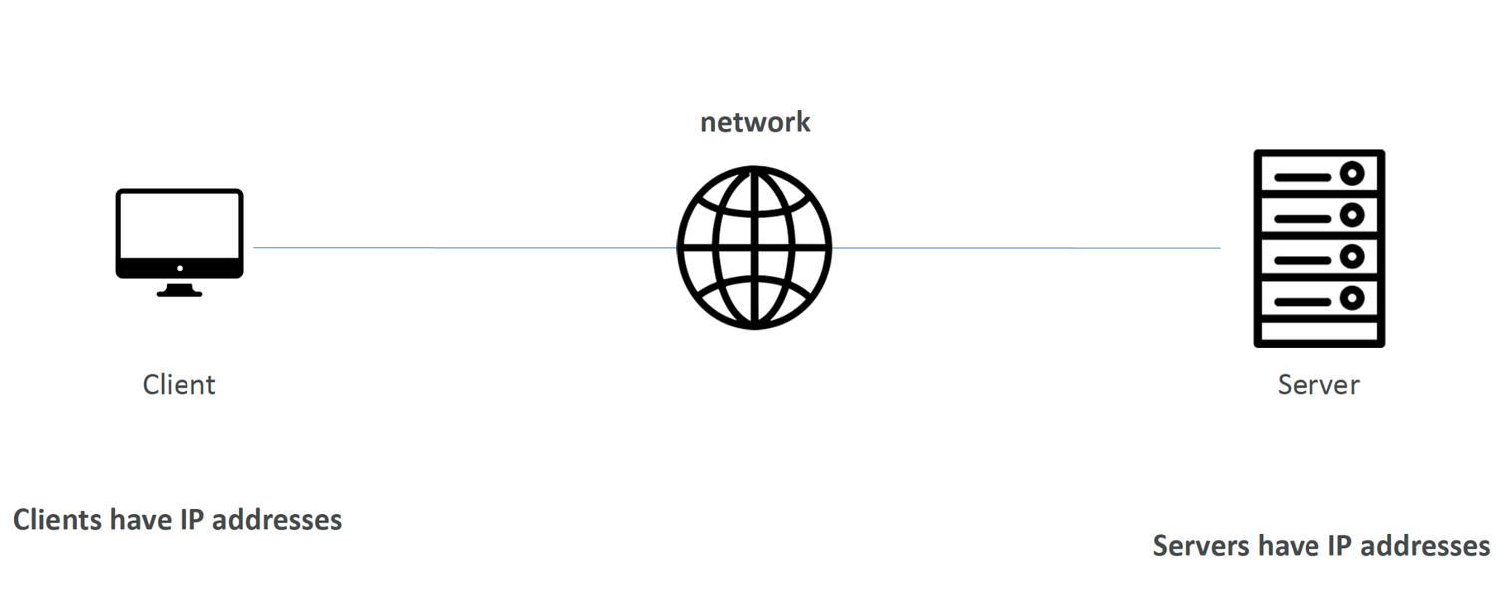
TOPIC 1
How websites work
AWS Certified Cloud Practitioner (CLF-C02) · TGS-2023039183
© 2026 Tertiary Infotech Academy Pte Ltd
21

Slide 23
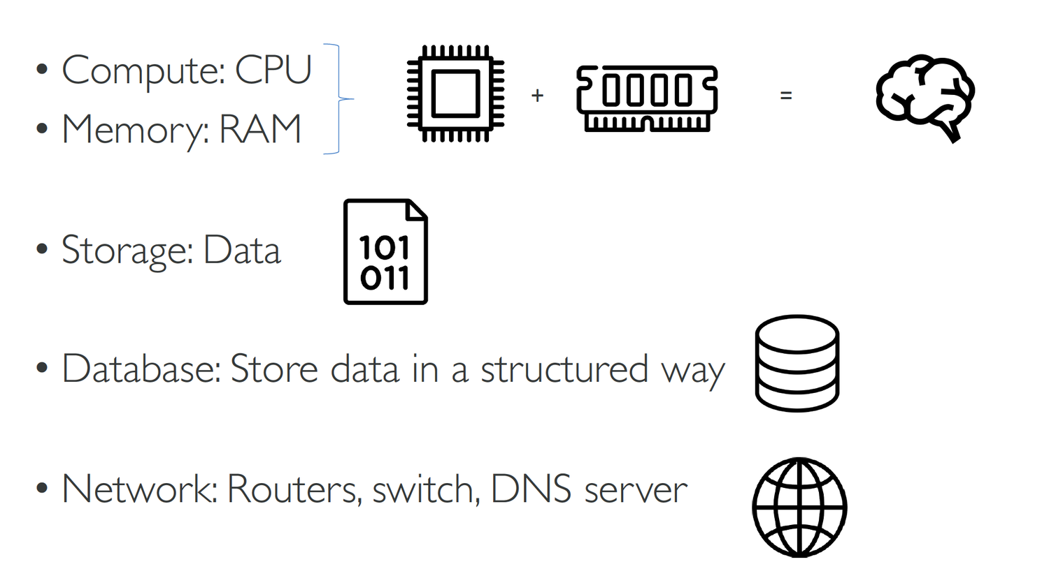
TOPIC 1
What is a server composed of?
AWS Certified Cloud Practitioner (CLF-C02) · TGS-2023039183
© 2026 Tertiary Infotech Academy Pte Ltd
22

Slide 24
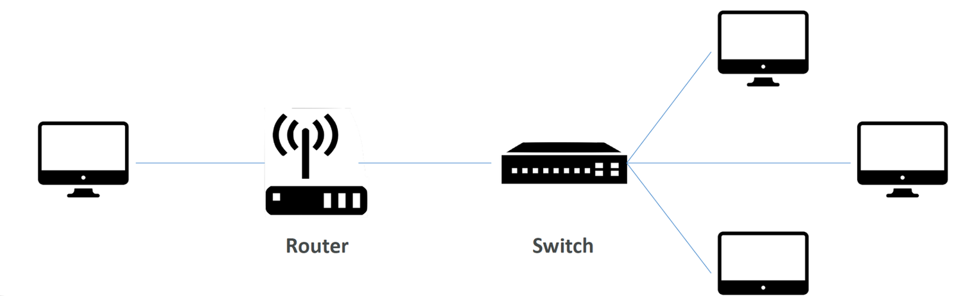
TOPIC 1
IT Terminology
Network: cables, routers and servers connected with each other
AWS Certified Cloud Practitioner (CLF-C02) · TGS-2023039183
© 2026 Tertiary Infotech Academy Pte Ltd
23

Slide 25
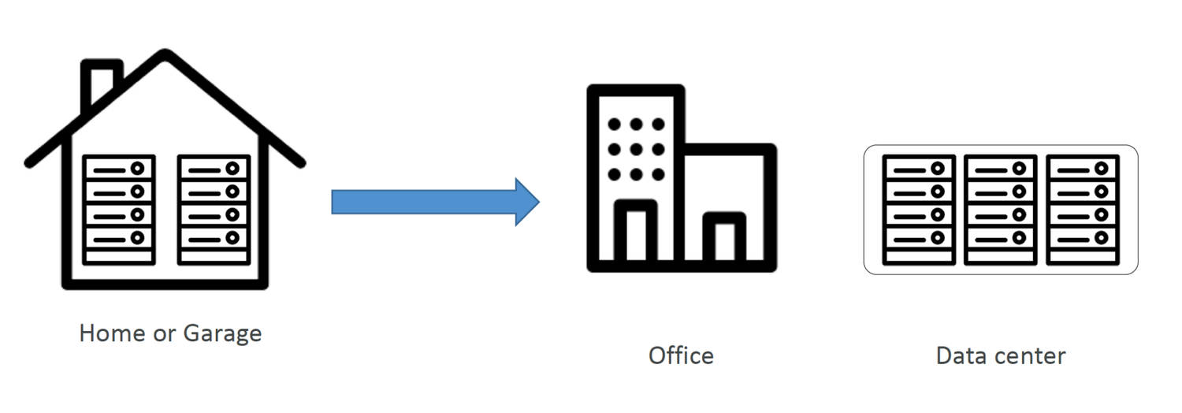
TOPIC 1
Traditionally, how to build infrastructure
AWS Certified Cloud Practitioner (CLF-C02) · TGS-2023039183
© 2026 Tertiary Infotech Academy Pte Ltd
24

Slide 26
TOPIC 1
Problems with traditional IT approach
• Pay for the rent for the data center
• Pay for power supply, cooling, maintenance
• Adding and replacing hardware takes time
• Scaling is limited
• Hire 24/7 team to monitor the infrastructure
• How to deal with disasters? (earthquake, power shutdown, fire…)
• Can we externalize all this?
AWS Certified Cloud Practitioner (CLF-C02) · TGS-2023039183
© 2026 Tertiary Infotech Academy Pte Ltd
25

Slide 27
TOPIC 1
What is Cloud Computing?
• Cloud computing is the on-demand delivery of compute power, database storage, applications, and other IT resources
• Through a cloud services platform with pay-as-you-go pricing
• You can provision exactly the right type and size of computing resources you need
• You can access as many resources as you need, almost instantly
• Simple way to access servers, storage, databases and a set of application services
• Amazon Web Services owns and maintains the network-connected hardware
• required for these application services, while you provision and use what you need via a web application.
AWS Certified Cloud Practitioner (CLF-C02) · TGS-2023039183
© 2026 Tertiary Infotech Academy Pte Ltd
26

Slide 28
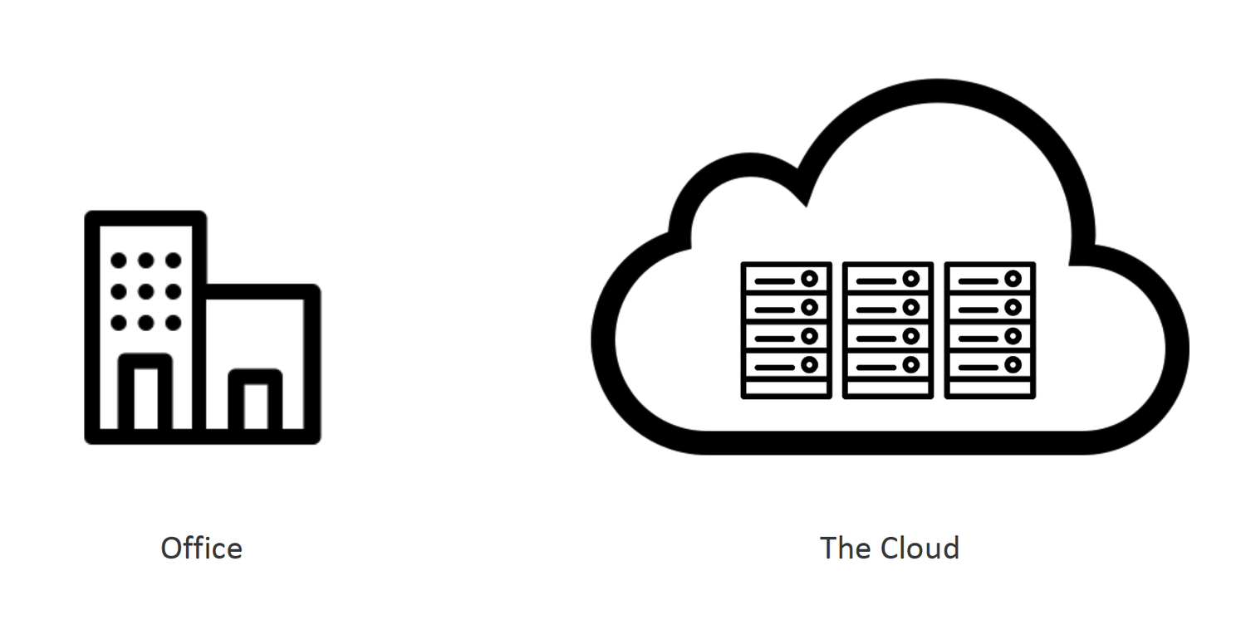
TOPIC 1
What is Cloud Computing?
AWS Certified Cloud Practitioner (CLF-C02) · TGS-2023039183
© 2026 Tertiary Infotech Academy Pte Ltd
27

Slide 29
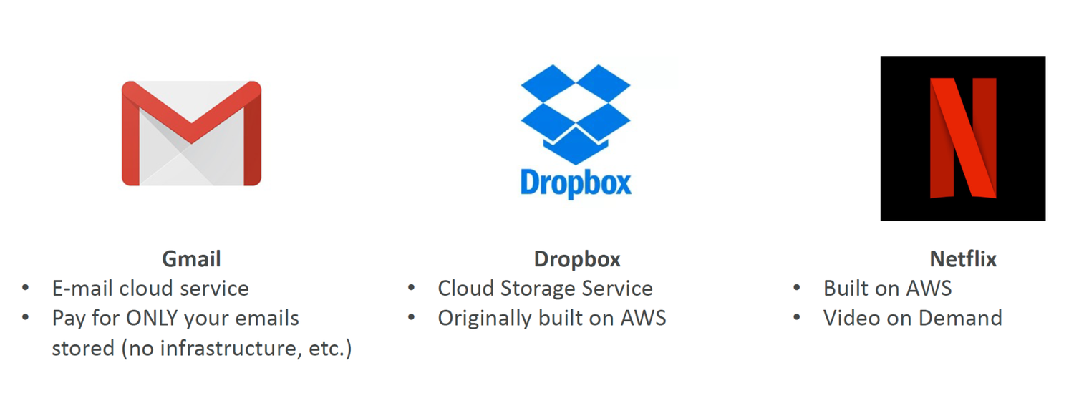
TOPIC 1
You’ve been using some Cloud services
AWS Certified Cloud Practitioner (CLF-C02) · TGS-2023039183
© 2026 Tertiary Infotech Academy Pte Ltd
28

Slide 30
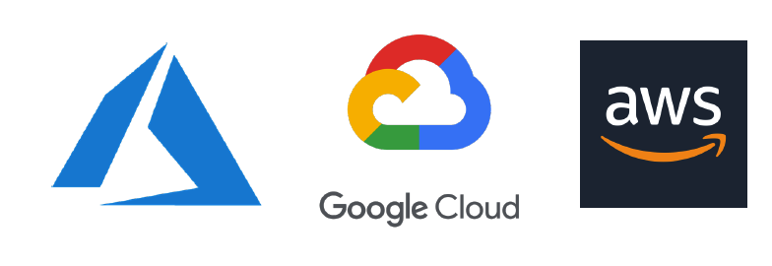
TOPIC 1
The Deployment Models of the Cloud
Private Cloud:
AWS Certified Cloud Practitioner (CLF-C02) · TGS-2023039183
© 2026 Tertiary Infotech Academy Pte Ltd
29

Slide 31
TOPIC 1
The Five Characteristics of Cloud Computing
• On-demand self service:
• Users can provision resources and use them without human interaction from the service provider
• Broad network access:
• Resources available over the network, and can be accessed by diverse client platforms
• Multi-tenancy and resource pooling:
• Multiple customers can share the same infrastructure and applications with security and privacy
• Multiple customers are serviced from the same physical resources
• Rapid elasticity and scalability:
• Automatically and quickly acquire and dispose resources when needed
• Quickly and easily scale based on demand
• Measured service:
• Usage is measured, users pay correctly for what they have used
AWS Certified Cloud Practitioner (CLF-C02) · TGS-2023039183
© 2026 Tertiary Infotech Academy Pte Ltd
30

Slide 32
TOPIC 1
Six Advantages of Cloud Computing
• Trade capital expense (CAPEX) for operational expense (OPEX)
• Pay On-Demand: don’t own hardware
• Reduced Total Cost of Ownership (TCO) & Operational Expense (OPEX)
• Benefit from massive economies of scale
• Prices are reduced as AWS is more efficient due to large scale
• Stop guessing capacity
• Scale based on actual measured usage
• Increase speed and agility
• Stop spending money running and maintaining data centers
• Go global in minutes: leverage the AWS global infrastructure
AWS Certified Cloud Practitioner (CLF-C02) · TGS-2023039183
© 2026 Tertiary Infotech Academy Pte Ltd
31

Slide 33
TOPIC 1
Problems solved by the Cloud
• Flexibility: change resource types when needed
• Cost-Effectiveness: pay as you go, for what you us
• Scalability: accommodate larger loads by making hardware stronger or adding additional nodes
• Elasticity: ability to scale out and scale-in when needed
• High-availability and fault-tolerance: build across data centers
• Agility: rapidly develop, test and launch software applications
AWS Certified Cloud Practitioner (CLF-C02) · TGS-2023039183
© 2026 Tertiary Infotech Academy Pte Ltd
32

Slide 34
TOPIC 1
Types of Cloud Computing
• Infrastructure as a Service (IaaS)
• Provide building blocks for cloud IT
• Provides networking, computers, data storage space
• Highest level of flexibility
• Easy parallel with traditional on-premises IT
• Platform as a Service (PaaS)
• Removes the need for your organization to manage the underlying infrastructure
• Focus on the deployment and management of your applications
• Software as a Service (SaaS)
• Completed product that is run and managed by the service provider
AWS Certified Cloud Practitioner (CLF-C02) · TGS-2023039183
© 2026 Tertiary Infotech Academy Pte Ltd
33

Slide 35
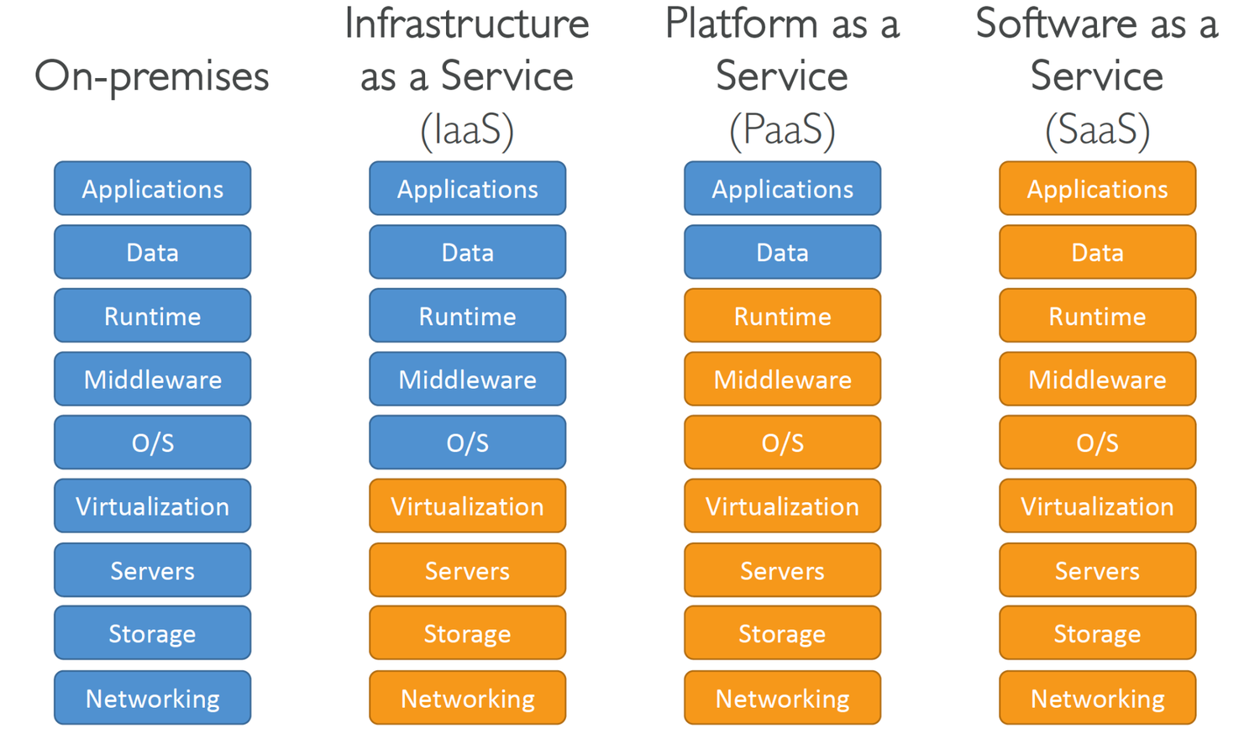
TOPIC 1
Reference
AWS Certified Cloud Practitioner (CLF-C02) · TGS-2023039183
© 2026 Tertiary Infotech Academy Pte Ltd
34

Slide 36
TOPIC 1
Example of Cloud Computing Types
• Infrastructure as a Service:
• Amazon EC2 (on AWS)
• GCP, Azure, Rackspace, Digital Ocean, Linode
• Platform as a Service:
• Elastic Beanstalk (on AWS)
• Heroku, Google App Engine (GCP), Windows Azure (Microsoft)
• Software as a Service:
• Many AWS services (ex: Rekognition for Machine Learning)
• Google Apps (Gmail), Dropbox, Zoom
AWS Certified Cloud Practitioner (CLF-C02) · TGS-2023039183
© 2026 Tertiary Infotech Academy Pte Ltd
35

Slide 37
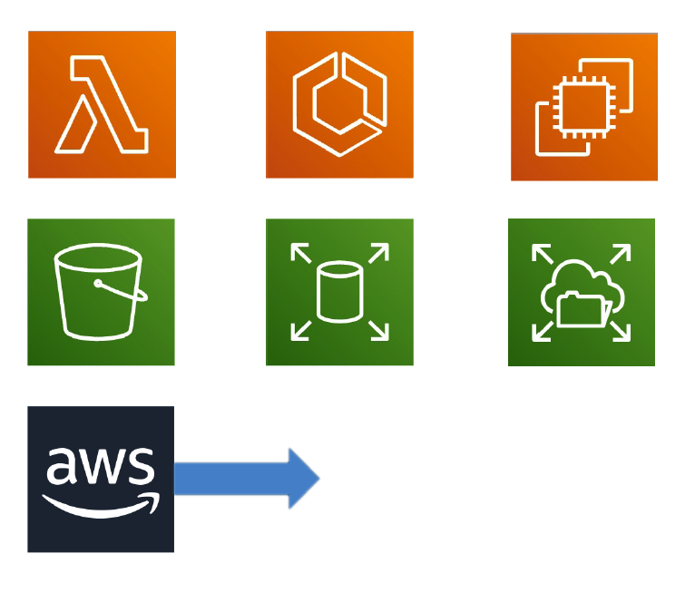
TOPIC 1
Pricing of the Cloud – Quick Overview
AWS has 3 pricing fundamentals, following the pay-as-you-go pricing model
AWS Certified Cloud Practitioner (CLF-C02) · TGS-2023039183
© 2026 Tertiary Infotech Academy Pte Ltd
36

Slide 38
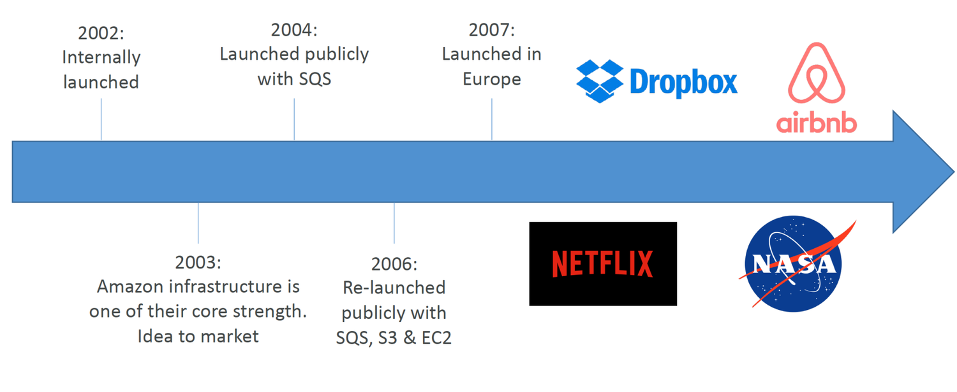
TOPIC 1
AWS Cloud History
AWS Certified Cloud Practitioner (CLF-C02) · TGS-2023039183
© 2026 Tertiary Infotech Academy Pte Ltd
37

Slide 39
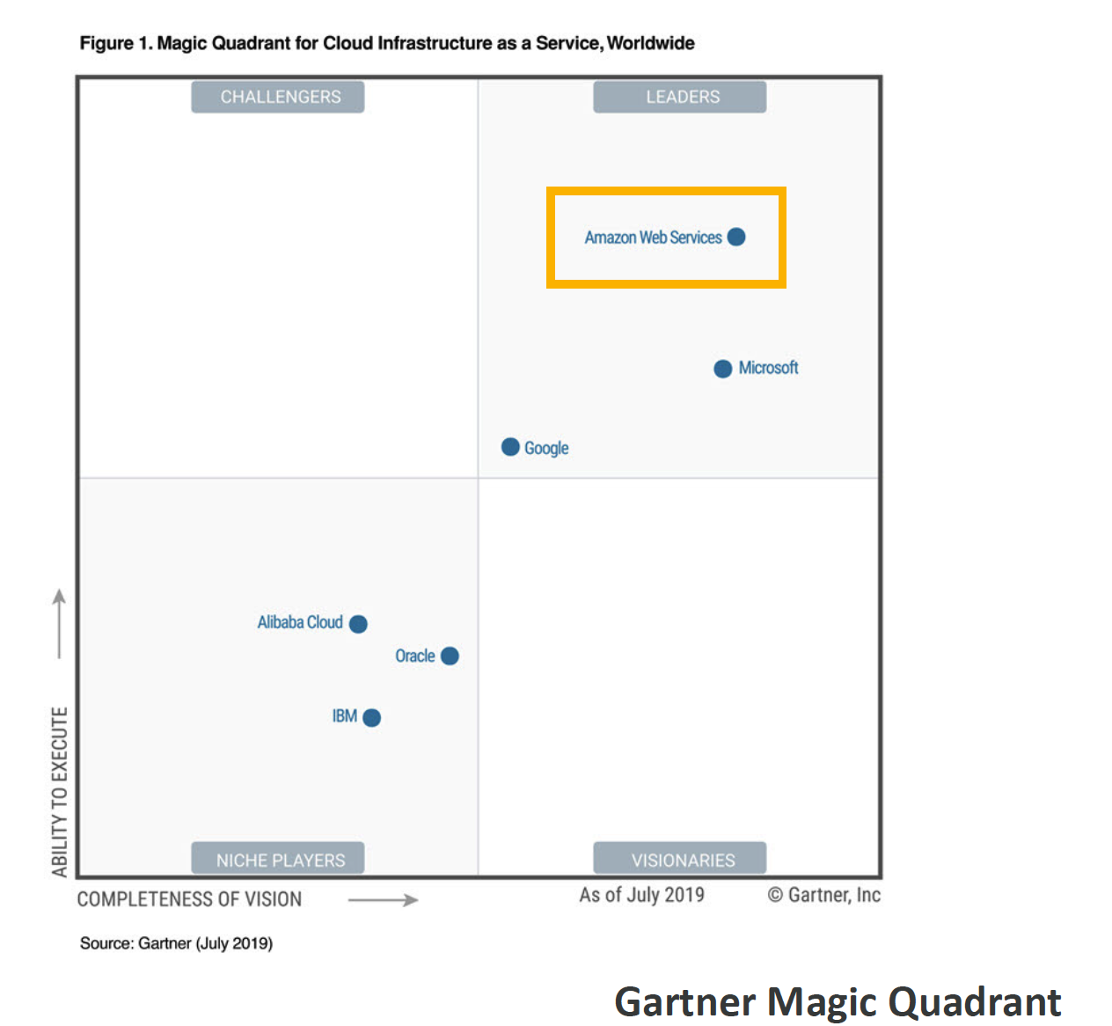
TOPIC 1
AWS Cloud Number Facts
In 2019, AWS had $35.02 billion in annual revenue
AWS Certified Cloud Practitioner (CLF-C02) · TGS-2023039183
© 2026 Tertiary Infotech Academy Pte Ltd
38

Slide 40

TOPIC 1
AWS Cloud Use Cases
AWS enables you to build sophisticated, scalable applications
AWS Certified Cloud Practitioner (CLF-C02) · TGS-2023039183
© 2026 Tertiary Infotech Academy Pte Ltd
39

Slide 41
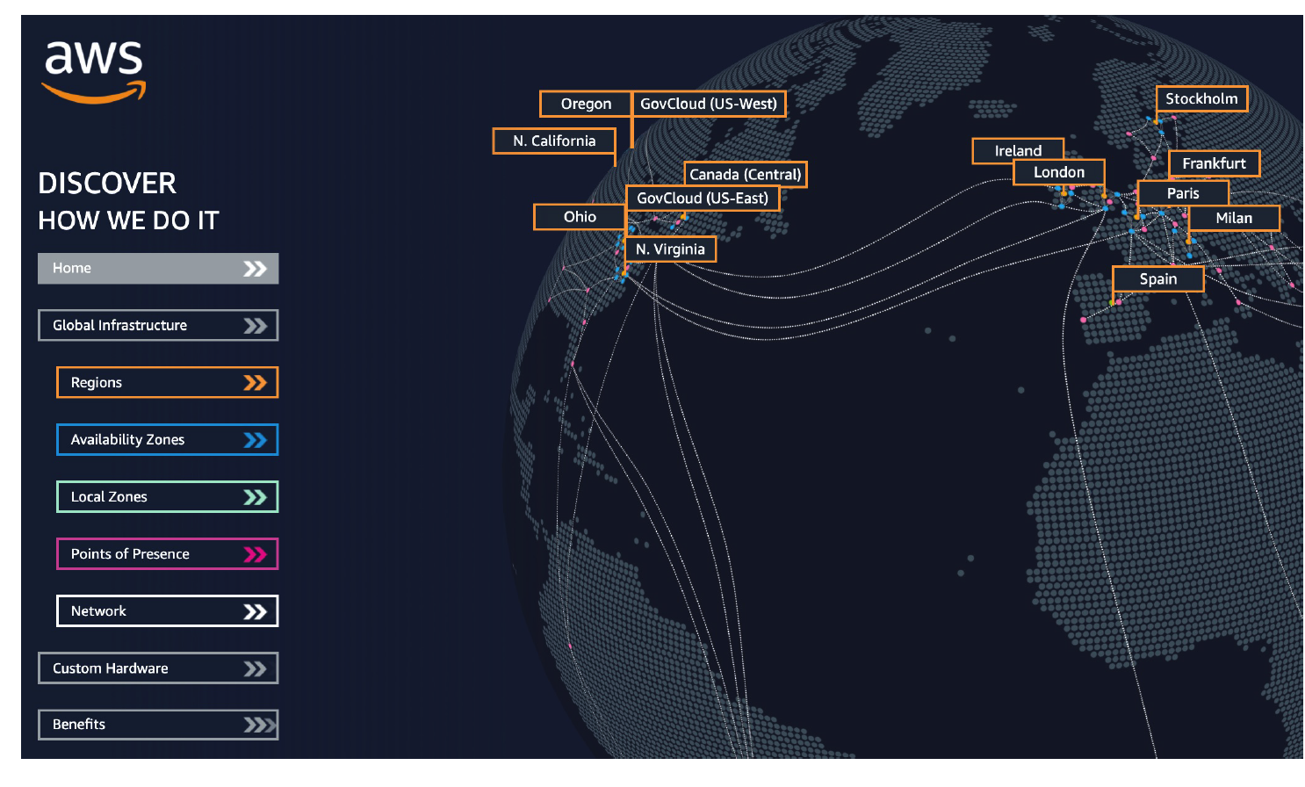
TOPIC 1
AWS Global Infrastructure
AWS Regions
AWS Certified Cloud Practitioner (CLF-C02) · TGS-2023039183
© 2026 Tertiary Infotech Academy Pte Ltd
40

Slide 42
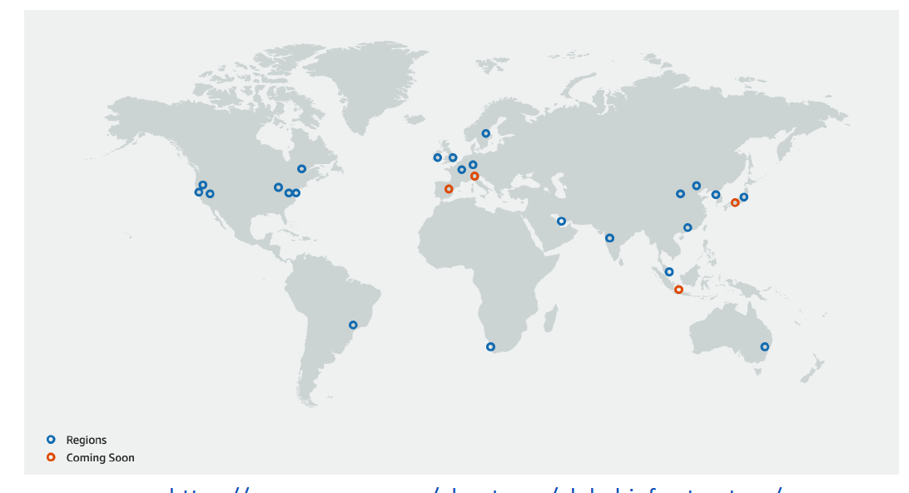
TOPIC 1
AWS Regions
AWS has Regions all around the world
AWS Certified Cloud Practitioner (CLF-C02) · TGS-2023039183
© 2026 Tertiary Infotech Academy Pte Ltd
41

Slide 43
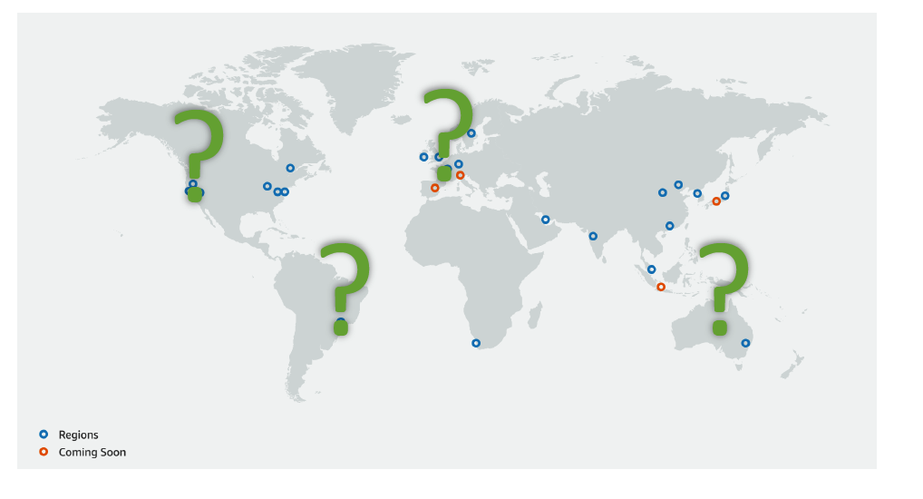
TOPIC 1
How to choose an AWS Region?
Compliance with data governance and legal requirements: data never leaves a region without your explicit permission
AWS Certified Cloud Practitioner (CLF-C02) · TGS-2023039183
© 2026 Tertiary Infotech Academy Pte Ltd
42

Slide 44
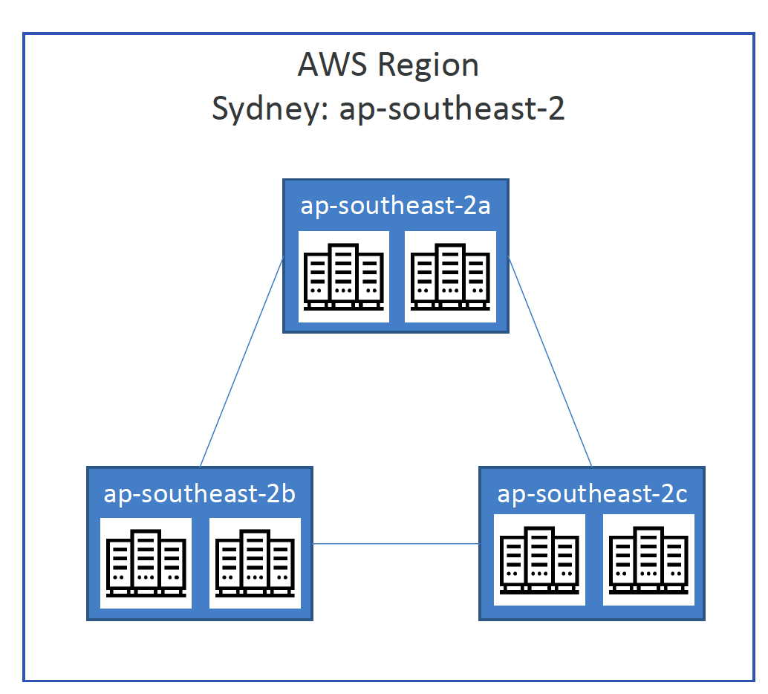
TOPIC 1
AWS Availability Zones
Each region has many availability zones (usually 3, min is 3, max is 6). Example:
AWS Certified Cloud Practitioner (CLF-C02) · TGS-2023039183
© 2026 Tertiary Infotech Academy Pte Ltd
43

Slide 45
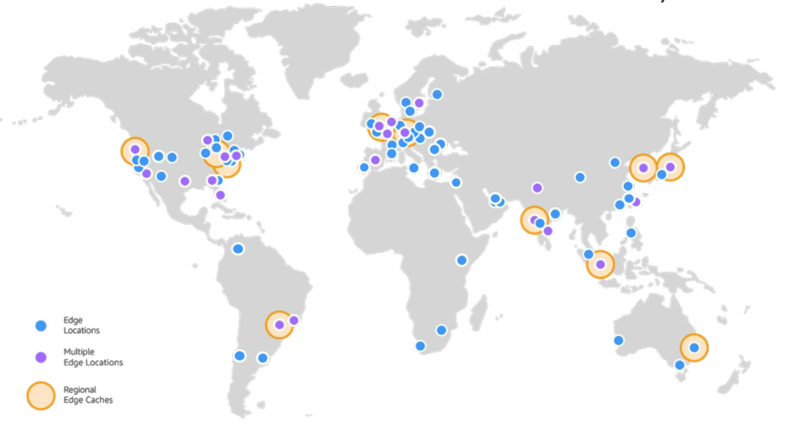
TOPIC 1
AWS Points of Presence (Edge Locations)
Amazon has 400+ Points of Presence (400+ Edge Locations & 10+
AWS Certified Cloud Practitioner (CLF-C02) · TGS-2023039183
© 2026 Tertiary Infotech Academy Pte Ltd
44

Slide 46
TOPIC 1
Tour of the AWS Console
• AWS has Global Services:
• Identity and Access Management (IAM)
• Route 53 (DNS service)
• CloudFront (Content Delivery Network)
• WAF (Web Application Firewall)
• Most AWS services are Region-scoped:
• Amazon EC2 (Infrastructure as a Service)
• Elastic Beanstalk (Platform as a Service)
• Lambda (Function as a Service)
• Rekognition (Software as a Service)
• Region Table: https://aws.amazon.com/about-aws/global-infrastructure/regional-product-services
AWS Certified Cloud Practitioner (CLF-C02) · TGS-2023039183
© 2026 Tertiary Infotech Academy Pte Ltd
45

Slide 47
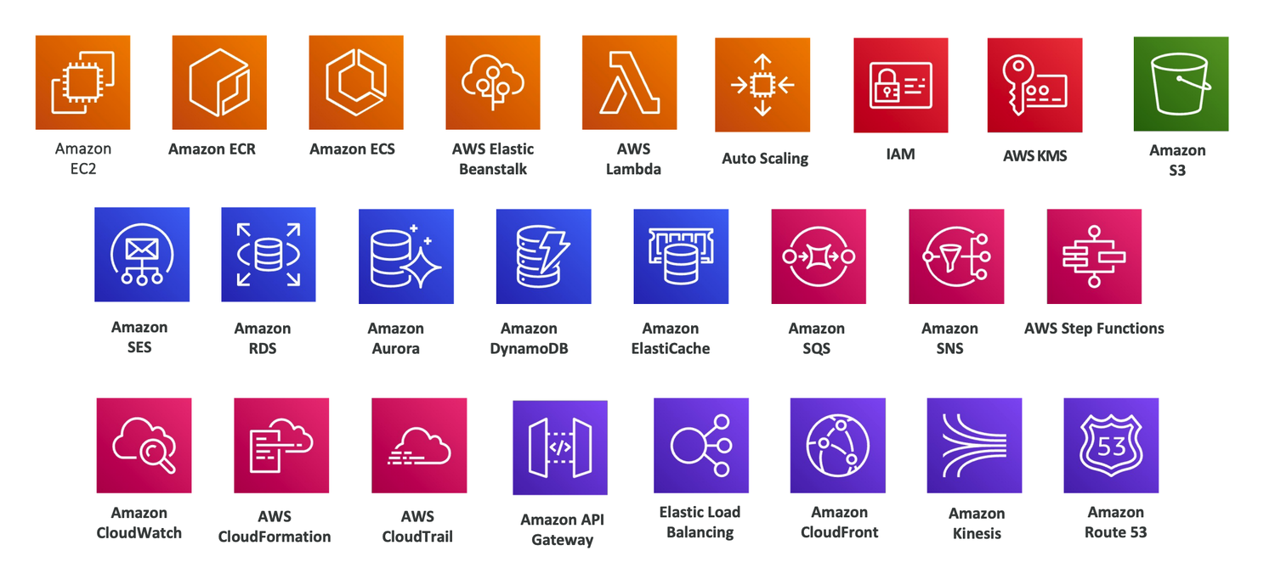
TOPIC 1
AWS Services (>200)
AWS Certified Cloud Practitioner (CLF-C02) · TGS-2023039183
© 2026 Tertiary Infotech Academy Pte Ltd
46

Slide 48
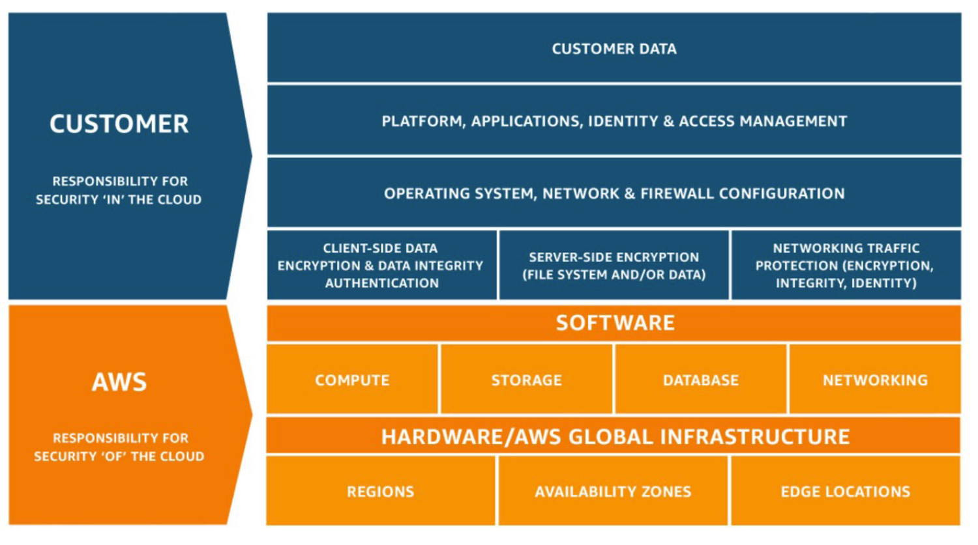
TOPIC 1
Shared Responsibility Model diagram
https://aws.amazon.com/compliance/shared-responsibility-model/
AWS Certified Cloud Practitioner (CLF-C02) · TGS-2023039183
© 2026 Tertiary Infotech Academy Pte Ltd
47

Slide 49
TOPIC 1
AWS Acceptable Use Policy
https://aws.amazon.com/aup/
No Illegal, Harmful, or Offensive Use or Content
No Security Violations
1
2
3
No Network Abuse
No E-Mail or Other Message Abuse
4
5
AWS Certified Cloud Practitioner (CLF-C02) · TGS-2023039183
© 2026 Tertiary Infotech Academy Pte Ltd
48

Slide 50
TOPIC 2
Security and Compliance
AWS Certified Cloud Practitioner (CLF-C02) · TGS-2023039183
© 2026 Tertiary Infotech Academy Pte Ltd
49

Slide 51
IAM
IAM
AWS Certified Cloud Practitioner (CLF-C02) · TGS-2023039183
© 2026 Tertiary Infotech Academy Pte Ltd
50

Slide 52
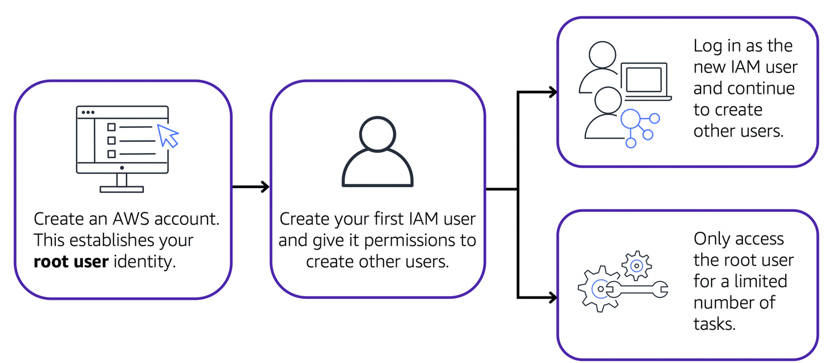
AWS account root user
AWS Certified Cloud Practitioner (CLF-C02) · TGS-2023039183
© 2026 Tertiary Infotech Academy Pte Ltd
51

Slide 53
IAM: Users & Groups
https://aws.amazon.com/aup/
No Illegal, Harmful, or Offensive Use or Content
No Security Violations
1
2
3
No Network Abuse
No E-Mail or Other Message Abuse
4
5
AWS Certified Cloud Practitioner (CLF-C02) · TGS-2023039183
© 2026 Tertiary Infotech Academy Pte Ltd
52

Slide 54
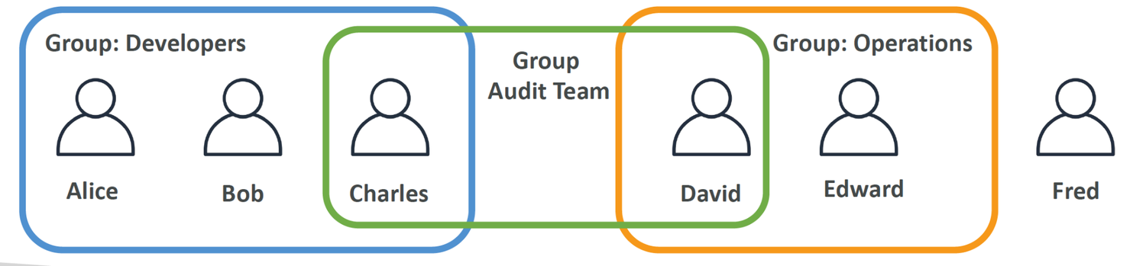
IAM: Users & Groups
IAM = Identity and Access Management, Global service
AWS Certified Cloud Practitioner (CLF-C02) · TGS-2023039183
© 2026 Tertiary Infotech Academy Pte Ltd
53

Slide 55
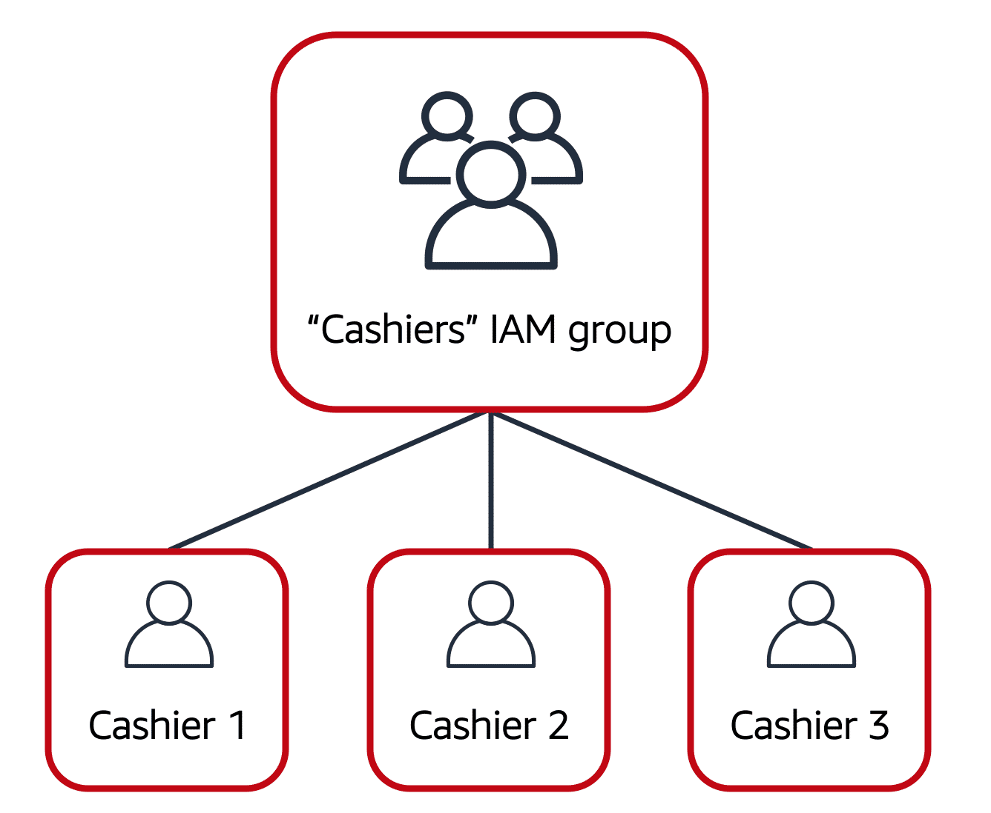
IAM groups
AWS Certified Cloud Practitioner (CLF-C02) · TGS-2023039183
© 2026 Tertiary Infotech Academy Pte Ltd
54

Slide 56

IAM roles
An IAM role is an identity that you can assume to gain temporary access to permissions.
AWS Certified Cloud Practitioner (CLF-C02) · TGS-2023039183
© 2026 Tertiary Infotech Academy Pte Ltd
55

Slide 57
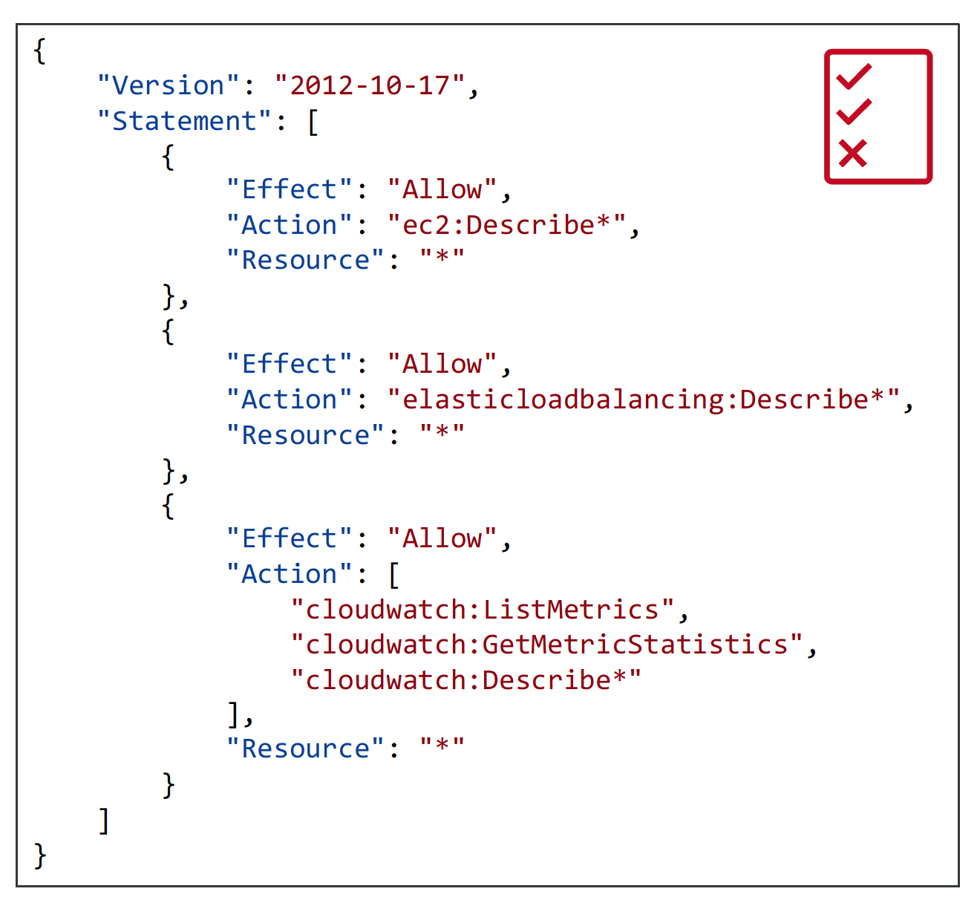
IAM: Permissions
Users or Groups can be assigned JSON documents called policies
AWS Certified Cloud Practitioner (CLF-C02) · TGS-2023039183
© 2026 Tertiary Infotech Academy Pte Ltd
56

Slide 58
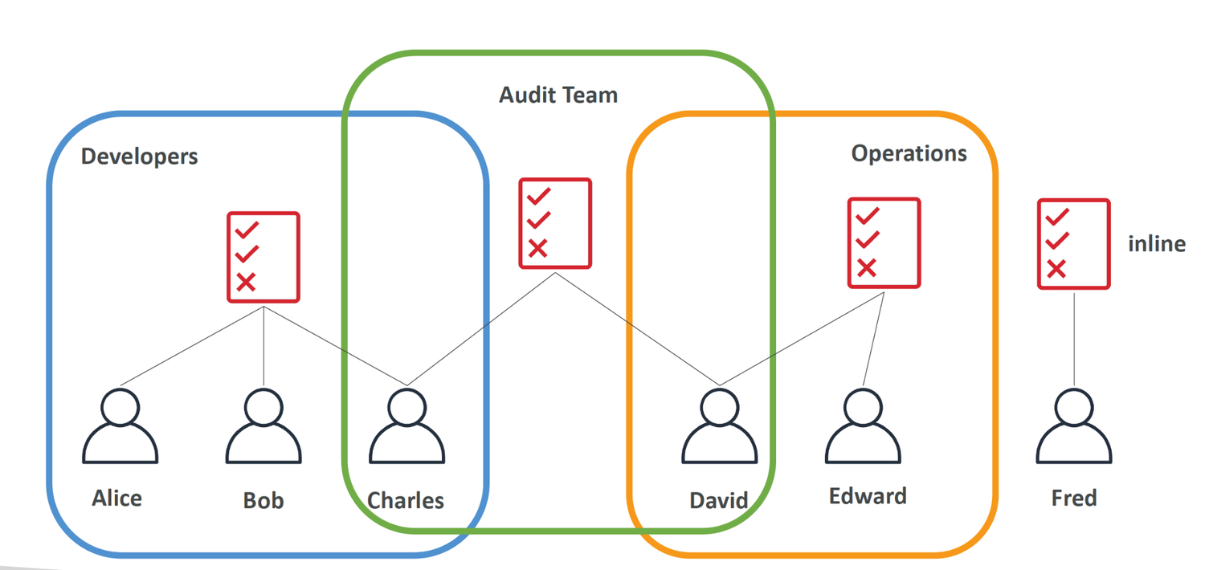
IAM Policies inheritance
AWS Certified Cloud Practitioner (CLF-C02) · TGS-2023039183
© 2026 Tertiary Infotech Academy Pte Ltd
57

Slide 59
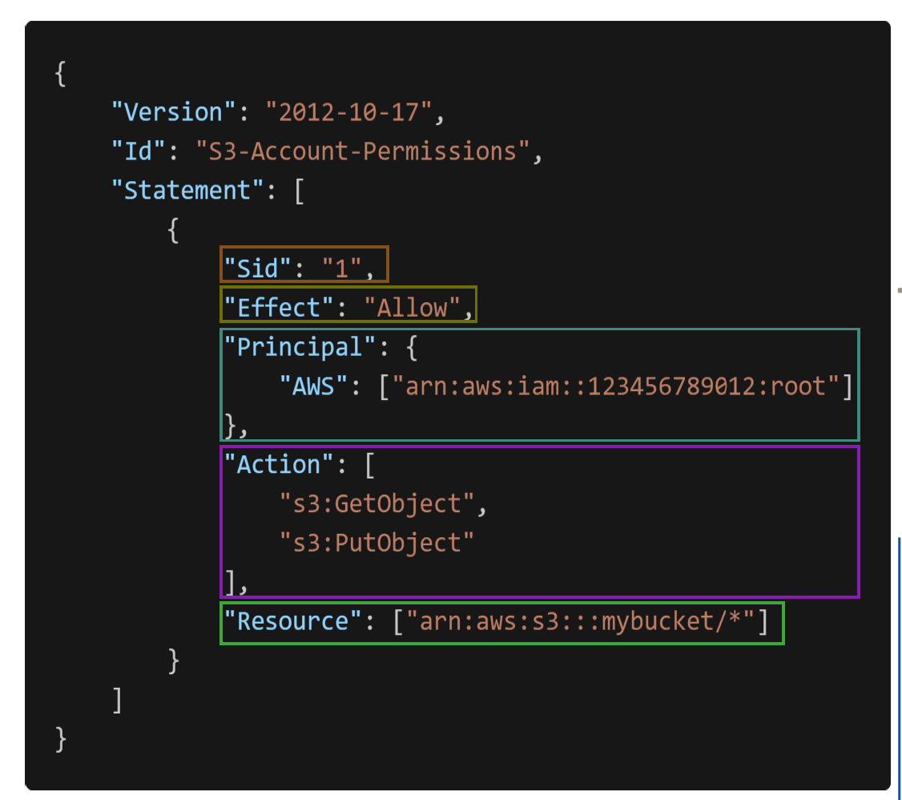
IAM Policies Structure
Consists of
AWS Certified Cloud Practitioner (CLF-C02) · TGS-2023039183
© 2026 Tertiary Infotech Academy Pte Ltd
58

Slide 60
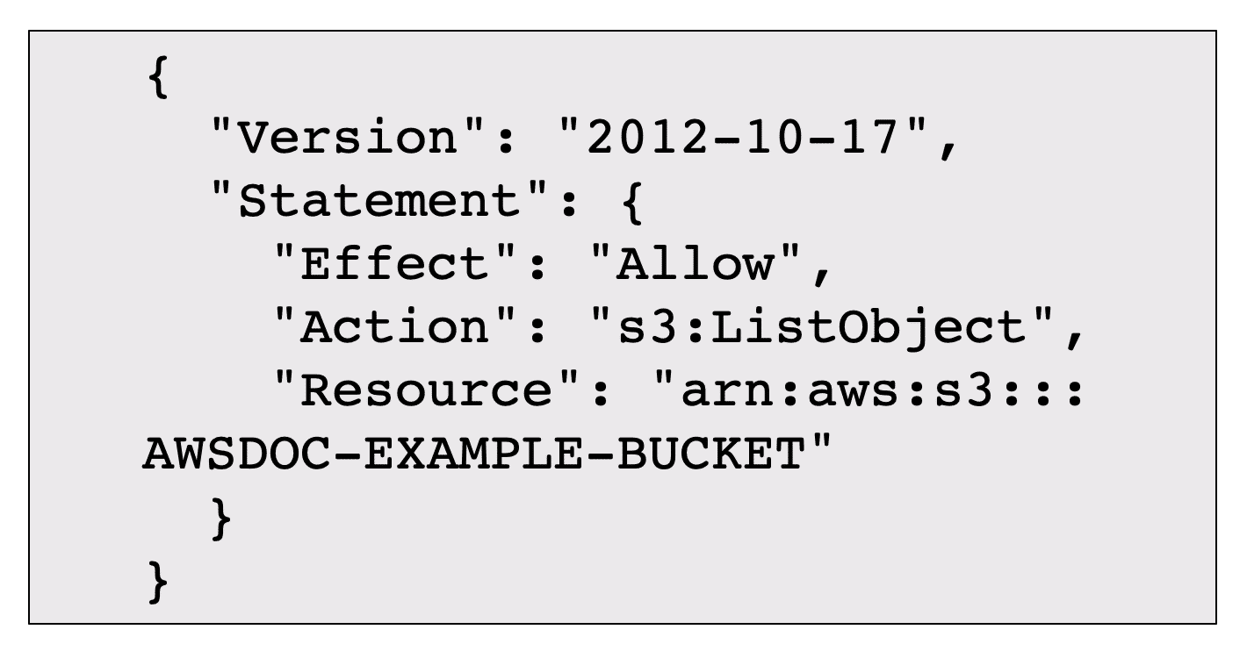
Example: IAM policy
AWS Certified Cloud Practitioner (CLF-C02) · TGS-2023039183
© 2026 Tertiary Infotech Academy Pte Ltd
59

Slide 61
IAM – Password Policy
• Strong passwords = higher security for your account
• In AWS, you can setup a password policy:
• Set a minimum password length
• Require specific character types:
• including uppercase letters
• lowercase letters
• numbers
• non-alphanumeric characters
• Allow all IAM users to change their own passwords
• Require users to change their password after some time (password expiration)
• Prevent password re-use
AWS Certified Cloud Practitioner (CLF-C02) · TGS-2023039183
© 2026 Tertiary Infotech Academy Pte Ltd
60

Slide 62
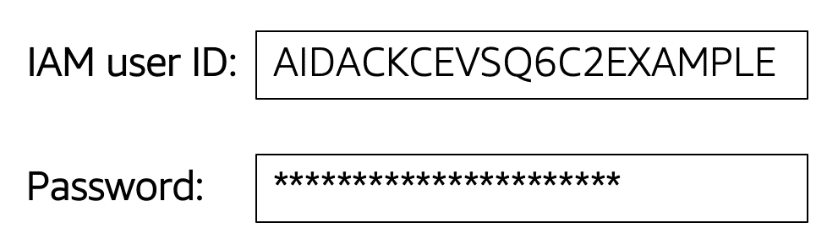
Multi-factor authentication
In IAM, multi-factor authentication (MFA) provides an extra layer of security for your AWS account.
AWS Certified Cloud Practitioner (CLF-C02) · TGS-2023039183
© 2026 Tertiary Infotech Academy Pte Ltd
61

Slide 63
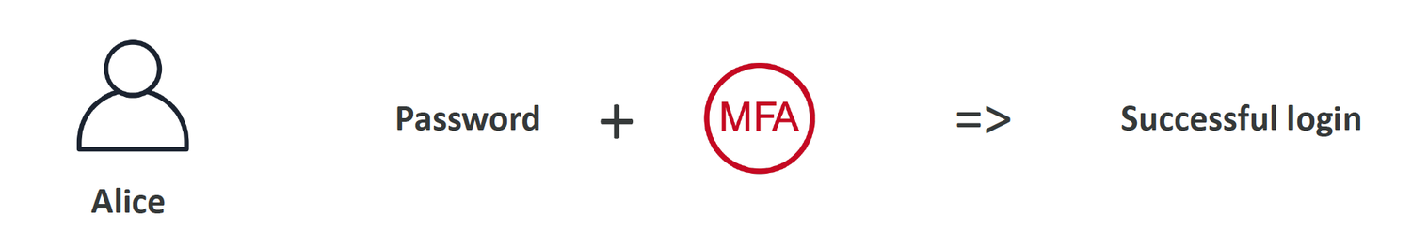
Multi Factor Authentication - MFA
Users have access to your account and can possibly change configurations or delete resources in your AWS account
AWS Certified Cloud Practitioner (CLF-C02) · TGS-2023039183
© 2026 Tertiary Infotech Academy Pte Ltd
62

Slide 64
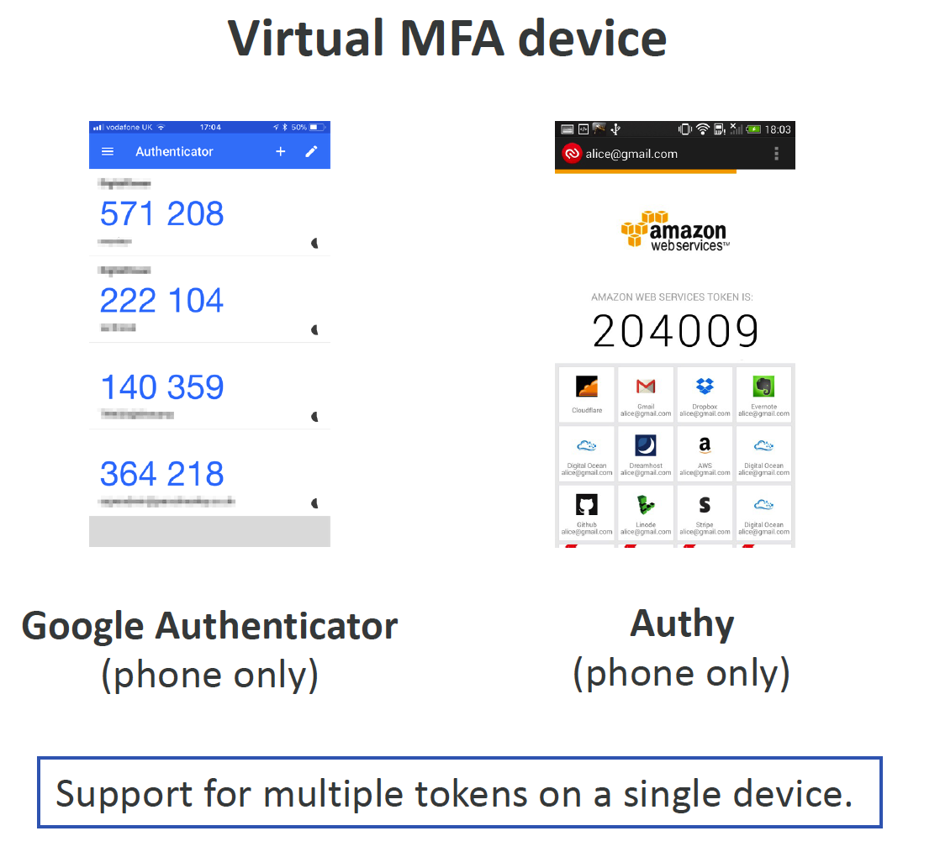
MFA devices options in AWS
AWS Certified Cloud Practitioner (CLF-C02) · TGS-2023039183
© 2026 Tertiary Infotech Academy Pte Ltd
63

Slide 65
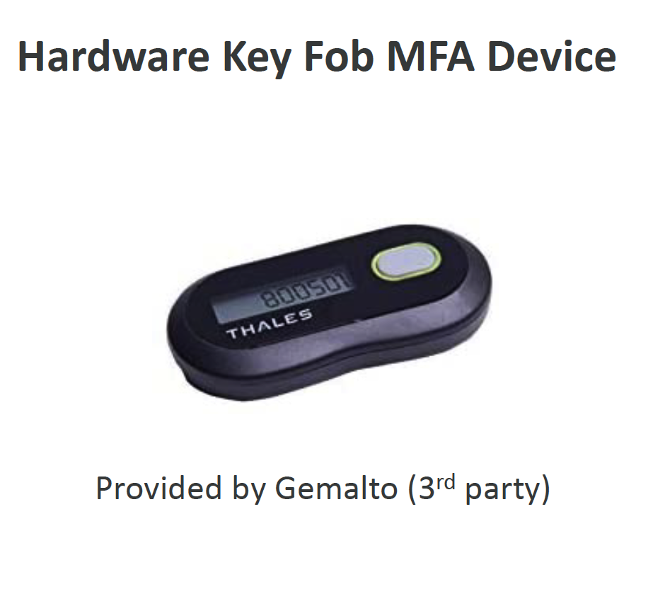
MFA devices options in AWS
AWS Certified Cloud Practitioner (CLF-C02) · TGS-2023039183
© 2026 Tertiary Infotech Academy Pte Ltd
64

Slide 66
How can users access AWS ?
• To access AWS, you have three options:
• AWS Management Console (protected by password + MFA)
• AWS Command Line Interface (CLI): protected by access keys
• AWS Software Developer Kit (SDK) - for code: protected by access keys
• Access Keys are generated through the AWS Console
• Users manage their own access keys
• Access Keys are secret, just like a password. Don’t share them
• Access Key ID ~= username
• Secret Access Key ~= password
AWS Certified Cloud Practitioner (CLF-C02) · TGS-2023039183
© 2026 Tertiary Infotech Academy Pte Ltd
65

Slide 67
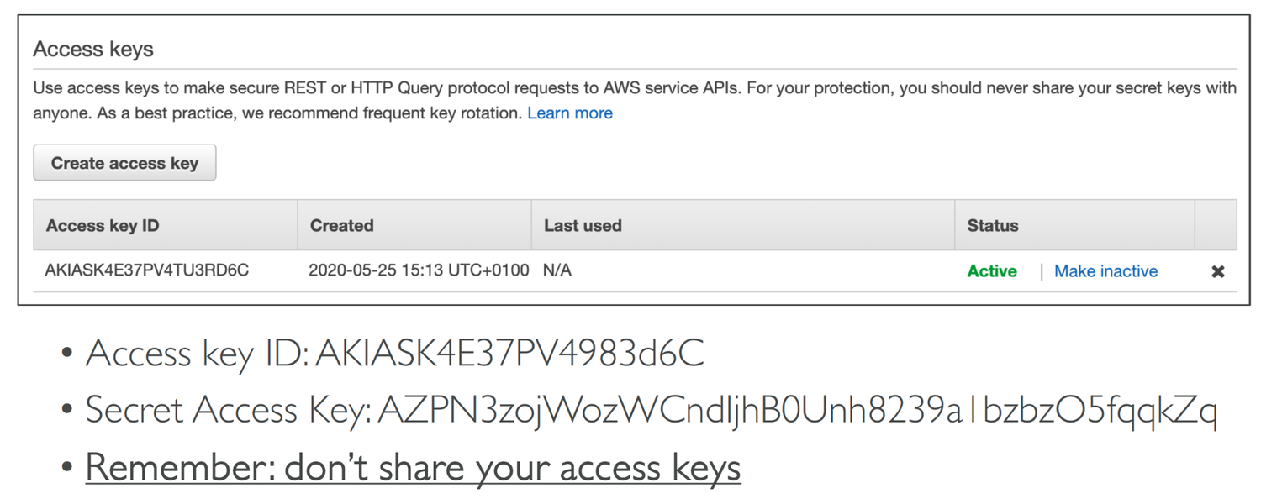
Example (Fake) Access Keys
AWS Certified Cloud Practitioner (CLF-C02) · TGS-2023039183
© 2026 Tertiary Infotech Academy Pte Ltd
66

Slide 68
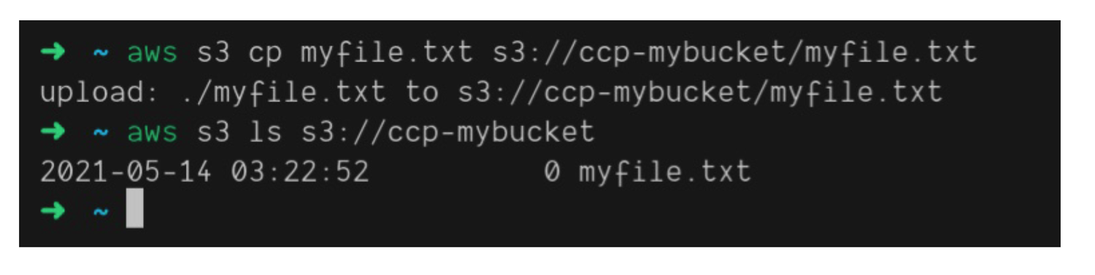
What’s the AWS CLI?
A tool that enables you to interact with AWS services using commands in your command-line shell
AWS Certified Cloud Practitioner (CLF-C02) · TGS-2023039183
© 2026 Tertiary Infotech Academy Pte Ltd
67

Slide 69
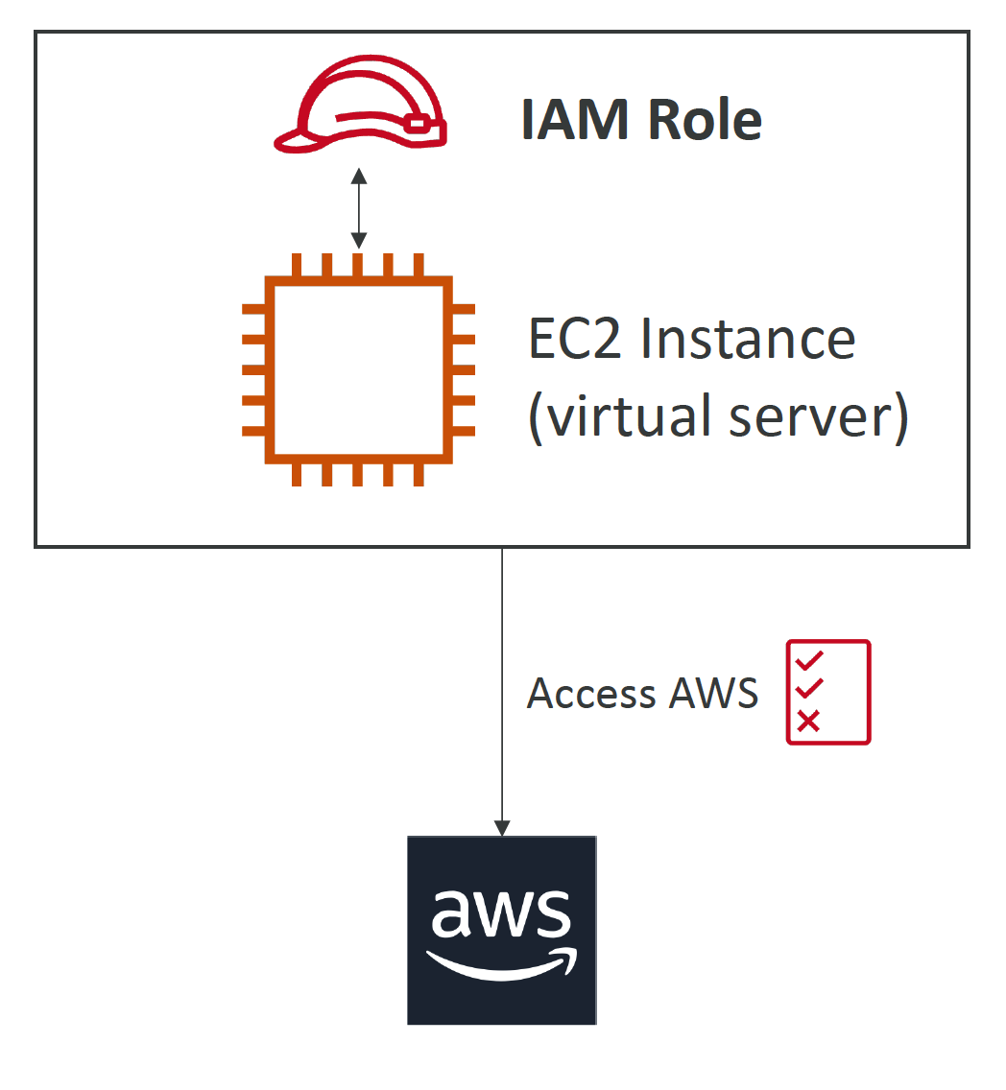
IAM Roles for Services
Some AWS service will need to perform actions on your behalf
AWS Certified Cloud Practitioner (CLF-C02) · TGS-2023039183
© 2026 Tertiary Infotech Academy Pte Ltd
68

Slide 70
IAM Security Tools
• IAM Credentials Report (account-level)
• a report that lists all your account's users and the status of their various credentials
• IAM Access Advisor (user-level)
• Access advisor shows the service permissions granted to a user and when those services were last accessed.
• You can use this information to revise your policies
AWS Certified Cloud Practitioner (CLF-C02) · TGS-2023039183
© 2026 Tertiary Infotech Academy Pte Ltd
69

Slide 71
IAM Guidelines & Best Practices
• Don’t use the root account except for AWS account setup
• One physical user = One AWS user
• Assign users to groups and assign permissions to groups
• Create a strong password policy
• Use and enforce the use of Multi Factor Authentication (MFA)
• Create and use Roles for giving permissions to AWS services
• Use Access Keys for Programmatic Access (CLI / SDK)
• Audit permissions of your account using IAM Credentials Report & IAM Access Advisor
• Never share IAM users & Access Keys
AWS Certified Cloud Practitioner (CLF-C02) · TGS-2023039183
© 2026 Tertiary Infotech Academy Pte Ltd
70

Slide 72
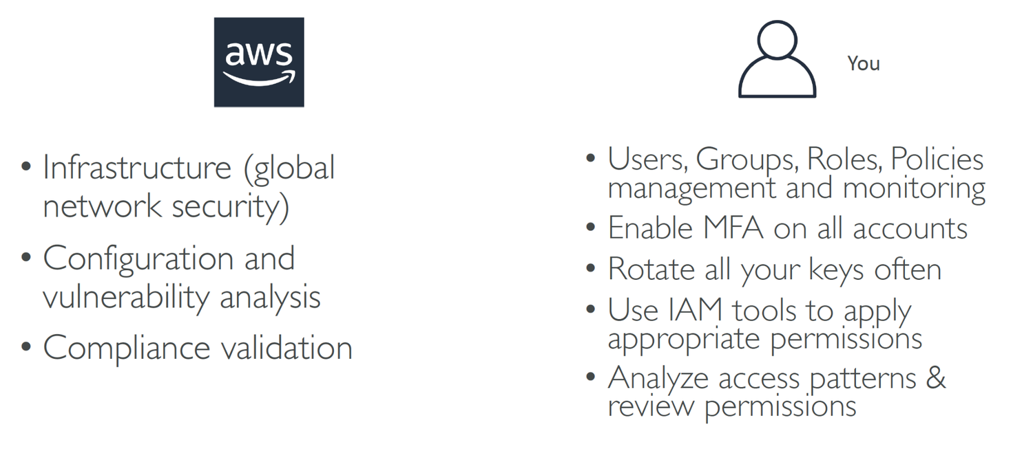
Shared Responsibility Model for IAM
AWS Certified Cloud Practitioner (CLF-C02) · TGS-2023039183
© 2026 Tertiary Infotech Academy Pte Ltd
71

Slide 73
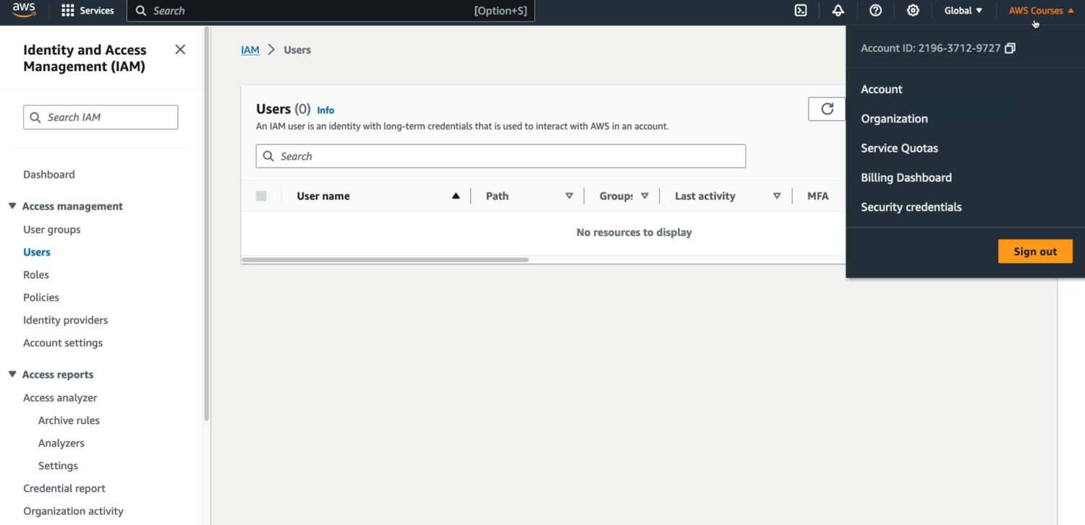
Activity: IAM Hand On
AWS Certified Cloud Practitioner (CLF-C02) · TGS-2023039183
© 2026 Tertiary Infotech Academy Pte Ltd
72

Slide 74
IAM Section – Summary
• Users: mapped to a physical user, has a password for AWS Console
• Groups: contains users only
• Policies: JSON document that outlines permissions for users or groups
• Roles: for EC2 instances or AWS services
• Security: MFA + Password Policy
• AWS CLI: manage your AWS services using the command-line
• AWS SDK: manage your AWS services using a programming language
• Access Keys: access AWS using the CLI or SDK
• Audit: IAM Credential Reports & IAM Access Advisor
AWS Certified Cloud Practitioner (CLF-C02) · TGS-2023039183
© 2026 Tertiary Infotech Academy Pte Ltd
73

Slide 75
TOPIC 3
AWS Compute Services
AWS Certified Cloud Practitioner (CLF-C02) · TGS-2023039183
© 2026 Tertiary Infotech Academy Pte Ltd
74

Slide 76
EC2
EC2
AWS Certified Cloud Practitioner (CLF-C02) · TGS-2023039183
© 2026 Tertiary Infotech Academy Pte Ltd
75

Slide 77
Amazon EC2
• EC2 is one of the most popular of AWS’ offering
• EC2 = Elastic Compute Cloud = Infrastructure as a Service
• It mainly consists in the capability of :
• Renting virtual machines (EC2)
• Storing data on virtual drives (EBS)
• Distributing load across machines (ELB)
• Scaling the services using an auto-scaling group (ASG)
• Knowing EC2 is fundamental to understand how the Cloud works
AWS Certified Cloud Practitioner (CLF-C02) · TGS-2023039183
© 2026 Tertiary Infotech Academy Pte Ltd
76

Slide 78
EC2 sizing & configuration options
• Operating System (OS): Linux, Windows or Mac OS
• How much compute power & cores (CPU)
• How much random-access memory (RAM)
• How much storage space:
• Network-attached (EBS & EFS)
• hardware (EC2 Instance Store)
• Network card: speed of the card, Public IP address
• Firewall rules: security group
• Bootstrap script (configure at first launch): EC2 User Data
AWS Certified Cloud Practitioner (CLF-C02) · TGS-2023039183
© 2026 Tertiary Infotech Academy Pte Ltd
77

Slide 79
EC2 User Data
• It is possible to bootstrap our instances using an EC2 User data script.
• bootstrapping means launching commands when a machine starts
• That script is only run once at the instance first start
• EC2 user data is used to automate boot tasks such as:
• Installing updates
• Installing software
• Downloading common files from the internet
• Anything you can think of
• The EC2 User Data Script runs with the root user
AWS Certified Cloud Practitioner (CLF-C02) · TGS-2023039183
© 2026 Tertiary Infotech Academy Pte Ltd
78

Slide 80
Activity: Launching an EC2 Instance running Linux
We’ll be launching our first virtual server using the AWS Console
We’ll get a first high-level approach to the various parameters
1
2
We’ll see that our web server is launched using EC2 user data
We’ll learn how to start / stop / terminate our instance.
3
4
AWS Certified Cloud Practitioner (CLF-C02) · TGS-2023039183
© 2026 Tertiary Infotech Academy Pte Ltd
79

Slide 81

EC2 Instance Types - Overview
AWS Certified Cloud Practitioner (CLF-C02) · TGS-2023039183
© 2026 Tertiary Infotech Academy Pte Ltd
80

Slide 82
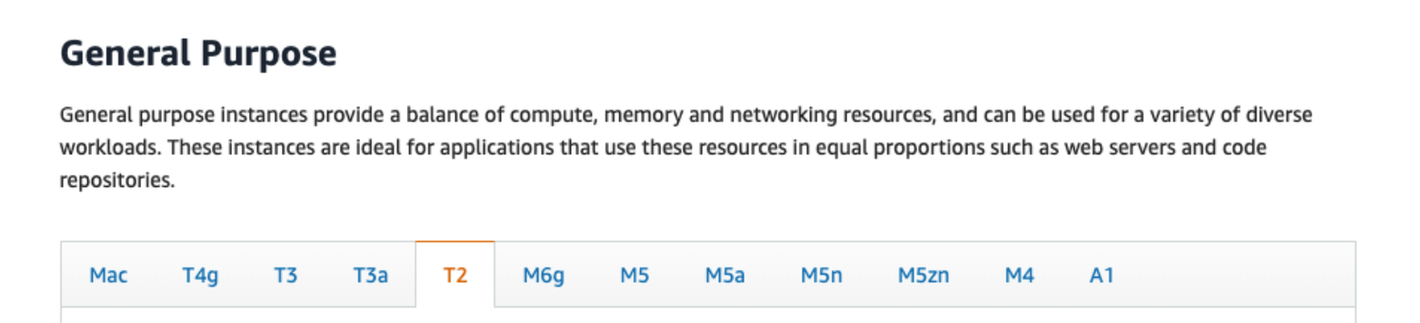
EC2 Instance Types – General Purpose
Great for a diversity of workloads such as web servers or code repositories
AWS Certified Cloud Practitioner (CLF-C02) · TGS-2023039183
© 2026 Tertiary Infotech Academy Pte Ltd
81

Slide 83
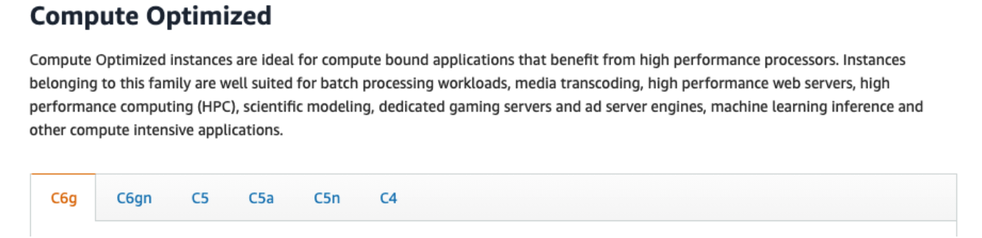
EC2 Instance Types – Compute Optimized
Great for compute-intensive tasks that require high performance processors:
AWS Certified Cloud Practitioner (CLF-C02) · TGS-2023039183
© 2026 Tertiary Infotech Academy Pte Ltd
82

Slide 84
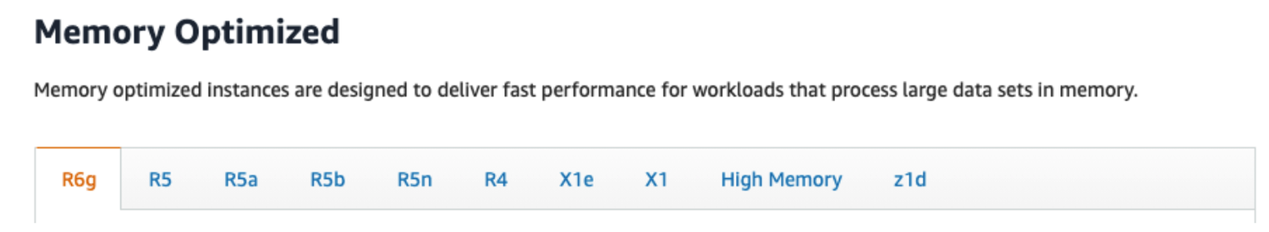
EC2 Instance Types – Memory Optimized
Fast performance for workloads that process large data sets in memory
AWS Certified Cloud Practitioner (CLF-C02) · TGS-2023039183
© 2026 Tertiary Infotech Academy Pte Ltd
83

Slide 85
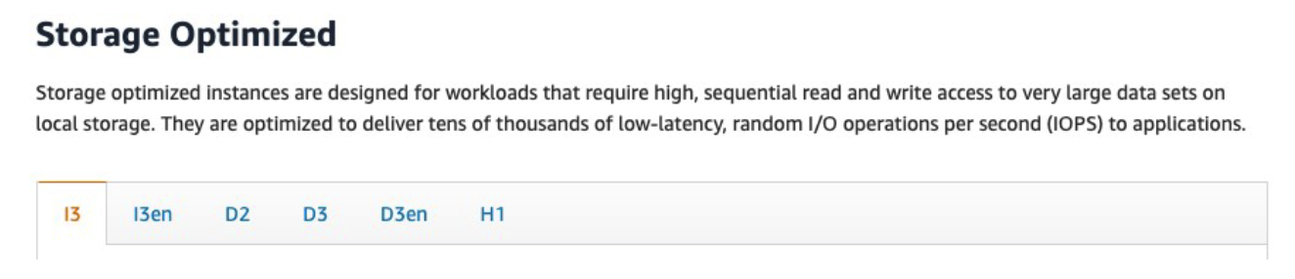
EC2 Instance Types – Storage Optimized
AWS Certified Cloud Practitioner (CLF-C02) · TGS-2023039183
© 2026 Tertiary Infotech Academy Pte Ltd
84

Slide 86
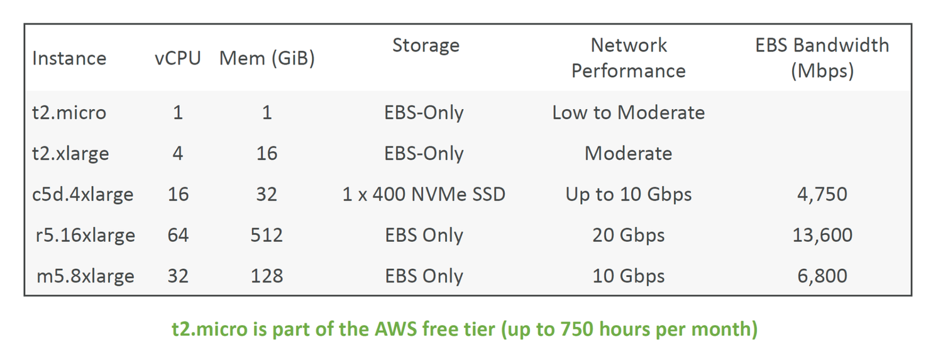
EC2 Instance Types: example
AWS Certified Cloud Practitioner (CLF-C02) · TGS-2023039183
© 2026 Tertiary Infotech Academy Pte Ltd
85

Slide 87
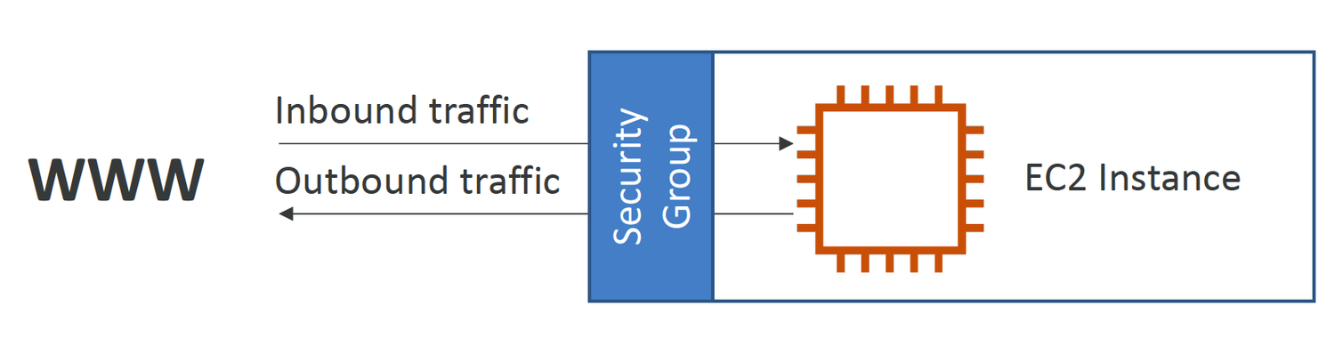
Introduction to Security Groups
Security Groups are the fundamental of network security in AWS
AWS Certified Cloud Practitioner (CLF-C02) · TGS-2023039183
© 2026 Tertiary Infotech Academy Pte Ltd
86

Slide 88
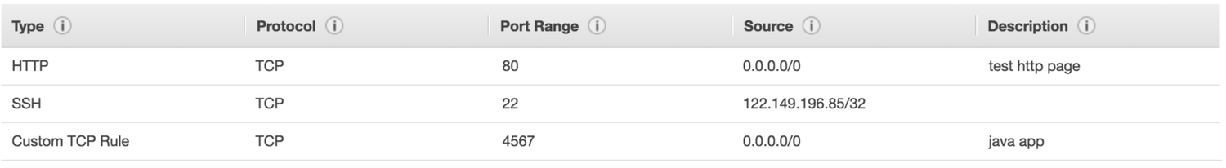
Security Groups Deeper Dive
Security groups are acting as a “firewall” on EC2 instances
AWS Certified Cloud Practitioner (CLF-C02) · TGS-2023039183
© 2026 Tertiary Infotech Academy Pte Ltd
87

Slide 89
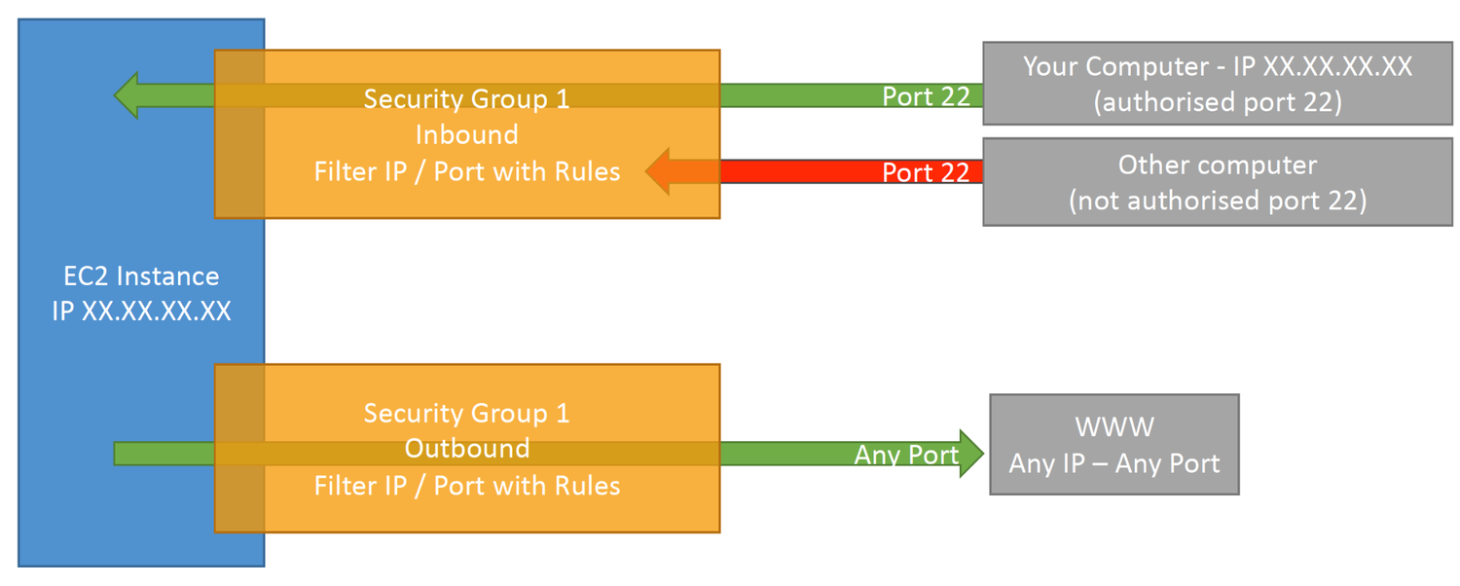
Security Groups Diagram
AWS Certified Cloud Practitioner (CLF-C02) · TGS-2023039183
© 2026 Tertiary Infotech Academy Pte Ltd
88

Slide 90
Security Groups Good to know
• Can be attached to multiple instances
• Locked down to a region / VPC combination
• Does live “outside” the EC2 – if traffic is blocked the EC2 instance won’t see it
• It’s good to maintain one separate security group for SSH access
• If your application is not accessible (time out), then it’s a security group issue
• If your application gives a “connection refused“ error, then it’s an application error or it’s not launched
• All inbound traffic is blocked by default
• All outbound traffic is authorised by default
AWS Certified Cloud Practitioner (CLF-C02) · TGS-2023039183
© 2026 Tertiary Infotech Academy Pte Ltd
89

Slide 91
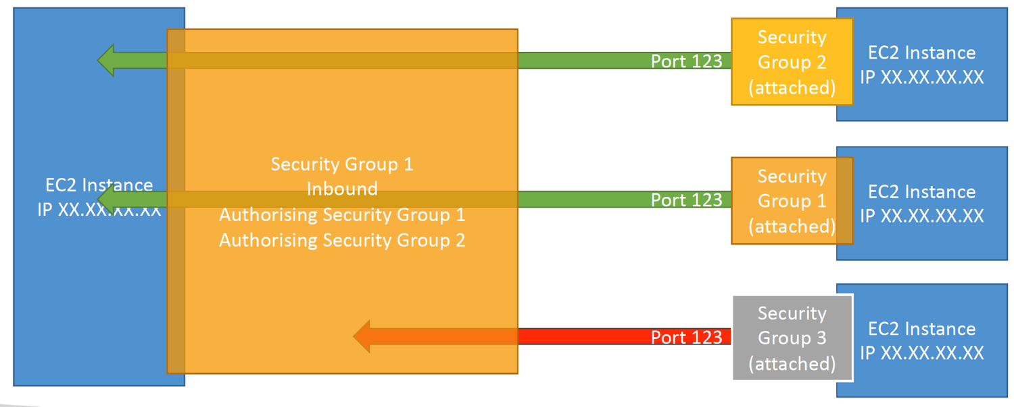
Referencing other security groups
Diagram
AWS Certified Cloud Practitioner (CLF-C02) · TGS-2023039183
© 2026 Tertiary Infotech Academy Pte Ltd
90

Slide 92
Classic Ports to know
22 = SSH (Secure Shell) - log into a Linux instance
21 = FTP (File Transfer Protocol) – upload files into a file share
22 = SFTP (Secure File Transfer Protocol) – upload files using SSH
1
2
3
80 = HTTP – access unsecured websites
443 = HTTPS – access secured websites
3389 = RDP (Remote Desktop Protocol) – log into a Windows instance
4
5
6
AWS Certified Cloud Practitioner (CLF-C02) · TGS-2023039183
© 2026 Tertiary Infotech Academy Pte Ltd
91

Slide 93
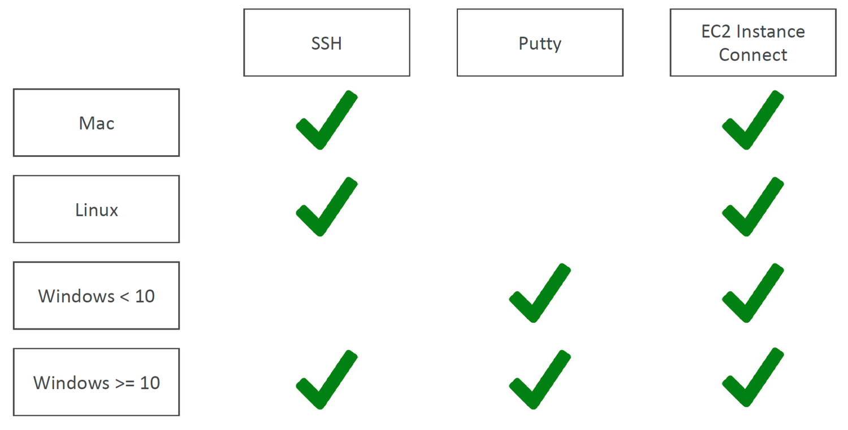
SSH Summary Table
AWS Certified Cloud Practitioner (CLF-C02) · TGS-2023039183
© 2026 Tertiary Infotech Academy Pte Ltd
92

Slide 94
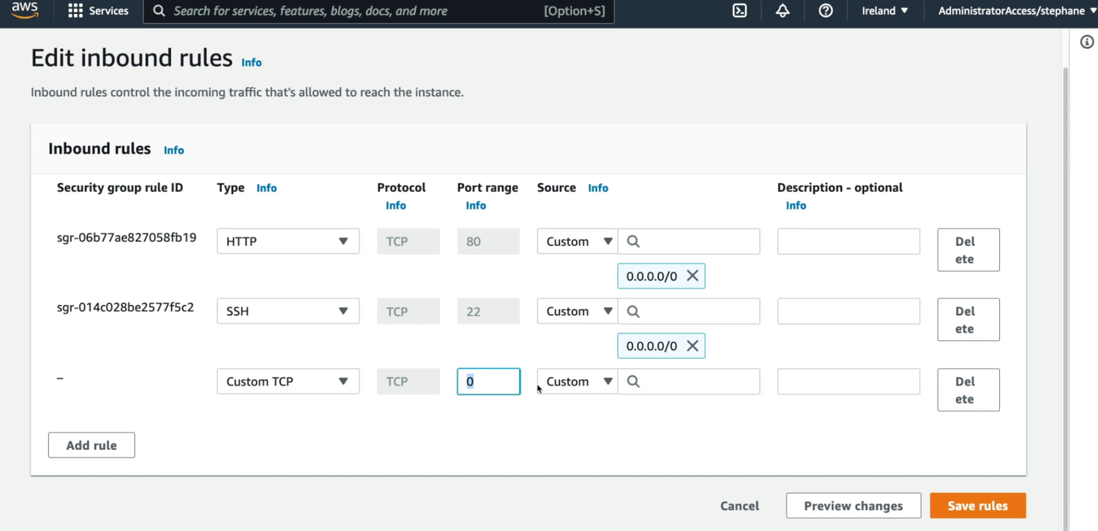
Activity: Security Tools Hand On
AWS Certified Cloud Practitioner (CLF-C02) · TGS-2023039183
© 2026 Tertiary Infotech Academy Pte Ltd
93

Slide 95
EC2 Instance Connect
Connect to your EC2 instance within your browser
No need to use your key file that was downloaded
The “magic” is that a temporary key is uploaded onto EC2 by AWS
1
2
3
Works only out-of-the-box with Amazon Linux 2
Need to make sure the port 22 is still opened!
4
5
AWS Certified Cloud Practitioner (CLF-C02) · TGS-2023039183
© 2026 Tertiary Infotech Academy Pte Ltd
94

Slide 96
EC2 Instances Purchasing Options
• On-Demand Instances – short workload, predictable pricing, pay by second
• Reserved (1 & 3 years)
• Reserved Instances – long workloads
• Convertible Reserved Instances – long workloads with flexible instances
• Savings Plans (1 & 3 years) –commitment to an amount of usage, long workload
• Spot Instances – short workloads, cheap, can lose instances (less reliable)
• Dedicated Hosts – book an entire physical server, control instance placement
• Dedicated Instances – no other customers will share your hardware
• Capacity Reservations – reserve capacity in a specific AZ for any duration
AWS Certified Cloud Practitioner (CLF-C02) · TGS-2023039183
© 2026 Tertiary Infotech Academy Pte Ltd
95

Slide 97
EC2 On Demand
• Pay for what you use:
• Linux or Windows - billing per second, after the first minute
• All other operating systems - billing per hour
• Has the highest cost but no upfront payment
• No long-term commitment
• Recommended for short-term and un-interrupted workloads, where you can't predict how the application will behave
AWS Certified Cloud Practitioner (CLF-C02) · TGS-2023039183
© 2026 Tertiary Infotech Academy Pte Ltd
96

Slide 98
EC2 Reserved Instances
• Up to 72% discount compared to On-demand
• You reserve a specific instance attributes (Instance Type, Region, Tenancy, OS)
• Reservation Period – 1 year (+discount) or 3 years (+++discount)
• Payment Options – No Upfront (+), Partial Upfront (++), All Upfront (+++)
• Reserved Instance’s Scope – Regional or Zonal (reserve capacity in an AZ)
• Recommended for steady-state usage applications (think database)
• You can buy and sell in the Reserved Instance Marketplace
• Convertible Reserved Instance
• Can change the EC2 instance
AWS Certified Cloud Practitioner (CLF-C02) · TGS-2023039183
© 2026 Tertiary Infotech Academy Pte Ltd
97

Slide 99
EC2 Savings Plans
• Get a discount based on long-term usage (up to 72% - same as RIs)
• Commit to a certain type of usage ($10/hour for 1 or 3 years)
• Usage beyond EC2 Savings Plans is billed at the On-Demand price
• Locked to a specific instance family & AWS region (e.g., M5 in us-east-1)
• Flexible across:
• Instance Size (e.g., m5.xlarge, m5.2xlarge)
• OS (e.g., Linux, Windows)
• Tenancy (Host, Dedicated, Default)
AWS Certified Cloud Practitioner (CLF-C02) · TGS-2023039183
© 2026 Tertiary Infotech Academy Pte Ltd
98

Slide 100
EC2 Spot Instances
• Can get a discount of up to 90% compared to On-demand
• Instances that you can “lose” at any point of time if your max price is less than the
• current spot price
• The MOST cost-efficient instances in AWS
• Useful for workloads that are resilient to failure
• Batch jobs
• Data analysis
• Image processing
• Any distributed workloads
• Workloads with a flexible start and end time
• Not suitable for critical jobs or databases
AWS Certified Cloud Practitioner (CLF-C02) · TGS-2023039183
© 2026 Tertiary Infotech Academy Pte Ltd
99

Slide 101
EC2 Dedicated Hosts
• A physical server with EC2 instance capacity fully dedicated to your use
• Allows you address compliance requirements and use your existing server bound software licenses (per-socket, per-core, pe—VM software licenses)
• Purchasing Options:
• On-demand – pay per second for active Dedicated Host
• Reserved - 1 or 3 years (No Upfront, Partial Upfront, All Upfront)
• The most expensive option
• Useful for software that have complicated licensing model (BYOL – Bring Your Own License)
• Or for companies that have strong regulatory or compliance needs
AWS Certified Cloud Practitioner (CLF-C02) · TGS-2023039183
© 2026 Tertiary Infotech Academy Pte Ltd
100

Slide 102
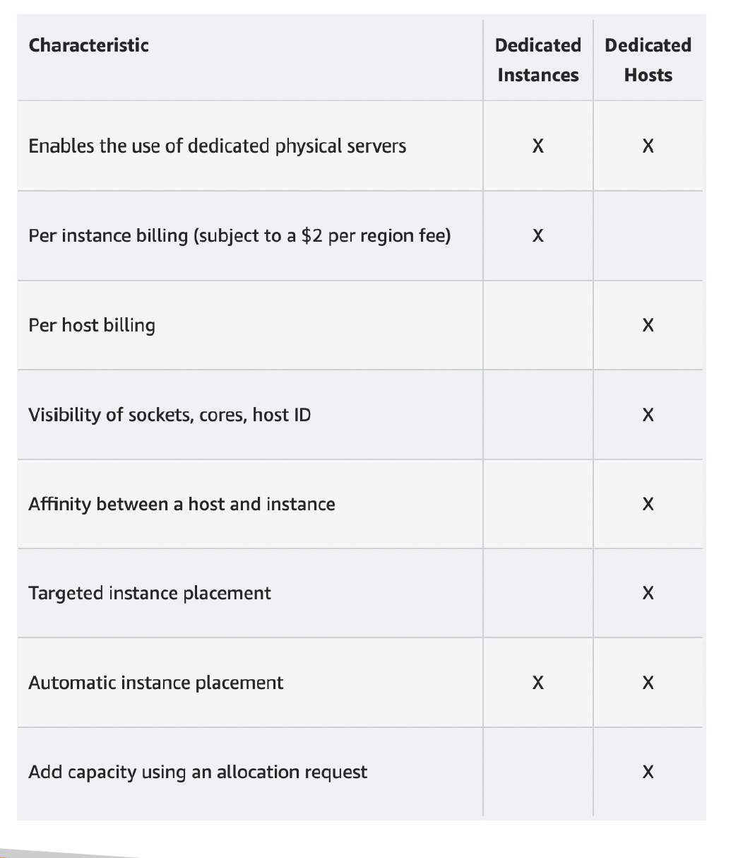
EC2 Dedicated Instances
Instances run on hardware that’s dedicated to you
AWS Certified Cloud Practitioner (CLF-C02) · TGS-2023039183
© 2026 Tertiary Infotech Academy Pte Ltd
101

Slide 103
EC2 Capacity Reservations
• Reserve On-Demand instances capacity in a specific AZ for any duration
• You always have access to EC2 capacity when you need it
• No time commitment (create/cancel anytime), no billing discounts
• Combine with Regional Reserved Instances and Savings Plans to benefit from billing discounts
• You’re charged at On-Demand rate whether you run instances or not
• Suitable for short-term, uninterrupted workloads that needs to be in a specific AZ
AWS Certified Cloud Practitioner (CLF-C02) · TGS-2023039183
© 2026 Tertiary Infotech Academy Pte Ltd
102

Slide 104
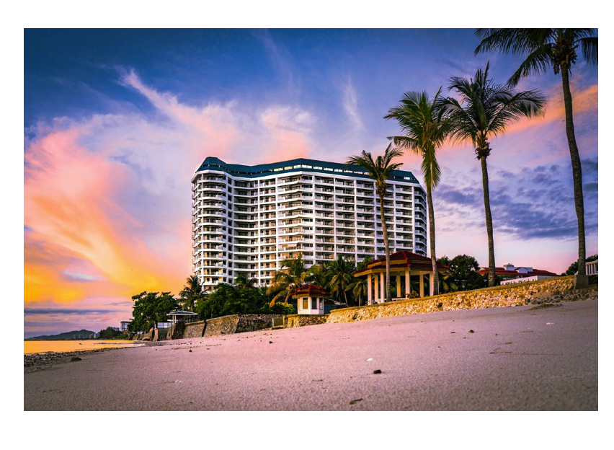
Which purchasing option is right for me?
On demand: coming and staying in resort whenever we like, we pay the full price
AWS Certified Cloud Practitioner (CLF-C02) · TGS-2023039183
© 2026 Tertiary Infotech Academy Pte Ltd
103

Slide 105
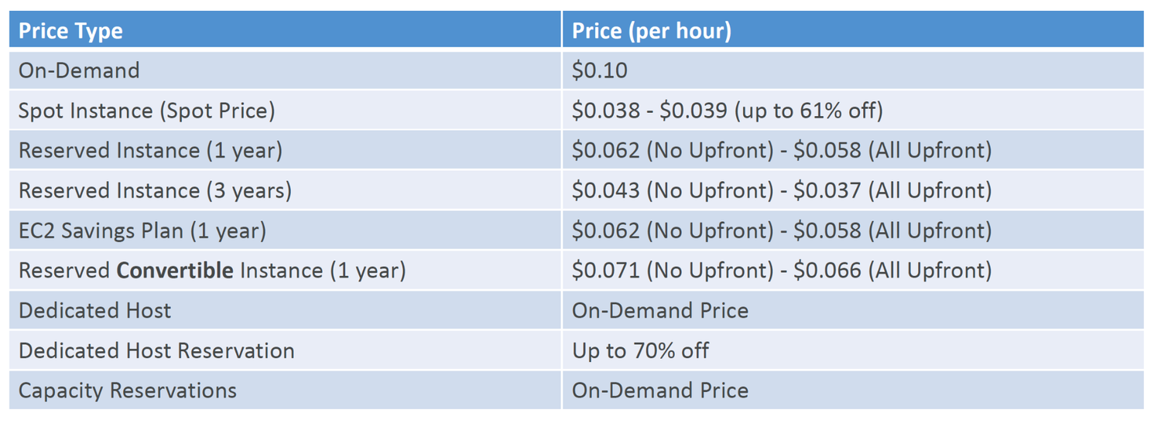
Price Comparison
Example – m4.large – us-east-1
AWS Certified Cloud Practitioner (CLF-C02) · TGS-2023039183
© 2026 Tertiary Infotech Academy Pte Ltd
104

Slide 106

Shared Responsibility Model for EC2
AWS Certified Cloud Practitioner (CLF-C02) · TGS-2023039183
© 2026 Tertiary Infotech Academy Pte Ltd
105

Slide 107
EC2 Summary
• EC2 Instance: AMI (OS) + Instance Size (CPU + RAM) + Storage +security groups + EC2 User Data
• Security Groups: Firewall attached to the EC2 instance
• EC2 User Data: Script launched at the first start of an instance
• SSH: start a terminal into our EC2 Instances (port 22)
• EC2 Instance Role: link to IAM roles
• Purchasing Options: On-Demand, Spot, Reserved (Standard + Convertible), Dedicated Host, Dedicated Instance
AWS Certified Cloud Practitioner (CLF-C02) · TGS-2023039183
© 2026 Tertiary Infotech Academy Pte Ltd
106

Slide 108
EC2 INSTANCE STORAGE
EC2 Instance Storage
AWS Certified Cloud Practitioner (CLF-C02) · TGS-2023039183
© 2026 Tertiary Infotech Academy Pte Ltd
107

Slide 109
What’s an EBS Volume?
• An EBS (Elastic Block Store) Volume is a network drive you can attach to your instances while they run
• It allows your instances to persist data, even after their termination
• They can only be mounted to one instance at a time (at the CCP level)
• They are bound to a specific availability zone
• Analogy: Think of them as a “network USB stick”
• Free tier: 30 GB of free EBS storage of type General Purpose (SSD) or Magnetic per month
AWS Certified Cloud Practitioner (CLF-C02) · TGS-2023039183
© 2026 Tertiary Infotech Academy Pte Ltd
108

Slide 110
EBS Volume
• It’s a network drive (i.e. not a physical drive)
• It uses the network to communicate the instance, which means there might be a bit of latency
• It can be detached from an EC2 instance and attached to another one quickly
• It’s locked to an Availability Zone (AZ)
• An EBS Volume in us-east-1a cannot be attached to us-east-1b
• To move a volume across, you first need to snapshot it
• Have a provisioned capacity (size in GBs, and IOPS)
• You get billed for all the provisioned capacity
• You can increase the capacity of the drive over time
AWS Certified Cloud Practitioner (CLF-C02) · TGS-2023039183
© 2026 Tertiary Infotech Academy Pte Ltd
109

Slide 111

EBS Volume - Example
AWS Certified Cloud Practitioner (CLF-C02) · TGS-2023039183
© 2026 Tertiary Infotech Academy Pte Ltd
110

Slide 112

EBS – Delete on Termination attribute
Controls the EBS behaviour when an EC2 instance terminates
AWS Certified Cloud Practitioner (CLF-C02) · TGS-2023039183
© 2026 Tertiary Infotech Academy Pte Ltd
111

Slide 113

EBS Snapshots
Make a backup (snapshot) of your EBS volume at a point in time
AWS Certified Cloud Practitioner (CLF-C02) · TGS-2023039183
© 2026 Tertiary Infotech Academy Pte Ltd
112

Slide 114

EBS Snapshots Features
EBS Snapshot Archive
AWS Certified Cloud Practitioner (CLF-C02) · TGS-2023039183
© 2026 Tertiary Infotech Academy Pte Ltd
113

Slide 115
AMI Overview
• AMI = Amazon Machine Image
• AMI are a customization of an EC2 instance
• You add your own software, configuration, operating system, monitoring…
• Faster boot / configuration time because all your software is pre-packaged
• AMI are built for a specific region (and can be copied across regions)
• You can launch EC2 instances from:
• A Public AMI: AWS provided
• Your own AMI: you make and maintain them yourself
• An AWS Marketplace AMI: an AMI someone else made (and potentially sells)
AWS Certified Cloud Practitioner (CLF-C02) · TGS-2023039183
© 2026 Tertiary Infotech Academy Pte Ltd
114

Slide 116

AMI Process (from an EC2 instance)
Start an EC2 instance and customize it
AWS Certified Cloud Practitioner (CLF-C02) · TGS-2023039183
© 2026 Tertiary Infotech Academy Pte Ltd
115

Slide 117

EC2 Image Builder
Used to automate the creation of Virtual Machines or container images
AWS Certified Cloud Practitioner (CLF-C02) · TGS-2023039183
© 2026 Tertiary Infotech Academy Pte Ltd
116

Slide 118
EC2 Instance Store
• EBS volumes are network drives with good but “limited” performance
• If you need a high-performance hardware disk, use EC2 Instance Store
• Better I/O performance
• EC2 Instance Store lose their storage if they’re stopped (ephemeral)
• Good for buffer / cache / scratch data / temporary content
• Risk of data loss if hardware fails
• Backups and Replication are your responsibility
AWS Certified Cloud Practitioner (CLF-C02) · TGS-2023039183
© 2026 Tertiary Infotech Academy Pte Ltd
117

Slide 119

Local EC2 Instance Store
AWS Certified Cloud Practitioner (CLF-C02) · TGS-2023039183
© 2026 Tertiary Infotech Academy Pte Ltd
118

Slide 120

EFS – Elastic File System
Managed NFS (network file system) that can be mounted on 100s of EC2
AWS Certified Cloud Practitioner (CLF-C02) · TGS-2023039183
© 2026 Tertiary Infotech Academy Pte Ltd
119

Slide 121

EBS vs EFS
AWS Certified Cloud Practitioner (CLF-C02) · TGS-2023039183
© 2026 Tertiary Infotech Academy Pte Ltd
120

Slide 122

EFS Infrequent Access (EFS-IA)
Storage class that is cost-optimized for files not accessed every day
AWS Certified Cloud Practitioner (CLF-C02) · TGS-2023039183
© 2026 Tertiary Infotech Academy Pte Ltd
121

Slide 123

Shared Responsibility Model for EC2 Storage
AWS Certified Cloud Practitioner (CLF-C02) · TGS-2023039183
© 2026 Tertiary Infotech Academy Pte Ltd
122

Slide 124

Amazon FSx – Overview
Launch 3rd party high-performance file systems on AWS
AWS Certified Cloud Practitioner (CLF-C02) · TGS-2023039183
© 2026 Tertiary Infotech Academy Pte Ltd
123

Slide 125

Amazon FSx for Windows File Server
A fully managed, highly reliable, and scalable Windows native shared file system
AWS Certified Cloud Practitioner (CLF-C02) · TGS-2023039183
© 2026 Tertiary Infotech Academy Pte Ltd
124

Slide 126

Amazon FSx for Lustre
A fully managed, high-performance, scalable file storage for High Performance Computing (HPC)
AWS Certified Cloud Practitioner (CLF-C02) · TGS-2023039183
© 2026 Tertiary Infotech Academy Pte Ltd
125

Slide 127
EC2 Instance Storage - Summary
• EBS volumes:
• network drives attached to one EC2 instance at a time
• Mapped to an Availability Zones
• Can use EBS Snapshots for backups / transferring EBS volumes across AZ
• AMI: create ready-to-use EC2 instances with our customizations
• EC2 Image Builder: automatically build, test and distribute AMIs
• EC2 Instance Store:
• High performance hardware disk attached to our EC2 instance
• Lost if our instance is stopped / terminated
• EFS: network file system, can be attached to 100s of instances in a region
• EFS-IA: cost-optimized storage class for infrequent accessed files
• FSx for Windows: Network File System for Windows servers
• FSx for Lustre: High Performance Computing Linux file system
AWS Certified Cloud Practitioner (CLF-C02) · TGS-2023039183
© 2026 Tertiary Infotech Academy Pte Ltd
126

Slide 128
OTHER COMPUTE
Other Compute
AWS Certified Cloud Practitioner (CLF-C02) · TGS-2023039183
© 2026 Tertiary Infotech Academy Pte Ltd
127

Slide 129
What is Docker?
• Docker is a software development platform to deploy apps
• Apps are packaged in containers that can be run on any OS
• Apps run the same, regardless of where they’re run
• Any machine
• No compatibility issues
• Predictable behavior
• Less work
• Easier to maintain and deploy
• Works with any language, any OS, any technology
• Scale containers up and down very quickly (seconds)
AWS Certified Cloud Practitioner (CLF-C02) · TGS-2023039183
© 2026 Tertiary Infotech Academy Pte Ltd
128

Slide 130

Docker on an OS
AWS Certified Cloud Practitioner (CLF-C02) · TGS-2023039183
© 2026 Tertiary Infotech Academy Pte Ltd
129

Slide 131
Where Docker images are stored?
• Docker images are stored in Docker Repositories
• Public: Docker Hub https://hub.docker.com/
• Find base images for many technologies or OS:
• Ubuntu
• MySQL
• NodeJS, Java…
• Private: Amazon ECR (Elastic Container Registry)
AWS Certified Cloud Practitioner (CLF-C02) · TGS-2023039183
© 2026 Tertiary Infotech Academy Pte Ltd
130

Slide 132

Docker versus Virtual Machines
Docker is ”sort of” a virtualization technology, but not exactly
AWS Certified Cloud Practitioner (CLF-C02) · TGS-2023039183
© 2026 Tertiary Infotech Academy Pte Ltd
131

Slide 133

ECS
ECS = Elastic Container Service
AWS Certified Cloud Practitioner (CLF-C02) · TGS-2023039183
© 2026 Tertiary Infotech Academy Pte Ltd
132

Slide 134

Fargate
Launch Docker containers on AWS
AWS Certified Cloud Practitioner (CLF-C02) · TGS-2023039183
© 2026 Tertiary Infotech Academy Pte Ltd
133

Slide 135

ECR
Elastic Container Registry
AWS Certified Cloud Practitioner (CLF-C02) · TGS-2023039183
© 2026 Tertiary Infotech Academy Pte Ltd
134

Slide 136
What’s serverless?
• Serverless is a new paradigm in which the developers don’t have to manage servers anymore…
• They just deploy code
• They just deploy… functions !
• Initially... Serverless == FaaS (Function as a Service)
• Serverless was pioneered by AWS Lambda but now also includes anything that’s managed: “databases, messaging, storage, etc.”
• Serverless does not mean there are no servers… it means you just don’t manage / provision / see them
AWS Certified Cloud Practitioner (CLF-C02) · TGS-2023039183
© 2026 Tertiary Infotech Academy Pte Ltd
135

Slide 137

Serverless computing
AWS Certified Cloud Practitioner (CLF-C02) · TGS-2023039183
© 2026 Tertiary Infotech Academy Pte Ltd
136

Slide 138

Example of Serverless
AWS Certified Cloud Practitioner (CLF-C02) · TGS-2023039183
© 2026 Tertiary Infotech Academy Pte Ltd
137

Slide 139

Why AWS Lambda
Virtual Servers in the Cloud
AWS Certified Cloud Practitioner (CLF-C02) · TGS-2023039183
© 2026 Tertiary Infotech Academy Pte Ltd
138

Slide 140
Benefits of AWS Lambda
• Easy Pricing:
• Pay per request and compute time
• Free tier of 1,000,000 AWS Lambda requests and 400,000 GBs of compute time
• Integrated with the whole AWS suite of services
• Event-Driven: functions get invoked by AWS when needed
• Integrated with many programming languages
• Easy monitoring through AWS CloudWatch
• Easy to get more resources per functions (up to 10GB of RAM!)
• Increasing RAM will also improve CPU and network!
AWS Certified Cloud Practitioner (CLF-C02) · TGS-2023039183
© 2026 Tertiary Infotech Academy Pte Ltd
139

Slide 141
AWS Lambda language support
• Node.js (JavaScript)
• Python
• Java (Java 8 compatible)
• C# (.NET Core)
• Golang
• C# / Powershell
• Ruby
• Custom Runtime API (community supported, example Rust)
• Lambda Container Image
• The container image must implement the Lambda Runtime API
• ECS / Fargate is preferred for running arbitrary Docker images
AWS Certified Cloud Practitioner (CLF-C02) · TGS-2023039183
© 2026 Tertiary Infotech Academy Pte Ltd
140

Slide 142

Example: Serverless Thumbnail creation
AWS Certified Cloud Practitioner (CLF-C02) · TGS-2023039183
© 2026 Tertiary Infotech Academy Pte Ltd
141

Slide 143

Example: Serverless CRON Job
AWS Certified Cloud Practitioner (CLF-C02) · TGS-2023039183
© 2026 Tertiary Infotech Academy Pte Ltd
142

Slide 144
AWS Lambda Pricing: example
• You can find overall pricing information here: https://aws.amazon.com/lambda/pricing/
• Pay per calls:
• First 1,000,000 requests are free
• $0.20 per 1 million requests thereafter ($0.0000002 per request)
• Pay per duration: (in increment of 1 ms)
• 400,000 GB-seconds of compute time per month for FREE
• == 400,000 seconds if function is 1GB RAM
• == 3,200,000 seconds if function is 128 MB RAM
• After that $1.00 for 600,000 GB-seconds
• It is usually very cheap to run AWS Lambda so it’s very popular
AWS Certified Cloud Practitioner (CLF-C02) · TGS-2023039183
© 2026 Tertiary Infotech Academy Pte Ltd
143

Slide 145

AWS Step Functions
Build serverless visual workflow to orchestrate your Lambda functions
AWS Certified Cloud Practitioner (CLF-C02) · TGS-2023039183
© 2026 Tertiary Infotech Academy Pte Ltd
144

Slide 146

Amazon API Gateway
Example: building a serverless API
AWS Certified Cloud Practitioner (CLF-C02) · TGS-2023039183
© 2026 Tertiary Infotech Academy Pte Ltd
145

Slide 147
AWS Batch
• Fully managed batch processing at any scale
• Efficiently run 100,000s of computing batch jobs on AWS
• A “batch” job is a job with a start and an end (opposed to continuous)
• Batch will dynamically launch EC2 instances or Spot Instances
• AWS Batch provisions the right amount of compute / memory
• You submit or schedule batch jobs and AWS Batch does the rest!
• Batch jobs are defined as Docker images and run on ECS
• Helpful for cost optimizations and focusing less on the infrastructure
AWS Certified Cloud Practitioner (CLF-C02) · TGS-2023039183
© 2026 Tertiary Infotech Academy Pte Ltd
146

Slide 148

AWS Batch – Simplified Example
AWS Certified Cloud Practitioner (CLF-C02) · TGS-2023039183
© 2026 Tertiary Infotech Academy Pte Ltd
147

Slide 149

Batch vs Lambda
Lambda:
AWS Certified Cloud Practitioner (CLF-C02) · TGS-2023039183
© 2026 Tertiary Infotech Academy Pte Ltd
148

Slide 150
Amazon Lightsail
• Virtual servers, storage, databases, and networking
• Low & predictable pricing
• Simpler alternative to using EC2, RDS, ELB, EBS, Route 53…
• Great for people with little cloud experience!
• Can setup notifications and monitoring of your Lightsail resources
• Use cases:
• Simple web applications (has templates for LAMP, Nginx, MEAN, Node.js…)
• Websites (templates for WordPress, Magento, Plesk, Joomla) Dev / Test environment
• Has high availability but no auto-scaling, limited AWS integrations
AWS Certified Cloud Practitioner (CLF-C02) · TGS-2023039183
© 2026 Tertiary Infotech Academy Pte Ltd
149

Slide 151
Other Compute - Summary
• Docker: container technology to run applications
• ECS: run Docker containers on EC2 instances
• Fargate:
• Run Docker containers without provisioning the infrastructure
• Serverless offering (no EC2 instances)
• ECR: Private Docker Images Repository
• Batch: run batch jobs on AWS across managed EC2 instances
• Lightsail: predictable & low pricing for simple application & DB stacks
AWS Certified Cloud Practitioner (CLF-C02) · TGS-2023039183
© 2026 Tertiary Infotech Academy Pte Ltd
150

Slide 152
Lambda Summary
• Lambda is Serverless, Function as a Service, seamless scaling, reactive
• Lambda Billing:
• By the time run x by the RAM provisioned
• By the number of invocations
• Language Support: many programming languages except (arbitrary) Docker
• Invocation time: up to 15 minutes
• Use cases:
• Create Thumbnails for images uploaded onto S3
• Run a Serverless cron job
• API Gateway: expose Lambda functions as HTTP API
AWS Certified Cloud Practitioner (CLF-C02) · TGS-2023039183
© 2026 Tertiary Infotech Academy Pte Ltd
151

Slide 153
DEPLOYING AND MANAGING
Infrastructure at Scale
AWS Certified Cloud Practitioner (CLF-C02) · TGS-2023039183
© 2026 Tertiary Infotech Academy Pte Ltd
152

Slide 154
What is CloudFormation
• CloudFormation is a declarative way of outlining your AWS Infrastructure, for any resources (most of them are supported).
• For example, within a CloudFormation template, you say:
• I want a security group
• I want two EC2 instances using this security group
• I want an S3 bucket
• I want a load balancer (ELB) in front of these machines
• Then CloudFormation creates those for you, in the right order, with the exact configuration that you specify
AWS Certified Cloud Practitioner (CLF-C02) · TGS-2023039183
© 2026 Tertiary Infotech Academy Pte Ltd
153

Slide 155
Benefits of AWS CloudFormation (1/2)
• Infrastructure as code
• No resources are manually created, which is excellent for control
• Changes to the infrastructure are reviewed through code
• Cost
• Each resources within the stack is tagged with an identifier so you can easily see how much a stack costs you
• You can estimate the costs of your resources using the CloudFormation template
• Savings strategy: In Dev, you could automation deletion of templates at 5 PM and recreated at 8 AM, safely
AWS Certified Cloud Practitioner (CLF-C02) · TGS-2023039183
© 2026 Tertiary Infotech Academy Pte Ltd
154

Slide 156
Benefits of AWS CloudFormation (2/2)
• Productivity
• Ability to destroy and re-create an infrastructure on the cloud on the fly
• Automated generation of Diagram for your templates!
• Declarative programming (no need to figure out ordering and orchestration)
• Don’t re-invent the wheel
• Leverage existing templates on the web!
• Leverage the documentation
• Supports (almost) all AWS resources:
• Everything we’ll see in this course is supported
• You can use “custom resources” for resources that are not supported
AWS Certified Cloud Practitioner (CLF-C02) · TGS-2023039183
© 2026 Tertiary Infotech Academy Pte Ltd
155

Slide 157

CloudFormation + Application Composer
Example: WordPress CloudFormation Stack
AWS Certified Cloud Practitioner (CLF-C02) · TGS-2023039183
© 2026 Tertiary Infotech Academy Pte Ltd
156

Slide 158

AWS Cloud Development Kit (CDK)
Define your cloud infrastructure using a familiar language:
AWS Certified Cloud Practitioner (CLF-C02) · TGS-2023039183
© 2026 Tertiary Infotech Academy Pte Ltd
157

Slide 159

CDK Example
AWS Certified Cloud Practitioner (CLF-C02) · TGS-2023039183
© 2026 Tertiary Infotech Academy Pte Ltd
158

Slide 160

Typical architecture: Web App 3-tier
AWS Certified Cloud Practitioner (CLF-C02) · TGS-2023039183
© 2026 Tertiary Infotech Academy Pte Ltd
159

Slide 161
Developer problems on AWS
• Managing infrastructure
• Deploying Code
• Configuring all the databases, load balancers, etc
• Scaling concerns
• Most web apps have the same architecture (ALB + ASG)
• All the developers want is for their code to run!
• Possibly, consistently across different applications and environments
AWS Certified Cloud Practitioner (CLF-C02) · TGS-2023039183
© 2026 Tertiary Infotech Academy Pte Ltd
160

Slide 162
AWS Elastic Beanstalk Overview
• Elastic Beanstalk is a developer centric view of deploying an application on AWS
• It uses all the component’s we’ve seen before: EC2, ASG, ELB, RDS, etc…
• But it’s all in one view that’s easy to make sense of!
• We still have full control over the configuration
• Beanstalk = Platform as a Service (PaaS)
• Beanstalk is free but you pay for the underlying instances
AWS Certified Cloud Practitioner (CLF-C02) · TGS-2023039183
© 2026 Tertiary Infotech Academy Pte Ltd
161

Slide 163
Elastic Beanstalk
• Managed service
• Instance configuration / OS is handled by Beanstalk
• Deployment strategy is configurable but performed by Elastic Beanstalk
• Capacity provisioning
• Load balancing & auto-scaling
• Application health-monitoring & responsiveness
• Just the application code is the responsibility of the developer
• Three architecture models:
• Single Instance deployment: good for dev
• LB + ASG: great for production or pre-production web applications
• ASG only: great for non-web apps in production (workers, etc..)
AWS Certified Cloud Practitioner (CLF-C02) · TGS-2023039183
© 2026 Tertiary Infotech Academy Pte Ltd
162

Slide 164
Elastic Beanstalk
• Support for many platforms:
• Go
• Java SE
• Java with Tomcat
• .NET on Windows Server with IIS
• Node.js
• PHP
• Python
• Ruby
• Packer Builder
• Single Container Docker
• Multi-Container Docker
• Preconfigured Docker
AWS Certified Cloud Practitioner (CLF-C02) · TGS-2023039183
© 2026 Tertiary Infotech Academy Pte Ltd
163

Slide 165

Elastic Beanstalk – Health Monitoring
Health agent pushes metrics to CloudWatch
AWS Certified Cloud Practitioner (CLF-C02) · TGS-2023039183
© 2026 Tertiary Infotech Academy Pte Ltd
164

Slide 166

AWS CodeDeploy
We want to deploy our application automatically
AWS Certified Cloud Practitioner (CLF-C02) · TGS-2023039183
© 2026 Tertiary Infotech Academy Pte Ltd
165

Slide 167

AWS CodeCommit
Before pushing the application code to servers, it needs to be stored somewhere
AWS Certified Cloud Practitioner (CLF-C02) · TGS-2023039183
© 2026 Tertiary Infotech Academy Pte Ltd
166

Slide 168

AWS CodeBuild
Code building service in the cloud (name is obvious)
AWS Certified Cloud Practitioner (CLF-C02) · TGS-2023039183
© 2026 Tertiary Infotech Academy Pte Ltd
167

Slide 169

AWS CodePipeline
Orchestrate the different steps to have the code automatically pushed to production
AWS Certified Cloud Practitioner (CLF-C02) · TGS-2023039183
© 2026 Tertiary Infotech Academy Pte Ltd
168

Slide 170
AWS CodeArtifact
• Software packages depend on each other to be built (also called code dependencies), and new ones are created
• Storing and retrieving these dependencies is called artifact management
• Traditionally you need to setup your own artifact management system
• CodeArtifact is a secure, scalable, and cost-effective artifact management for software development
• Works with common dependency management tools such as Maven, Gradle, npm, yarn, twine, pip, and NuGet
• Developers and CodeBuild can then retrieve dependencies straight from CodeArtifact
AWS Certified Cloud Practitioner (CLF-C02) · TGS-2023039183
© 2026 Tertiary Infotech Academy Pte Ltd
169

Slide 171

AWS CodeStar
Unified UI to easily manage software development activities in one place
AWS Certified Cloud Practitioner (CLF-C02) · TGS-2023039183
© 2026 Tertiary Infotech Academy Pte Ltd
170

Slide 172

AWS Cloud9
AWS Cloud9 is a cloud IDE (Integrated Development Environment) for writing, running and debugging code
AWS Certified Cloud Practitioner (CLF-C02) · TGS-2023039183
© 2026 Tertiary Infotech Academy Pte Ltd
171

Slide 173
AWS Systems Manager (SSM)
• Helps you manage your EC2 and On-Premises systems at scale
• Another Hybrid AWS service
• Get operational insights about the state of your infrastructure
• Suite of 10+ products
• Most important features are:
• Patching automation for enhanced compliance
• Run commands across an entire fleet of servers
• Store parameter configuration with the SSM Parameter Store
• Works for Linux, Windows, MacOS, and Raspberry Pi OS (Raspbian)
AWS Certified Cloud Practitioner (CLF-C02) · TGS-2023039183
© 2026 Tertiary Infotech Academy Pte Ltd
172

Slide 174

How Systems Manager works
We need to install the SSM agent onto the systems we control
AWS Certified Cloud Practitioner (CLF-C02) · TGS-2023039183
© 2026 Tertiary Infotech Academy Pte Ltd
173

Slide 175

Systems Manager – SSM Session Manager
Allows you to start a secure shell on your EC2 and on-premises servers
AWS Certified Cloud Practitioner (CLF-C02) · TGS-2023039183
© 2026 Tertiary Infotech Academy Pte Ltd
174

Slide 176

Systems Manager Parameter Store
Secure storage for configuration and secrets
AWS Certified Cloud Practitioner (CLF-C02) · TGS-2023039183
© 2026 Tertiary Infotech Academy Pte Ltd
175

Slide 177
Deployment - Summary
• CloudFormation: (AWS only)
• Infrastructure as Code, works with almost all of AWS resources
• Repeat across Regions & Accounts
• Beanstalk: (AWS only)
• Platform as a Service (PaaS), limited to certain programming languages or Docker
• Deploy code consistently with a known architecture: ex, ALB + EC2 + RDS
• CodeDeploy (hybrid): deploy & upgrade any application onto servers
• Systems Manager (hybrid): patch, configure and run commands at scale
AWS Certified Cloud Practitioner (CLF-C02) · TGS-2023039183
© 2026 Tertiary Infotech Academy Pte Ltd
176

Slide 178
Developer Services - Summary
• CodeCommit: Store code in private git repository (version controlled)
• CodeBuild: Build & test code in AWS
• CodeDeploy: Deploy code onto servers
• CodePipeline: Orchestration of pipeline (from code to build to deploy)
• CodeArtifact: Store software packages / dependencies on AWS
• CodeStar: Unified view for allowing developers to do CICD and code
• Cloud9: Cloud IDE (Integrated Development Environment) with collab
• AWS CDK: Define your cloud infrastructure using a programming language
AWS Certified Cloud Practitioner (CLF-C02) · TGS-2023039183
© 2026 Tertiary Infotech Academy Pte Ltd
177

Slide 179
TOPIC 4
AWS Database and Storage Services
AWS Certified Cloud Practitioner (CLF-C02) · TGS-2023039183
© 2026 Tertiary Infotech Academy Pte Ltd
178

Slide 180
AMAZON S3
Amazon S3
AWS Certified Cloud Practitioner (CLF-C02) · TGS-2023039183
© 2026 Tertiary Infotech Academy Pte Ltd
179

Slide 181
Amazon S3
Amazon S3 is one of the main building blocks of AWS
It’s advertised as ”infinitely scaling” storage
1
2
Many websites use Amazon S3 as a backbone
Many AWS services use Amazon S3 as an integration as well
3
4
AWS Certified Cloud Practitioner (CLF-C02) · TGS-2023039183
© 2026 Tertiary Infotech Academy Pte Ltd
180

Slide 182

Amazon S3 Use cases
Backup and storage
AWS Certified Cloud Practitioner (CLF-C02) · TGS-2023039183
© 2026 Tertiary Infotech Academy Pte Ltd
181

Slide 183

Amazon S3 - Buckets
Amazon S3 allows people to store objects (files) in “buckets” (directories)
AWS Certified Cloud Practitioner (CLF-C02) · TGS-2023039183
© 2026 Tertiary Infotech Academy Pte Ltd
182

Slide 184

Amazon S3 - Objects
Objects (files) have a Key
AWS Certified Cloud Practitioner (CLF-C02) · TGS-2023039183
© 2026 Tertiary Infotech Academy Pte Ltd
183

Slide 185
Amazon S3 – Objects (cont.)
Object values are the content of the body:
AWS Certified Cloud Practitioner (CLF-C02) · TGS-2023039183
© 2026 Tertiary Infotech Academy Pte Ltd
184

Slide 186
Amazon S3 – Security
• User-Based
• IAM Policies – which API calls should be allowed for a specific user from IAM
• Resource-Based
• Bucket Policies – bucket wide rules from the S3 console - allows cross account
• Object Access Control List (ACL) – finer grain (can be disabled)
• Bucket Access Control List (ACL) – less common (can be disabled)
• Note: an IAM principal can access an S3 object if
• The user IAM permissions ALLOW it OR the resource policy ALLOWS it
• AND there’s no explicit DENY
• Encryption: encrypt objects in Amazon S3 using encryption keys
AWS Certified Cloud Practitioner (CLF-C02) · TGS-2023039183
© 2026 Tertiary Infotech Academy Pte Ltd
185

Slide 187

S3 Bucket Policies
JSON based policies
AWS Certified Cloud Practitioner (CLF-C02) · TGS-2023039183
© 2026 Tertiary Infotech Academy Pte Ltd
186

Slide 188

Example: Public Access - Use Bucket Policy
AWS Certified Cloud Practitioner (CLF-C02) · TGS-2023039183
© 2026 Tertiary Infotech Academy Pte Ltd
187

Slide 189

Example: User Access to S3 – IAM permissions
AWS Certified Cloud Practitioner (CLF-C02) · TGS-2023039183
© 2026 Tertiary Infotech Academy Pte Ltd
188

Slide 190

Example: EC2 instance access - Use IAM Roles
AWS Certified Cloud Practitioner (CLF-C02) · TGS-2023039183
© 2026 Tertiary Infotech Academy Pte Ltd
189

Slide 191

Advanced: Cross-Account Access –
Use Bucket Policy
AWS Certified Cloud Practitioner (CLF-C02) · TGS-2023039183
© 2026 Tertiary Infotech Academy Pte Ltd
190

Slide 192

Bucket settings for Block Public Access
These settings were created to prevent company data leaks
AWS Certified Cloud Practitioner (CLF-C02) · TGS-2023039183
© 2026 Tertiary Infotech Academy Pte Ltd
191

Slide 193
Amazon S3 – Static Website Hosting
• S3 can host static websites and have them accessible on the Internet
• The website URL will be (depending on the region) http://bucket-name.s3-website-aws-region.amazonaws.com OR http://bucket-name.s3-website.aws-region.amazonaws.com
• If you get a 403 Forbidden error, make sure the bucket policy allows public reads!
AWS Certified Cloud Practitioner (CLF-C02) · TGS-2023039183
© 2026 Tertiary Infotech Academy Pte Ltd
192

Slide 194

Amazon S3 - Versioning
You can version your files in Amazon S3
AWS Certified Cloud Practitioner (CLF-C02) · TGS-2023039183
© 2026 Tertiary Infotech Academy Pte Ltd
193

Slide 195

Amazon S3 – Replication (CRR & SRR)
Must enable Versioning in source and destination buckets
AWS Certified Cloud Practitioner (CLF-C02) · TGS-2023039183
© 2026 Tertiary Infotech Academy Pte Ltd
194

Slide 196
S3 Storage Classes
• Amazon S3 Standard - General Purpose
• Amazon S3 Standard-Infrequent Access (IA)
• Amazon S3 One Zone-Infrequent Access
• Amazon S3 Glacier Instant Retrieval
• Amazon S3 Glacier Flexible Retrieval
• Amazon S3 Glacier Deep Archive
• Amazon S3 Intelligent Tiering
• Can move between classes manually or using S3 Lifecycle configurations
AWS Certified Cloud Practitioner (CLF-C02) · TGS-2023039183
© 2026 Tertiary Infotech Academy Pte Ltd
195

Slide 197
S3 Durability and Availability
• Durability:
• High durability (99.999999999%, 11 9’s) of objects across multiple AZ
• If you store 10,000,000 objects with Amazon S3, you can on average expect to incur a loss of a single object once every 10,000 years
• Same for all storage classes
• Availability:
• Measures how readily available a service is
• Varies depending on storage class
• Example: S3 standard has 99.99% availability = not available 53 minutes a year
AWS Certified Cloud Practitioner (CLF-C02) · TGS-2023039183
© 2026 Tertiary Infotech Academy Pte Ltd
196

Slide 198
S3 Standard – General Purpose
• 99.99% Availability
• Used for frequently accessed data
• Low latency and high throughput
• Sustain 2 concurrent facility failures
• Use Cases: Big Data analytics, mobile & gaming applications, content distribution…
AWS Certified Cloud Practitioner (CLF-C02) · TGS-2023039183
© 2026 Tertiary Infotech Academy Pte Ltd
197

Slide 199
S3 Storage Classes – Infrequent Access
• For data that is less frequently accessed, but requires rapid access when needed
• Lower cost than S3 Standard
• Amazon S3 Standard-Infrequent Access (S3 Standard-IA)
• 99.9% Availability
• Use cases: Disaster Recovery, backups
• Amazon S3 One Zone-Infrequent Access (S3 One Zone-IA)
• High durability (99.999999999%) in a single AZ; data lost when AZ is destroyed
• 99.5% Availability
• Use Cases: Storing secondary backup copies of on-premise data, or data you can recreate
AWS Certified Cloud Practitioner (CLF-C02) · TGS-2023039183
© 2026 Tertiary Infotech Academy Pte Ltd
198

Slide 200
Amazon S3 Glacier Storage Classes
• Low-cost object storage meant for archiving / backup
• Pricing: price for storage + object retrieval cost
• Amazon S3 Glacier Instant Retrieval
• Millisecond retrieval, great for data accessed once a quarter
• Minimum storage duration of 90 days
• Amazon S3 Glacier Flexible Retrieval (formerly Amazon S3 Glacier):
• Expedited (1 to 5 minutes), Standard (3 to 5 hours), Bulk (5 to 12 hours) – free
• Minimum storage duration of 90 days
• Amazon S3 Glacier Deep Archive – for long term storage:
• Standard (12 hours), Bulk (48 hours)
• Minimum storage duration of 180 days
AWS Certified Cloud Practitioner (CLF-C02) · TGS-2023039183
© 2026 Tertiary Infotech Academy Pte Ltd
199

Slide 201
S3 Intelligent-Tiering
• Small monthly monitoring and auto-tiering fee
• Moves objects automatically between Access Tiers based on usage
• There are no retrieval charges in S3 Intelligent-Tiering
• Frequent Access tier (automatic): default tier
• Infrequent Access tier (automatic): objects not accessed for 30 days
• Archive Instant Access tier (automatic): objects not accessed for 90 days
• Archive Access tier (optional): configurable from 90 days to 700+ days
• Deep Archive Access tier (optional): config. from 180 days to 700+ days
AWS Certified Cloud Practitioner (CLF-C02) · TGS-2023039183
© 2026 Tertiary Infotech Academy Pte Ltd
200

Slide 202

S3 Storage Classes Comparison
https://aws.amazon.com/s3/storage-classes/
AWS Certified Cloud Practitioner (CLF-C02) · TGS-2023039183
© 2026 Tertiary Infotech Academy Pte Ltd
201

Slide 203

S3 Storage Classes – Price Comparison
Example: us-east-1
AWS Certified Cloud Practitioner (CLF-C02) · TGS-2023039183
© 2026 Tertiary Infotech Academy Pte Ltd
202

Slide 204

S3 Encryption
AWS Certified Cloud Practitioner (CLF-C02) · TGS-2023039183
© 2026 Tertiary Infotech Academy Pte Ltd
203

Slide 205

IAM Access Analyzer for S3
Ensures that only intended people have access to your S3 buckets
AWS Certified Cloud Practitioner (CLF-C02) · TGS-2023039183
© 2026 Tertiary Infotech Academy Pte Ltd
204

Slide 206

Shared Responsibility Model for S3
AWS Certified Cloud Practitioner (CLF-C02) · TGS-2023039183
© 2026 Tertiary Infotech Academy Pte Ltd
205

Slide 207

Activity: S3 Hand On
AWS Certified Cloud Practitioner (CLF-C02) · TGS-2023039183
© 2026 Tertiary Infotech Academy Pte Ltd
206

Slide 208

AWS Snow Family
Highly-secure, portable devices to collect and process data at the edge, and migrate data into and out of AWS
AWS Certified Cloud Practitioner (CLF-C02) · TGS-2023039183
© 2026 Tertiary Infotech Academy Pte Ltd
207

Slide 209

Data Migrations with AWS Snow Family
Challenges:
AWS Certified Cloud Practitioner (CLF-C02) · TGS-2023039183
© 2026 Tertiary Infotech Academy Pte Ltd
208

Slide 210

Diagrams
Direct upload to S3:
AWS Certified Cloud Practitioner (CLF-C02) · TGS-2023039183
© 2026 Tertiary Infotech Academy Pte Ltd
209

Slide 211

Snowball Edge (for data transfers)
Physical data transport solution: move TBs or PBs of data in or out of AWS
AWS Certified Cloud Practitioner (CLF-C02) · TGS-2023039183
© 2026 Tertiary Infotech Academy Pte Ltd
210

Slide 212

AWS Snowcone & Snowcone SSD
Small, portable computing, anywhere, rugged & secure, withstands harsh environments
AWS Certified Cloud Practitioner (CLF-C02) · TGS-2023039183
© 2026 Tertiary Infotech Academy Pte Ltd
211

Slide 213

AWS Snowmobile
Transfer exabytes of data (1 EB = 1,000 PB = 1,000,000 TBs)
AWS Certified Cloud Practitioner (CLF-C02) · TGS-2023039183
© 2026 Tertiary Infotech Academy Pte Ltd
212

Slide 214

AWS Snow Family for Data Migrations
AWS Certified Cloud Practitioner (CLF-C02) · TGS-2023039183
© 2026 Tertiary Infotech Academy Pte Ltd
213

Slide 215
Snow Family – Usage Process
Request Snowball devices from the AWS console for delivery
Install the snowball client / AWS OpsHub on your servers
Connect the snowball to your servers and copy files using the client
1
2
3
Ship back the device when you’re done (goes to the right AWS facility)
Data will be loaded into an S3 bucket
Snowball is completely wiped
4
5
6
AWS Certified Cloud Practitioner (CLF-C02) · TGS-2023039183
© 2026 Tertiary Infotech Academy Pte Ltd
214

Slide 216
AWS DataSync
• Move large amount of data from on-premises to AWS
• Can synchronize to: Amazon S3 (any storage classes – including Glacier), Amazon EFS, Amazon FSx for Windows
• Replication tasks can be scheduled hourly, daily, weekly
• The replication tasks are incremental after the first full load
AWS Certified Cloud Practitioner (CLF-C02) · TGS-2023039183
© 2026 Tertiary Infotech Academy Pte Ltd
215

Slide 217

AWS DataSync
AWS Certified Cloud Practitioner (CLF-C02) · TGS-2023039183
© 2026 Tertiary Infotech Academy Pte Ltd
216

Slide 218

AWS Migration Hub
AWS Certified Cloud Practitioner (CLF-C02) · TGS-2023039183
© 2026 Tertiary Infotech Academy Pte Ltd
217

Slide 219

What is Edge Computing?
Process data while it’s being created on an edge location
AWS Certified Cloud Practitioner (CLF-C02) · TGS-2023039183
© 2026 Tertiary Infotech Academy Pte Ltd
218

Slide 220
Snow Family – Edge Computing
• Snowcone & Snowcone SSD (smaller)
• 2 CPUs, 4 GB of memory, wired or wireless access
• USB-C power using a cord or the optional battery
• Snowball Edge – Compute Optimized
• 104 vCPUs, 416 GiB of RAM
• Optional GPU (useful for video processing or machine learning)
• 28 TB NVMe or 42TB HDD usable storage
• Storage Clustering available (up to 16 nodes)
• Snowball Edge – Storage Optimized
• Up to 40 vCPUs, 80 GiB of RAM, 80 TB storage
• Up to 104 vCPUs, 416 GiB of RAM, 210 TB NVMe storage
• All: Can run EC2 Instances & AWS Lambda functions (using AWS IoT Greengrass)
• Long-term deployment options: 1 and 3 years discounted pricing
AWS Certified Cloud Practitioner (CLF-C02) · TGS-2023039183
© 2026 Tertiary Infotech Academy Pte Ltd
219

Slide 221

AWS OpsHub
Historically, to use Snow Family devices, you needed a CLI (Command Line Interface tool)
AWS Certified Cloud Practitioner (CLF-C02) · TGS-2023039183
© 2026 Tertiary Infotech Academy Pte Ltd
220

Slide 222
Snowball Edge Pricing
• You pay for device usage and data transfer out of AWS
• Data transfer IN to Amazon S3 is $0.00 per GB
• On-Demand
• Includes a one-time service fee per job, which includes:
• 10 days of usage for Snowball Edge Storage Optimized 80TB
• 15 days of usage for Snowball Edge Storage Optimized 210TB
• Shipping days are NOT counted towards the included 10 or 15 days
• Pay per day for any additional days
• Committed Upfront
• Pay in advance for monthly, 1-year, and 3-years of usage (Edge Computing)
• Up to 62% discounted pricing
AWS Certified Cloud Practitioner (CLF-C02) · TGS-2023039183
© 2026 Tertiary Infotech Academy Pte Ltd
221

Slide 223
Hybrid Cloud for Storage
• AWS is pushing for ”hybrid cloud”
• Part of your infrastructure is on-premises
• Part of your infrastructure is on the cloud
• This can be due to
• Long cloud migrations
• Security requirements
• Compliance requirements
• IT strategy
• S3 is a proprietary storage technology (unlike EFS / NFS), so how do you expose the S3 data on-premise?
• AWS Storage Gateway!
AWS Certified Cloud Practitioner (CLF-C02) · TGS-2023039183
© 2026 Tertiary Infotech Academy Pte Ltd
222

Slide 224

AWS Storage Cloud Native Options
AWS Certified Cloud Practitioner (CLF-C02) · TGS-2023039183
© 2026 Tertiary Infotech Academy Pte Ltd
223

Slide 225

AWS Storage Gateway
Bridge between on-premise data and cloud data in S3
AWS Certified Cloud Practitioner (CLF-C02) · TGS-2023039183
© 2026 Tertiary Infotech Academy Pte Ltd
224

Slide 226
Amazon S3 – Summary
• Buckets vs Objects: global unique name, tied to a region
• S3 security: IAM policy, S3 Bucket Policy (public access), S3 Encryption
• S3 Websites: host a static website on Amazon S3
• S3 Versioning: multiple versions for files, prevent accidental deletes
• S3 Replication: same-region or cross-region, must enable versioning
• S3 Storage Classes: Standard, IA, 1Z-IA, Intelligent, Glacier (Instant, Flexible, Deep)
• Snow Family: import data onto S3 through a physical device, edge computing
• OpsHub: desktop application to manage Snow Family devices
• Storage Gateway: hybrid solution to extend on-premises storage to S3
AWS Certified Cloud Practitioner (CLF-C02) · TGS-2023039183
© 2026 Tertiary Infotech Academy Pte Ltd
225

Slide 227
DATABASE
Database
AWS Certified Cloud Practitioner (CLF-C02) · TGS-2023039183
© 2026 Tertiary Infotech Academy Pte Ltd
226

Slide 228
Databases Intro
• Storing data on disk (EFS, EBS, EC2 Instance Store, S3) can have its limits
• Sometimes, you want to store data in a database…
• You can structure the data
• You build indexes to efficiently query / search through the data
• You define relationships between your datasets
• Databases are optimized for a purpose and come with different features, shapes and constraints
AWS Certified Cloud Practitioner (CLF-C02) · TGS-2023039183
© 2026 Tertiary Infotech Academy Pte Ltd
227

Slide 229

Relational Databases
Looks just like Excel spreadsheets, with links between them!
AWS Certified Cloud Practitioner (CLF-C02) · TGS-2023039183
© 2026 Tertiary Infotech Academy Pte Ltd
228

Slide 230
NoSQL Databases
• NoSQL = non-SQL = non relational databases
• NoSQL databases are purpose built for specific data models and have flexible schemas for building modern applications.
• Benefits:
• Flexibility: easy to evolve data model
• Scalability: designed to scale-out by using distributed clusters
• High-performance: optimized for a specific data model
• Highly functional: types optimized for the data model
• Examples: Key-value, document, graph, in-memory, search databases
AWS Certified Cloud Practitioner (CLF-C02) · TGS-2023039183
© 2026 Tertiary Infotech Academy Pte Ltd
229

Slide 231

NoSQL data example: JSON
JSON = JavaScript Object Notation
AWS Certified Cloud Practitioner (CLF-C02) · TGS-2023039183
© 2026 Tertiary Infotech Academy Pte Ltd
230

Slide 232
Databases & Shared Responsibility on AWS
• AWS offers use to manage different databases
• Benefits include:
• Quick Provisioning, High Availability, Vertical and Horizontal Scaling
• Automated Backup & Restore, Operations, Upgrades
• Operating System Patching is handled by AWS
• Monitoring, alerting
• Note: many databases technologies could be run on EC2, but you must handle yourself the resiliency, backup, patching, high availability, fault tolerance, scaling…
AWS Certified Cloud Practitioner (CLF-C02) · TGS-2023039183
© 2026 Tertiary Infotech Academy Pte Ltd
231

Slide 233
Amazon RDS Overview
• RDS stands for Relational Database Service
• It’s a managed DB service for DB use SQL as a query language.
• It allows you to create databases in the cloud that are managed by AWS
• Postgres
• MySQL
• MariaDB
• Oracle
• Microsoft SQL Server
• IBM DB2
• Aurora (AWS Proprietary database)
AWS Certified Cloud Practitioner (CLF-C02) · TGS-2023039183
© 2026 Tertiary Infotech Academy Pte Ltd
232

Slide 234

RDS Solution Architecture
AWS Certified Cloud Practitioner (CLF-C02) · TGS-2023039183
© 2026 Tertiary Infotech Academy Pte Ltd
233

Slide 235
Advantage over using RDS versus deploying DB on EC2
• RDS is a managed service:
• Automated provisioning, OS patching
• Continuous backups and restore to specific timestamp (Point in Time Restore)!
• Monitoring dashboards
• Read replicas for improved read performance
• Multi AZ setup for DR (Disaster Recovery)
• Maintenance windows for upgrades
• Scaling capability (vertical and horizontal)
• Storage backed by EBS
• BUT you can’t SSH into your instances
AWS Certified Cloud Practitioner (CLF-C02) · TGS-2023039183
© 2026 Tertiary Infotech Academy Pte Ltd
234

Slide 236

Amazon Aurora
Aurora is a proprietary technology from AWS (not open sourced)
AWS Certified Cloud Practitioner (CLF-C02) · TGS-2023039183
© 2026 Tertiary Infotech Academy Pte Ltd
235

Slide 237

Amazon Aurora Serverless
Automated database instantiation and Client auto-scaling based on actual usage
AWS Certified Cloud Practitioner (CLF-C02) · TGS-2023039183
© 2026 Tertiary Infotech Academy Pte Ltd
236

Slide 238

RDS Deployments: Read Replicas, Multi-AZ
AWS Certified Cloud Practitioner (CLF-C02) · TGS-2023039183
© 2026 Tertiary Infotech Academy Pte Ltd
237

Slide 239

RDS Deployments: Multi-Region
AWS Certified Cloud Practitioner (CLF-C02) · TGS-2023039183
© 2026 Tertiary Infotech Academy Pte Ltd
238

Slide 240
Amazon ElastiCache Overview
• The same way RDS is to get managed Relational Databases…
• ElastiCache is to get managed Redis or Memcached
• Caches are in-memory databases with high performance, low latency
• Helps reduce load off databases for read intensive workloads
• AWS takes care of OS maintenance / patching, optimizations, setup, configuration, monitoring, failure recovery and backups
AWS Certified Cloud Practitioner (CLF-C02) · TGS-2023039183
© 2026 Tertiary Infotech Academy Pte Ltd
239

Slide 241

ElastiCache
Solution Architecture - Cache
AWS Certified Cloud Practitioner (CLF-C02) · TGS-2023039183
© 2026 Tertiary Infotech Academy Pte Ltd
240

Slide 242
DynamoDB
• Fully Managed Highly available with replication across 3 AZ
• NoSQL database - not a relational database
• Scales to massive workloads, distributed “serverless” database
• Millions of requests per seconds, trillions of row, 100s of TB of storage
• Fast and consistent in performance
• Single-digit millisecond latency – low latency retrieval
• Integrated with IAM for security, authorization and administration
• Low cost and auto scaling capabilities
• Standard & Infrequent Access (IA) Table Class
AWS Certified Cloud Practitioner (CLF-C02) · TGS-2023039183
© 2026 Tertiary Infotech Academy Pte Ltd
241

Slide 243

DynamoDB – type of data
https://aws.amazon.com/nosql/key-value/
AWS Certified Cloud Practitioner (CLF-C02) · TGS-2023039183
© 2026 Tertiary Infotech Academy Pte Ltd
242

Slide 244

DynamoDB Accelerator - DAX
Fully Managed in-memory cache for DynamoDB
AWS Certified Cloud Practitioner (CLF-C02) · TGS-2023039183
© 2026 Tertiary Infotech Academy Pte Ltd
243

Slide 245

DynamoDB – Global Tables
Make a DynamoDB table accessible with low latency in multiple-regions
AWS Certified Cloud Practitioner (CLF-C02) · TGS-2023039183
© 2026 Tertiary Infotech Academy Pte Ltd
244

Slide 246
Redshift Overview
• Redshift is based on PostgreSQL, but it’s not used for OLTP
• It’s OLAP – online analytical processing (analytics and data warehousing)
• Load data once every hour, not every second
• 10x better performance than other data warehouses, scale to PBs of data
• Columnar storage of data (instead of row based)
• Massively Parallel Query Execution (MPP), highly available
• Pay as you go based on the instances provisioned
• Has a SQL interface for performing the queries
• BI tools such as AWS Quicksight or Tableau integrate with it
AWS Certified Cloud Practitioner (CLF-C02) · TGS-2023039183
© 2026 Tertiary Infotech Academy Pte Ltd
245

Slide 247

Redshift Serverless
Automatically provisions and scales data warehouse underlying capacity
AWS Certified Cloud Practitioner (CLF-C02) · TGS-2023039183
© 2026 Tertiary Infotech Academy Pte Ltd
246

Slide 248
Amazon EMR
• EMR stands for “Elastic MapReduce”
• EMR helps creating Hadoop clusters (Big Data) to analyze and process vast amount of data
• The clusters can be made of hundreds of EC2 instances
• Also supports Apache Spark, HBase, Presto, Flink…
• EMR takes care of all the provisioning and configuration
• Auto-scaling and integrated with Spot instances
• Use cases: data processing, machine learning, web indexing, big data…
AWS Certified Cloud Practitioner (CLF-C02) · TGS-2023039183
© 2026 Tertiary Infotech Academy Pte Ltd
247

Slide 249

Amazon Athena
Serverless query service to analyze data stored in Amazon S3
AWS Certified Cloud Practitioner (CLF-C02) · TGS-2023039183
© 2026 Tertiary Infotech Academy Pte Ltd
248

Slide 250

Amazon QuickSight
Serverless machine learning-powered business intelligence service to create interactive dashboards
AWS Certified Cloud Practitioner (CLF-C02) · TGS-2023039183
© 2026 Tertiary Infotech Academy Pte Ltd
249

Slide 251
DocumentDB
• Aurora is an “AWS-implementation” of PostgreSQL / MySQL …
• DocumentDB is the same for MongoDB (which is a NoSQL database)
• MongoDB is used to store, query, and index JSON data
• Similar “deployment concepts” as Aurora
• Fully Managed, highly available with replication across 3 AZ
• DocumentDB storage automatically grows in increments of 10GB
• Automatically scales to workloads with millions of requests per seconds
AWS Certified Cloud Practitioner (CLF-C02) · TGS-2023039183
© 2026 Tertiary Infotech Academy Pte Ltd
250

Slide 252

Amazon Neptune
Fully managed graph database
AWS Certified Cloud Practitioner (CLF-C02) · TGS-2023039183
© 2026 Tertiary Infotech Academy Pte Ltd
251

Slide 253

Amazon Timestream
Fully managed, fast, scalable, serverless time series database
AWS Certified Cloud Practitioner (CLF-C02) · TGS-2023039183
© 2026 Tertiary Infotech Academy Pte Ltd
252

Slide 254

Amazon QLDB
QLDB stands for ”Quantum Ledger Database”
AWS Certified Cloud Practitioner (CLF-C02) · TGS-2023039183
© 2026 Tertiary Infotech Academy Pte Ltd
253

Slide 255

Amazon Managed Blockchain
AWS Certified Cloud Practitioner (CLF-C02) · TGS-2023039183
© 2026 Tertiary Infotech Academy Pte Ltd
254

Slide 256

AWS Glue
Managed extract, transform, and load (ETL) service
AWS Certified Cloud Practitioner (CLF-C02) · TGS-2023039183
© 2026 Tertiary Infotech Academy Pte Ltd
255

Slide 257

DMS – Database Migration Service
Quickly and securely migrate databases to AWS, resilient, self healing
AWS Certified Cloud Practitioner (CLF-C02) · TGS-2023039183
© 2026 Tertiary Infotech Academy Pte Ltd
256

Slide 258
Databases & Analytics Summary
• Relational Databases - OLTP: RDS & Aurora (SQL)
• Differences between Multi-AZ, Read Replicas, Multi-Region
• In-memory Database: ElastiCache
• Key/Value Database: DynamoDB (serverless) & DAX (cache for DynamoDB)
• Warehouse - OLAP: Redshift (SQL)
• Hadoop Cluster: EMR
• Athena: query data on Amazon S3 (serverless & SQL)
• QuickSight: dashboards on your data (serverless)
• DocumentDB: “Aurora for MongoDB” (JSON – NoSQL database)
• Amazon QLDB: Financial Transactions Ledger (immutable journal, cryptographically verifiable)
• Amazon Managed Blockchain: managed Hyperledger Fabric & Ethereum blockchains
• Glue: Managed ETL (Extract Transform Load) and Data Catalog service
• Database Migration: DMS
• Neptune: graph database
• Timestream: time-series database
AWS Certified Cloud Practitioner (CLF-C02) · TGS-2023039183
© 2026 Tertiary Infotech Academy Pte Ltd
257

Slide 259
TOPIC 5
AWS Networking and Other Services
AWS Certified Cloud Practitioner (CLF-C02) · TGS-2023039183
© 2026 Tertiary Infotech Academy Pte Ltd
258

Slide 260
TOPIC 5
VPC
• VPC
AWS Certified Cloud Practitioner (CLF-C02) · TGS-2023039183
© 2026 Tertiary Infotech Academy Pte Ltd
259

Slide 261
TOPIC 5
Amazon Virtual Private Cloud (Amazon VPC)
• VPC is something you should know in depth for the AWS Certified Solutions Architect Associate & AWS Certified SysOps Administrator
• At the AWS Certified Cloud Practitioner Level, you should know about:
• VPC, Subnets, Internet Gateways & NAT Gateways
• Security Groups, Network ACL (NACL), VPC Flow Logs
• VPC Peering, VPC Endpoints
• Site to Site VPN & Direct Connect
• Transit Gateway
AWS Certified Cloud Practitioner (CLF-C02) · TGS-2023039183
© 2026 Tertiary Infotech Academy Pte Ltd
260

Slide 262
TOPIC 5
IP Addresses in AWS
• IPv4 – Internet Protocol version 4 (4.3 Billion Addresses)
• Public IPv4 – can be used on the Internet
• EC2 instance gets a new a public IP address every time you stop then start it (default)
• Private IPv4 – can be used on private networks (LAN) such as internal AWS networking (e.g., 192.168.1.1)
• Private IPv4 is fixed for EC2 Instances even if you start/stop them
• Elastic IP – allows you to attach a fixed public IPv4 address to EC2 instance
• Note: all public IPv4 on AWS will be charged $0.005 per hour
• Free Tier: 750 hours usage per month
• IPv6 – Internet Protocol version 6 (3.4 × 10!" Addresses)
• Every IP address is public in AWS (no private range)
• Example: 2001:db8:3333:4444:cccc:dddd:eeee:ffff
• Free
AWS Certified Cloud Practitioner (CLF-C02) · TGS-2023039183
© 2026 Tertiary Infotech Academy Pte Ltd
261

Slide 263

TOPIC 5
VPC & Subnets Primer
VPC - Virtual Private Cloud: private network to deploy your resources (regional resource)
AWS Certified Cloud Practitioner (CLF-C02) · TGS-2023039183
© 2026 Tertiary Infotech Academy Pte Ltd
262

Slide 264

TOPIC 5
Subnets
AWS Certified Cloud Practitioner (CLF-C02) · TGS-2023039183
© 2026 Tertiary Infotech Academy Pte Ltd
263

Slide 265

TOPIC 5
VPC Diagram
AWS Certified Cloud Practitioner (CLF-C02) · TGS-2023039183
© 2026 Tertiary Infotech Academy Pte Ltd
264

Slide 266

TOPIC 5
Internet Gateway & NAT Gateways
Internet Gateways helps our VPC instances connect with the internet
AWS Certified Cloud Practitioner (CLF-C02) · TGS-2023039183
© 2026 Tertiary Infotech Academy Pte Ltd
265

Slide 267

TOPIC 5
Internet Gateway
AWS Certified Cloud Practitioner (CLF-C02) · TGS-2023039183
© 2026 Tertiary Infotech Academy Pte Ltd
266

Slide 268

TOPIC 5
Network ACL & Security Groups
NACL (Network ACL)
AWS Certified Cloud Practitioner (CLF-C02) · TGS-2023039183
© 2026 Tertiary Infotech Academy Pte Ltd
267

Slide 269

TOPIC 5
Network ACLs vs Security Groups
AWS Certified Cloud Practitioner (CLF-C02) · TGS-2023039183
© 2026 Tertiary Infotech Academy Pte Ltd
268

Slide 270

TOPIC 5
Subnets and Network Access Control Lists
AWS Certified Cloud Practitioner (CLF-C02) · TGS-2023039183
© 2026 Tertiary Infotech Academy Pte Ltd
269

Slide 271

TOPIC 5
Subnets and Network Access Control Lists
AWS Certified Cloud Practitioner (CLF-C02) · TGS-2023039183
© 2026 Tertiary Infotech Academy Pte Ltd
270

Slide 272

TOPIC 5
Stateless packet filtering
AWS Certified Cloud Practitioner (CLF-C02) · TGS-2023039183
© 2026 Tertiary Infotech Academy Pte Ltd
271

Slide 273

TOPIC 5
Security groups
AWS Certified Cloud Practitioner (CLF-C02) · TGS-2023039183
© 2026 Tertiary Infotech Academy Pte Ltd
272

Slide 274

TOPIC 5
Stateful packet filtering
AWS Certified Cloud Practitioner (CLF-C02) · TGS-2023039183
© 2026 Tertiary Infotech Academy Pte Ltd
273

Slide 275

TOPIC 5
Stateful packet filtering
AWS Certified Cloud Practitioner (CLF-C02) · TGS-2023039183
© 2026 Tertiary Infotech Academy Pte Ltd
274

Slide 276
TOPIC 5
VPC Flow Logs
• Capture information about IP traffic going into your interfaces:
• VPC Flow Logs
• Subnet Flow Logs
• Elastic Network Interface Flow Logs
• Helps to monitor & troubleshoot connectivity issues. Example:
• Subnets to internet
• Subnets to subnets
• Internet to subnets
• Captures network information from AWS managed interfaces too: Elastic Load Balancers, ElastiCache, RDS, Aurora, etc…
• VPC Flow logs data can go to S3, CloudWatch Logs, and Kinesis Data Firehose
AWS Certified Cloud Practitioner (CLF-C02) · TGS-2023039183
© 2026 Tertiary Infotech Academy Pte Ltd
275

Slide 277

TOPIC 5
VPC Peering
Connect two VPC, privately using AWS’ network
AWS Certified Cloud Practitioner (CLF-C02) · TGS-2023039183
© 2026 Tertiary Infotech Academy Pte Ltd
276

Slide 278

TOPIC 5
VPC Endpoints
Endpoints allow you to connect to AWS Services using a private network instead of the public www network
AWS Certified Cloud Practitioner (CLF-C02) · TGS-2023039183
© 2026 Tertiary Infotech Academy Pte Ltd
277

Slide 279

TOPIC 5
AWS PrivateLink (VPC Endpoint Services)
Most secure & scalable way to expose a service to 1000s of VPCs
AWS Certified Cloud Practitioner (CLF-C02) · TGS-2023039183
© 2026 Tertiary Infotech Academy Pte Ltd
278

Slide 280

TOPIC 5
Site to Site VPN & Direct Connect
Site to Site VPN
AWS Certified Cloud Practitioner (CLF-C02) · TGS-2023039183
© 2026 Tertiary Infotech Academy Pte Ltd
279

Slide 281

TOPIC 5
Site to Site VPN
On-premises: must use a Customer Gateway (CGW)
AWS Certified Cloud Practitioner (CLF-C02) · TGS-2023039183
© 2026 Tertiary Infotech Academy Pte Ltd
280

Slide 282

TOPIC 5
Virtual Private Gateway
AWS Certified Cloud Practitioner (CLF-C02) · TGS-2023039183
© 2026 Tertiary Infotech Academy Pte Ltd
281

Slide 283

TOPIC 5
AWS Direct Connect
AWS Certified Cloud Practitioner (CLF-C02) · TGS-2023039183
© 2026 Tertiary Infotech Academy Pte Ltd
282

Slide 284

TOPIC 5
AWS Client VPN
Connect from your computer using OpenVPN to your private network in AWS and on-premises
AWS Certified Cloud Practitioner (CLF-C02) · TGS-2023039183
© 2026 Tertiary Infotech Academy Pte Ltd
283

Slide 285

TOPIC 5
Network topologies can become complicated
AWS Certified Cloud Practitioner (CLF-C02) · TGS-2023039183
© 2026 Tertiary Infotech Academy Pte Ltd
284

Slide 286

TOPIC 5
Transit Gateway
For having transitive peering between thousands of VPC and on-premises, hub-and-spoke (star) connection
AWS Certified Cloud Practitioner (CLF-C02) · TGS-2023039183
© 2026 Tertiary Infotech Academy Pte Ltd
285

Slide 287
TOPIC 5
VPC Summary
• VPC – Virtual Private Cloud
• Subnets – Tied to an AZ, network partition of the VPC
• Internet Gateway – at the VPC level, provide Internet Access
• NAT Gateway / Instances – give internet access to private subnets
• NACL – Stateless, subnet rules for inbound and outbound
• Security Groups – Stateful, operate at the EC2 instance level or ENI
• VPC Peering – Connect two VPC with non overlapping IP ranges, nontransitive
• Elastic IP –fixed public IPv4, ongoing cost if not in-use
AWS Certified Cloud Practitioner (CLF-C02) · TGS-2023039183
© 2026 Tertiary Infotech Academy Pte Ltd
286

Slide 288
TOPIC 5
VPC Summary
• VPC Endpoints – Provide private access to AWS Services within VPC
• PrivateLink – Privately connect to a service in a 3rd party VPC
• VPC Flow Logs – network traffic logs
• Site to Site VPN – VPN over public internet between on-premises DC and AWS
• Client VPN – OpenVPN connection from your computer into your VPC
• Direct Connect – direct private connection to AWS
• Transit Gateway – Connect thousands of VPC and on-premises networks together
AWS Certified Cloud Practitioner (CLF-C02) · TGS-2023039183
© 2026 Tertiary Infotech Academy Pte Ltd
287

Slide 289
TOPIC 5
Elastic Load Balancing & Auto
• Scaling Groups
AWS Certified Cloud Practitioner (CLF-C02) · TGS-2023039183
© 2026 Tertiary Infotech Academy Pte Ltd
288

Slide 290
TOPIC 5
Scalability & High Availability
• Scalability means that an application / system can handle greater loads by adapting.
• There are two kinds of scalability:
• Vertical Scalability
• Horizontal Scalability (= elasticity)
• Scalability is linked but different to High Availability
• Let’s deep dive into the distinction, using a call center as an example
AWS Certified Cloud Practitioner (CLF-C02) · TGS-2023039183
© 2026 Tertiary Infotech Academy Pte Ltd
289

Slide 291

TOPIC 5
Vertical Scalability
Vertical Scalability means increasing the size of the instance
AWS Certified Cloud Practitioner (CLF-C02) · TGS-2023039183
© 2026 Tertiary Infotech Academy Pte Ltd
290

Slide 292

TOPIC 5
Horizontal Scalability
Horizontal Scalability means increasing the
AWS Certified Cloud Practitioner (CLF-C02) · TGS-2023039183
© 2026 Tertiary Infotech Academy Pte Ltd
291

Slide 293

TOPIC 5
High Availability
High Availability usually goes hand in hand with horizontal scaling
AWS Certified Cloud Practitioner (CLF-C02) · TGS-2023039183
© 2026 Tertiary Infotech Academy Pte Ltd
292

Slide 294
TOPIC 5
High Availability & Scalability For EC2
• Vertical Scaling: Increase instance size (= scale up / down)
• From: t2.nano - 0.5G of RAM, 1 vCPU
• To: u-12tb1.metal – 12.3 TB of RAM, 448 vCPUs
• Horizontal Scaling: Increase number of instances (= scale out / in)
• Auto Scaling Group
• Load Balancer
• High Availability: Run instances for the same application across multi AZ
• Auto Scaling Group multi AZ
• Load Balancer multi AZ
AWS Certified Cloud Practitioner (CLF-C02) · TGS-2023039183
© 2026 Tertiary Infotech Academy Pte Ltd
293

Slide 295
TOPIC 5
Scalability vs Elasticity (vs Agility)
• Scalability: ability to accommodate a larger load by making the hardware stronger (scale up), or by adding nodes (scale out)
• Elasticity: once a system is scalable, elasticity means that there will be some “auto-scaling” so that the system can scale based on the load. This is “cloud-friendly”: pay-per-use, match demand, optimize costs
• Agility: (not related to scalability - distractor) new IT resources are only a click away, which means that you reduce the time to make those resources available to your developers from weeks to just minutes.
AWS Certified Cloud Practitioner (CLF-C02) · TGS-2023039183
© 2026 Tertiary Infotech Academy Pte Ltd
294

Slide 296

TOPIC 5
What is load balancing?
Load balancers are servers that forward internet traffic to multiple servers (EC2 Instances) downstream.
AWS Certified Cloud Practitioner (CLF-C02) · TGS-2023039183
© 2026 Tertiary Infotech Academy Pte Ltd
295

Slide 297
TOPIC 5
Why use an Elastic Load Balancer?
• An ELB (Elastic Load Balancer) is a managed load balancer
• AWS guarantees that it will be working
• AWS takes care of upgrades, maintenance, high availability
• AWS provides only a few configuration knobs
• It costs less to setup your own load balancer but it will be a lot more effort on your end (maintenance, integrations)
• 4 kinds of load balancers offered by AWS:
• Application Load Balancer (HTTP / HTTPS only) – Layer 7
• Network Load Balancer (ultra-high performance, allows for TCP) – Layer 4
• Gateway Load Balancer – Layer 3
• Classic Load Balancer (retired in 2023) – Layer 4 & 7
AWS Certified Cloud Practitioner (CLF-C02) · TGS-2023039183
© 2026 Tertiary Infotech Academy Pte Ltd
296

Slide 298

TOPIC 5
Reference
AWS Certified Cloud Practitioner (CLF-C02) · TGS-2023039183
© 2026 Tertiary Infotech Academy Pte Ltd
297

Slide 299
TOPIC 5
What’s an Auto Scaling Group?
• In real-life, the load on your websites and application can change
• In the cloud, you can create and get rid of servers very quickly
• The goal of an Auto Scaling Group (ASG) is to:
• Scale out (add EC2 instances) to match an increased load
• Scale in (remove EC2 instances) to match a decreased load
• Ensure we have a minimum and a maximum number of machines running
• Automatically register new instances to a load balancer
• Replace unhealthy instances
• Cost Savings: only run at an optimal capacity (principle of the cloud)
AWS Certified Cloud Practitioner (CLF-C02) · TGS-2023039183
© 2026 Tertiary Infotech Academy Pte Ltd
298

Slide 300

TOPIC 5
Auto Scaling Group in AWS
AWS Certified Cloud Practitioner (CLF-C02) · TGS-2023039183
© 2026 Tertiary Infotech Academy Pte Ltd
299

Slide 301

TOPIC 5
Example: Elastic Load Balancing
AWS Certified Cloud Practitioner (CLF-C02) · TGS-2023039183
© 2026 Tertiary Infotech Academy Pte Ltd
300

Slide 302

TOPIC 5
Auto Scaling Group in AWS
With Load Balancer
AWS Certified Cloud Practitioner (CLF-C02) · TGS-2023039183
© 2026 Tertiary Infotech Academy Pte Ltd
301

Slide 303
TOPIC 5
Auto Scaling Groups – Scaling Strategies
• Manual Scaling: Update the size of an ASG manually
• Dynamic Scaling: Respond to changing demand
• Simple / Step Scaling
• When a CloudWatch alarm is triggered (example CPU > 70%), then add 2 units
• When a CloudWatch alarm is triggered (example CPU < 30%), then remove 1
• Target Tracking Scaling
• Example: I want the average ASG CPU to stay at around 40%
• Scheduled Scaling
• Anticipate a scaling based on known usage patterns
• Example: increase the min. capacity to 10 at 5 pm on Fridays
AWS Certified Cloud Practitioner (CLF-C02) · TGS-2023039183
© 2026 Tertiary Infotech Academy Pte Ltd
302

Slide 304

TOPIC 5
Auto Scaling Groups – Scaling Strategies
Predictive Scaling
AWS Certified Cloud Practitioner (CLF-C02) · TGS-2023039183
© 2026 Tertiary Infotech Academy Pte Ltd
303

Slide 305
TOPIC 5
ELB & ASG – Summary
• High Availability vs Scalability (vertical and horizontal) vs Elasticity vs Agility in the Cloud
• Elastic Load Balancers (ELB)
• Distribute traffic across backend EC2 instances, can be Multi-AZ
• Supports health checks
• 4 types: Classic (old), Application (HTTP – L7), Network (TCP – L4), Gateway (L3)
• Auto Scaling Groups (ASG)
• Implement Elasticity for your application, across multiple AZ
• Scale EC2 instances based on the demand on your system, replace unhealthy
• Integrated with the ELB
AWS Certified Cloud Practitioner (CLF-C02) · TGS-2023039183
© 2026 Tertiary Infotech Academy Pte Ltd
304

Slide 306
GLOBAL INFRASTRUCTURE
Global Infrastructure
AWS Certified Cloud Practitioner (CLF-C02) · TGS-2023039183
© 2026 Tertiary Infotech Academy Pte Ltd
305

Slide 307
Why make a global application?
• A global application is an application deployed in multiple geographies
• On AWS: this could be Regions and / or Edge Locations
• Decreased Latency
• Latency is the time it takes for a network packet to reach a server
• It takes time for a packet from Asia to reach the US
• Deploy your applications closer to your users to decrease latency, better experience
• Disaster Recovery (DR)
• If an AWS region goes down (earthquake, storms, power shutdown, politics)…
• You can fail-over to another region and have your application still working
• A DR plan is important to increase the availability of your application
• Attack protection: distributed global infrastructure is harder to attack
AWS Certified Cloud Practitioner (CLF-C02) · TGS-2023039183
© 2026 Tertiary Infotech Academy Pte Ltd
306

Slide 308

Global AWS Infrastructure
Regions: For deploying applications and infrastructure
AWS Certified Cloud Practitioner (CLF-C02) · TGS-2023039183
© 2026 Tertiary Infotech Academy Pte Ltd
307

Slide 309
Global Applications in AWS
• Global DNS: Route 53
• Great to route users to the closest deployment with least latency
• Great for disaster recovery strategies
• Global Content Delivery Network (CDN): CloudFront
• Replicate part of your application to AWS Edge Locations – decrease latency
• Cache common requests – improved user experience and decreased latency
• S3 Transfer Acceleration
• Accelerate global uploads & downloads into Amazon S3
• AWS Global Accelerator:
• Improve global application availability and performance using the AWS global network
AWS Certified Cloud Practitioner (CLF-C02) · TGS-2023039183
© 2026 Tertiary Infotech Academy Pte Ltd
308

Slide 310
Amazon Route 53 Overview
• Route53 is a Managed DNS (Domain Name System)
• DNS is a collection of rules and records which helps clients understand how to reach a server through URLs.
• In AWS, the most common records are:
• www.google.com => 12.34.56.78 == A record (IPv4)
• www.google.com => 2001:0db8:85a3:0000:0000:8a2e:0370:7334 == AAAA IPv6
• search.google.com => www.google.com == CNAME: hostname to hostname
• example.com => AWS resource == Alias (ex: ELB, CloudFront, S3, RDS, etc…)
AWS Certified Cloud Practitioner (CLF-C02) · TGS-2023039183
© 2026 Tertiary Infotech Academy Pte Ltd
309

Slide 311

Domain Name System (DNS)
AWS Certified Cloud Practitioner (CLF-C02) · TGS-2023039183
© 2026 Tertiary Infotech Academy Pte Ltd
310

Slide 312

Route 53 – Diagram for A Record
AWS Certified Cloud Practitioner (CLF-C02) · TGS-2023039183
© 2026 Tertiary Infotech Academy Pte Ltd
311

Slide 313

Route 53 Routing Policies
AWS Certified Cloud Practitioner (CLF-C02) · TGS-2023039183
© 2026 Tertiary Infotech Academy Pte Ltd
312

Slide 314

Route 53 Routing Policies
AWS Certified Cloud Practitioner (CLF-C02) · TGS-2023039183
© 2026 Tertiary Infotech Academy Pte Ltd
313

Slide 315

Amazon CloudFront
Content Delivery Network (CDN)
AWS Certified Cloud Practitioner (CLF-C02) · TGS-2023039183
© 2026 Tertiary Infotech Academy Pte Ltd
314

Slide 316
CloudFront – Origins
• S3 bucket
• For distributing files and caching them at the edge
• Enhanced security with CloudFront Origin Access Control (OAC)
• OAC is replacing Origin Access Identity (OAI)
• CloudFront can be used as an ingress (to upload files to S3)
• Custom Origin (HTTP)
• Application Load Balancer
• EC2 instance
• S3 website (must first enable the bucket as a static S3 website)
• Any HTTP backend you want
AWS Certified Cloud Practitioner (CLF-C02) · TGS-2023039183
© 2026 Tertiary Infotech Academy Pte Ltd
315

Slide 317

CloudFront at a high level
AWS Certified Cloud Practitioner (CLF-C02) · TGS-2023039183
© 2026 Tertiary Infotech Academy Pte Ltd
316

Slide 318

CloudFront – S3 as an Origin
AWS Certified Cloud Practitioner (CLF-C02) · TGS-2023039183
© 2026 Tertiary Infotech Academy Pte Ltd
317

Slide 319
CloudFront vs S3 Cross Region Replication
• CloudFront:
• Global Edge network
• Files are cached for a TTL (maybe a day)
• Great for static content that must be available everywhere
• S3 Cross Region Replication:
• Must be setup for each region you want replication to happen
• Files are updated in near real-time
• Read only
• Great for dynamic content that needs to be available at low-latency in few regions
AWS Certified Cloud Practitioner (CLF-C02) · TGS-2023039183
© 2026 Tertiary Infotech Academy Pte Ltd
318

Slide 320

S3 Transfer Acceleration
AWS Certified Cloud Practitioner (CLF-C02) · TGS-2023039183
© 2026 Tertiary Infotech Academy Pte Ltd
319

Slide 321

AWS Global Accelerator
Improve global application availability and performance using the AWS global network
AWS Certified Cloud Practitioner (CLF-C02) · TGS-2023039183
© 2026 Tertiary Infotech Academy Pte Ltd
320

Slide 322

AWS Global Accelerator
https://aws.amazon.com/global-accelerator
AWS Certified Cloud Practitioner (CLF-C02) · TGS-2023039183
© 2026 Tertiary Infotech Academy Pte Ltd
321

Slide 323

AWS Global Accelerator vs CloudFront
https://speedtest.globalaccelerator.aws/#/
AWS Certified Cloud Practitioner (CLF-C02) · TGS-2023039183
© 2026 Tertiary Infotech Academy Pte Ltd
322

Slide 324
AWS Global Accelerator vs CloudFront
• They both use the AWS global network and its edge locations around the world
• Both services integrate with AWS Shield for DDoS protection.
• CloudFront – Content Delivery Network
• Improves performance for your cacheable content (such as images and videos)
• Content is served at the edge
• Global Accelerator
• No caching, proxying packets at the edge to applications running in one or more AWS Regions.
• Improves performance for a wide range of applications over TCP or UDP
• Good for HTTP use cases that require static IP addresses
• Good for HTTP use cases that required deterministic, fast regional failover
AWS Certified Cloud Practitioner (CLF-C02) · TGS-2023039183
© 2026 Tertiary Infotech Academy Pte Ltd
323

Slide 325

AWS Outposts
Hybrid Cloud: businesses that keep an on-premises infrastructure alongside a cloud infrastructure
AWS Certified Cloud Practitioner (CLF-C02) · TGS-2023039183
© 2026 Tertiary Infotech Academy Pte Ltd
324

Slide 326

AWS Outposts
Benefits:
AWS Certified Cloud Practitioner (CLF-C02) · TGS-2023039183
© 2026 Tertiary Infotech Academy Pte Ltd
325

Slide 327

AWS WaveLength
AWS Certified Cloud Practitioner (CLF-C02) · TGS-2023039183
© 2026 Tertiary Infotech Academy Pte Ltd
326

Slide 328

AWS Local Zones
AWS Certified Cloud Practitioner (CLF-C02) · TGS-2023039183
© 2026 Tertiary Infotech Academy Pte Ltd
327

Slide 329

Global Applications Architecture
AWS Certified Cloud Practitioner (CLF-C02) · TGS-2023039183
© 2026 Tertiary Infotech Academy Pte Ltd
328

Slide 330

Global Applications Architecture
AWS Certified Cloud Practitioner (CLF-C02) · TGS-2023039183
© 2026 Tertiary Infotech Academy Pte Ltd
329

Slide 331
Global Applications in AWS - Summary
• AWS Outposts
• Deploy Outposts Racks in your own Data Centers to extend AWS services
• AWS WaveLength
• Brings AWS services to the edge of the 5G networks
• Ultra-low latency applications
• AWS Local Zones
• Bring AWS resources (compute, database, storage, …) closer to your users
• Good for latency-sensitive applications
AWS Certified Cloud Practitioner (CLF-C02) · TGS-2023039183
© 2026 Tertiary Infotech Academy Pte Ltd
330

Slide 332
Global Applications in AWS - Summary
• Global DNS: Route 53
• Great to route users to the closest deployment with least latency
• Great for disaster recovery strategies
• Global Content Delivery Network (CDN): CloudFront
• Replicate part of your application to AWS Edge Locations – decrease latency
• Cache common requests – improved user experience and decreased latency
• S3 Transfer Acceleration
• Accelerate global uploads & downloads into Amazon S3
• AWS Global Accelerator
• Improve global application availability and performance using the AWS global network
AWS Certified Cloud Practitioner (CLF-C02) · TGS-2023039183
© 2026 Tertiary Infotech Academy Pte Ltd
331

Slide 333
Cloud Integration
• Cloud Integration
AWS Certified Cloud Practitioner (CLF-C02) · TGS-2023039183
© 2026 Tertiary Infotech Academy Pte Ltd
332

Slide 334

Sync vs Async Communications
AWS Certified Cloud Practitioner (CLF-C02) · TGS-2023039183
© 2026 Tertiary Infotech Academy Pte Ltd
333

Slide 335
Sync vs Async Communications
• Synchronous between applications can be problematic if there are sudden spikes of traffic
• What if you need to suddenly encode 1000 videos but usually it’s 10?
• In that case, it’s better to decouple your applications:
• using SQS: queue model
• using SNS: pub/sub model
• using Kinesis: real-time data streaming model
• These services can scale independently from our application!
AWS Certified Cloud Practitioner (CLF-C02) · TGS-2023039183
© 2026 Tertiary Infotech Academy Pte Ltd
334

Slide 336

Amazon SQS – Simple Queue Service
What’s a queue?
AWS Certified Cloud Practitioner (CLF-C02) · TGS-2023039183
© 2026 Tertiary Infotech Academy Pte Ltd
335

Slide 337
Amazon SQS – Standard Queue
• Oldest AWS offering (over 10 years old)
• Fully managed service (~serverless), use to decouple applications
• Scales from 1 message per second to 10,000s per second
• Default retention of messages: 4 days, maximum of 14 days
• No limit to how many messages can be in the queue
• Messages are deleted after they’re read by consumers
• Low latency (<10 ms on publish and receive)
• Consumers share the work to read messages & scale horizontally
AWS Certified Cloud Practitioner (CLF-C02) · TGS-2023039183
© 2026 Tertiary Infotech Academy Pte Ltd
336

Slide 338

SQS to decouple between application tiers
AWS Certified Cloud Practitioner (CLF-C02) · TGS-2023039183
© 2026 Tertiary Infotech Academy Pte Ltd
337

Slide 339

Amazon SQS – FIFO Queues
AWS Certified Cloud Practitioner (CLF-C02) · TGS-2023039183
© 2026 Tertiary Infotech Academy Pte Ltd
338

Slide 340

Example 1: Fulfilling an order
AWS Certified Cloud Practitioner (CLF-C02) · TGS-2023039183
© 2026 Tertiary Infotech Academy Pte Ltd
339

Slide 341
Example 2: Orders in a queue
AWS Certified Cloud Practitioner (CLF-C02) · TGS-2023039183
© 2026 Tertiary Infotech Academy Pte Ltd
340

Slide 342
Amazon SNS
AWS Certified Cloud Practitioner (CLF-C02) · TGS-2023039183
© 2026 Tertiary Infotech Academy Pte Ltd
341

Slide 343
Amazon SNS
The “event publishers” only sends message to one SNS topic
AWS Certified Cloud Practitioner (CLF-C02) · TGS-2023039183
© 2026 Tertiary Infotech Academy Pte Ltd
342

Slide 344
Publishing updates from a single topic
AWS Certified Cloud Practitioner (CLF-C02) · TGS-2023039183
© 2026 Tertiary Infotech Academy Pte Ltd
343

Slide 345
Publishing updates from multiple topics
AWS Certified Cloud Practitioner (CLF-C02) · TGS-2023039183
© 2026 Tertiary Infotech Academy Pte Ltd
344

Slide 346
Kinesis (high level overview)
AWS Certified Cloud Practitioner (CLF-C02) · TGS-2023039183
© 2026 Tertiary Infotech Academy Pte Ltd
345

Slide 347

Amazon MQ
SQS, SNS are “cloud-native” services: proprietary protocols from AWS
AWS Certified Cloud Practitioner (CLF-C02) · TGS-2023039183
© 2026 Tertiary Infotech Academy Pte Ltd
346

Slide 348
Integration Summary
• SQS:
• Queue service in AWS
• Multiple Producers, messages are kept up to 14 days
• Multiple Consumers share the read and delete messages when done
• Used to decouple applications in AWS
• SNS:
• Notification service in AWS
• Subscribers: Email, Lambda, SQS, HTTP, Mobile…
• Multiple Subscribers, send all messages to all of them
• No message retention
• Kinesis: real-time data streaming, persistence and analysis
• Amazon MQ: managed message broker for ActiveMQ and RabbitMQ in the cloud (MQTT, AMQP.. protocols)
AWS Certified Cloud Practitioner (CLF-C02) · TGS-2023039183
© 2026 Tertiary Infotech Academy Pte Ltd
347

Slide 349
TOPIC 6
AWS Analytics Services
AWS Certified Cloud Practitioner (CLF-C02) · TGS-2023039183
© 2026 Tertiary Infotech Academy Pte Ltd
348

Slide 350
CLOUD MONITORING
Cloud Monitoring
AWS Certified Cloud Practitioner (CLF-C02) · TGS-2023039183
© 2026 Tertiary Infotech Academy Pte Ltd
349

Slide 351
Amazon CloudWatch Metrics
CloudWatch provides metrics for every services in AWS
Metric is a variable to monitor (CPUUtilization, NetworkIn…)
1
2
Metrics have timestamps
Can create CloudWatch dashboards of metrics
3
4
AWS Certified Cloud Practitioner (CLF-C02) · TGS-2023039183
© 2026 Tertiary Infotech Academy Pte Ltd
350

Slide 352
Example: CloudWatch Billing metric
AWS Certified Cloud Practitioner (CLF-C02) · TGS-2023039183
© 2026 Tertiary Infotech Academy Pte Ltd
351

Slide 353
CloudWatch dashboard
AWS Certified Cloud Practitioner (CLF-C02) · TGS-2023039183
© 2026 Tertiary Infotech Academy Pte Ltd
352

Slide 354
Important Metrics
• EC2 instances: CPU Utilization, Status Checks, Network (not RAM)
• Default metrics every 5 minutes
• Option for Detailed Monitoring ($$$): metrics every 1 minute
• EBS volumes: Disk Read/Writes
• S3 buckets: BucketSizeBytes, NumberOfObjects, AllRequests
• Billing: Total Estimated Charge (only in us-east-1)
• Service Limits: how much you’ve been using a service API
• Custom metrics: push your own metrics
AWS Certified Cloud Practitioner (CLF-C02) · TGS-2023039183
© 2026 Tertiary Infotech Academy Pte Ltd
353

Slide 355
Amazon CloudWatch Alarms
• Alarms are used to trigger notifications for any metric
• Alarms actions…
• Auto Scaling: increase or decrease EC2 instances “desired” count
• EC2 Actions: stop, terminate, reboot or recover an EC2 instance
• SNS notifications: send a notification into an SNS topic
• Various options (sampling, %, max, min, etc…)
• Can choose the period on which to evaluate an alarm
• Example: create a billing alarm on the CloudWatch Billing metric
• Alarm States: OK. INSUFFICIENT_DATA, ALARM
AWS Certified Cloud Practitioner (CLF-C02) · TGS-2023039183
© 2026 Tertiary Infotech Academy Pte Ltd
354

Slide 356
Amazon CloudWatch Logs
• CloudWatch Logs can collect log from:
• Elastic Beanstalk: collection of logs from application
• ECS: collection from containers
• AWS Lambda: collection from function logs
• CloudTrail based on filter
• CloudWatch log agents: on EC2 machines or on-premises servers
• Route53: Log DNS queries
• Enables real-time monitoring of logs
• Adjustable CloudWatch Logs retention
AWS Certified Cloud Practitioner (CLF-C02) · TGS-2023039183
© 2026 Tertiary Infotech Academy Pte Ltd
355

Slide 357
CloudWatch Logs for EC2
By default, no logs from your EC2
AWS Certified Cloud Practitioner (CLF-C02) · TGS-2023039183
© 2026 Tertiary Infotech Academy Pte Ltd
356

Slide 358
Amazon EventBridge
(formerly CloudWatch Events)
AWS Certified Cloud Practitioner (CLF-C02) · TGS-2023039183
© 2026 Tertiary Infotech Academy Pte Ltd
357

Slide 359
Amazon EventBridge Rules
AWS Certified Cloud Practitioner (CLF-C02) · TGS-2023039183
© 2026 Tertiary Infotech Academy Pte Ltd
358

Slide 360
Amazon EventBridge
AWS Certified Cloud Practitioner (CLF-C02) · TGS-2023039183
© 2026 Tertiary Infotech Academy Pte Ltd
359

Slide 361
AWS CloudTrail
• Provides governance, compliance and audit for your AWS Account
• CloudTrail is enabled by default!
• Get an history of events / API calls made within your AWS Account by:
• Console
• SDK
• CLI
• AWS Services
• Can put logs from CloudTrail into CloudWatch Logs or S3
• A trail can be applied to All Regions (default) or a single Region.
• If a resource is deleted in AWS, investigate CloudTrail first!
AWS Certified Cloud Practitioner (CLF-C02) · TGS-2023039183
© 2026 Tertiary Infotech Academy Pte Ltd
360

Slide 362
Example: AWS CloudTrail event
AWS Certified Cloud Practitioner (CLF-C02) · TGS-2023039183
© 2026 Tertiary Infotech Academy Pte Ltd
361

Slide 363
CloudTrail Diagram
AWS Certified Cloud Practitioner (CLF-C02) · TGS-2023039183
© 2026 Tertiary Infotech Academy Pte Ltd
362

Slide 364
AWS X-Ray
• Debugging in Production, the good old way:
• Test locally
• Add log statements everywhere
• Re-deploy in production
• Log formats differ across applications and log analysis is hard.
• Debugging: one big monolith “easy”, distributed services “hard”
• No common views of your entire architecture
• Enter… AWS X-Ray!
AWS Certified Cloud Practitioner (CLF-C02) · TGS-2023039183
© 2026 Tertiary Infotech Academy Pte Ltd
363

Slide 365
AWS X-Ray
AWS Certified Cloud Practitioner (CLF-C02) · TGS-2023039183
© 2026 Tertiary Infotech Academy Pte Ltd
364

Slide 366
AWS X-Ray advantages
• Troubleshooting performance (bottlenecks)
• Understand dependencies in a microservice architecture
• Pinpoint service issues
• Review request behavior
• Find errors and exceptions
• Are we meeting time SLA?
• Where I am throttled?
• Identify users that are impacted
AWS Certified Cloud Practitioner (CLF-C02) · TGS-2023039183
© 2026 Tertiary Infotech Academy Pte Ltd
365

Slide 367
Amazon CodeGuru
An ML-powered service for automated code reviews and application performance recommendations
AWS Certified Cloud Practitioner (CLF-C02) · TGS-2023039183
© 2026 Tertiary Infotech Academy Pte Ltd
366

Slide 368
Amazon CodeGuru Reviewer
Identify critical issues, security vulnerabilities, and hard-to-find bugs
AWS Certified Cloud Practitioner (CLF-C02) · TGS-2023039183
© 2026 Tertiary Infotech Academy Pte Ltd
367

Slide 369
Amazon CodeGuru Profiler
Helps understand the runtime behavior of your application
AWS Certified Cloud Practitioner (CLF-C02) · TGS-2023039183
© 2026 Tertiary Infotech Academy Pte Ltd
368

Slide 370
AWS Health Dashboard - Service History
Shows all regions, all services health
AWS Certified Cloud Practitioner (CLF-C02) · TGS-2023039183
© 2026 Tertiary Infotech Academy Pte Ltd
369

Slide 371
AWS Health Dashboard – Your Account
• Previously called AWS Personal Health Dashboard (PHD)
• AWS Account Health Dashboard provides alerts and remediation guidance when AWS is experiencing events that may impact you.
• While the Service Health Dashboard displays the general status of AWS services, Account Health Dashboard gives you a personalized view into the performance and availability of the AWS services underlying your AWS resources.
• The dashboard displays relevant and timely information to help you manage events in progress and provides proactive notification to help you plan for scheduled activities.
• Can aggregate data from an entire AWS Organization
AWS Certified Cloud Practitioner (CLF-C02) · TGS-2023039183
© 2026 Tertiary Infotech Academy Pte Ltd
370

Slide 372
AWS Health Dashboard – Your Account
Global service
AWS Certified Cloud Practitioner (CLF-C02) · TGS-2023039183
© 2026 Tertiary Infotech Academy Pte Ltd
371

Slide 373
Monitoring Summary
• CloudWatch:
• Metrics: monitor the performance of AWS services and billing metrics
• Alarms: automate notification, perform EC2 action, notify to SNS based on metric
• Logs: collect log files from EC2 instances, servers, Lambda functions…
• Events (or EventBridge): react to events in AWS, or trigger a rule on a schedule
• CloudTrail: audit API calls made within your AWS account
• CloudTrail Insights: automated analysis of your CloudTrail Events
• X-Ray: trace requests made through your distributed applications
• AWS Health Dashboard: status of all AWS services across all regions
• AWS Account Health Dashboard: AWS events that impact your infrastructure
• Amazon CodeGuru: automated code reviews and application performance recommendations
AWS Certified Cloud Practitioner (CLF-C02) · TGS-2023039183
© 2026 Tertiary Infotech Academy Pte Ltd
372

Slide 374
MACHINE LEARNING
Machine Learning
AWS Certified Cloud Practitioner (CLF-C02) · TGS-2023039183
© 2026 Tertiary Infotech Academy Pte Ltd
373

Slide 375
Amazon Rekognition
• Find objects, people, text, scenes in images and videos using ML
• Facial analysis and facial search to do user verification, people counting
• Create a database of “familiar faces” or compare against celebrities
• Use cases:
• Labeling
• Content Moderation
• Text Detection
• Face Detection and Analysis (gender, age range, emotions…)
• Face Search and Verification
• Celebrity Recognition
• Pathing (ex: for sports game analysis)
• https://aws.amazon.com/rekognition/
AWS Certified Cloud Practitioner (CLF-C02) · TGS-2023039183
© 2026 Tertiary Infotech Academy Pte Ltd
374

Slide 376
Amazon Transcribe
Automatically convert speech to text
AWS Certified Cloud Practitioner (CLF-C02) · TGS-2023039183
© 2026 Tertiary Infotech Academy Pte Ltd
375

Slide 377
Amazon Polly
Turn text into lifelike speech using deep learning
AWS Certified Cloud Practitioner (CLF-C02) · TGS-2023039183
© 2026 Tertiary Infotech Academy Pte Ltd
376

Slide 378
Amazon Translate
Natural and accurate language translation
AWS Certified Cloud Practitioner (CLF-C02) · TGS-2023039183
© 2026 Tertiary Infotech Academy Pte Ltd
377

Slide 379
Amazon Lex & Connect
Amazon Lex: (same technology that powers Alexa)
AWS Certified Cloud Practitioner (CLF-C02) · TGS-2023039183
© 2026 Tertiary Infotech Academy Pte Ltd
378

Slide 380
Amazon Comprehend
• For Natural Language Processing – NLP
• Fully managed and serverless service
• Uses machine learning to find insights and relationships in text
• Language of the text
• Extracts key phrases, places, people, brands, or events
• Understands how positive or negative the text is
• Analyzes text using tokenization and parts of speech
• Automatically organizes a collection of text files by topic
• Sample use cases:
• analyze customer interactions (emails) to find what leads to a positive or negative experience
• Create and groups articles by topics that Comprehend will uncover
AWS Certified Cloud Practitioner (CLF-C02) · TGS-2023039183
© 2026 Tertiary Infotech Academy Pte Ltd
379

Slide 381
Amazon SageMaker
Fully managed service for developers / data scientists to build ML models
AWS Certified Cloud Practitioner (CLF-C02) · TGS-2023039183
© 2026 Tertiary Infotech Academy Pte Ltd
380

Slide 382
Amazon Forecast
Fully managed service that uses ML to deliver highly accurate forecasts
AWS Certified Cloud Practitioner (CLF-C02) · TGS-2023039183
© 2026 Tertiary Infotech Academy Pte Ltd
381

Slide 383
Amazon Kendra
Fully managed document search service powered by Machine Learning
AWS Certified Cloud Practitioner (CLF-C02) · TGS-2023039183
© 2026 Tertiary Infotech Academy Pte Ltd
382

Slide 384
Amazon Personalize
Fully managed ML-service to build apps with real-time personalized recommendations
AWS Certified Cloud Practitioner (CLF-C02) · TGS-2023039183
© 2026 Tertiary Infotech Academy Pte Ltd
383

Slide 385
Amazon Textract
Automatically extracts text, handwriting, and data from any scanned documents using AI and ML
AWS Certified Cloud Practitioner (CLF-C02) · TGS-2023039183
© 2026 Tertiary Infotech Academy Pte Ltd
384

Slide 386
Machine Learning Summary
• Rekognition: face detection, labeling, celebrity recognition
• Transcribe: audio to text (ex: subtitles)
• Polly: text to audio
• Translate: translations
• Lex: build conversational bots – chatbots
• Connect: cloud contact center
• Comprehend: natural language processing
• SageMaker: machine learning for every developer and data scientist
• Forecast: build highly accurate forecasts
• Kendra: ML-powered search engine
• Personalize: real-time personalized recommendations
• Textract: detect text and data in documents
AWS Certified Cloud Practitioner (CLF-C02) · TGS-2023039183
© 2026 Tertiary Infotech Academy Pte Ltd
385

Slide 387
Edge locations
AWS Certified Cloud Practitioner (CLF-C02) · TGS-2023039183
© 2026 Tertiary Infotech Academy Pte Ltd
386

Slide 388
TOPIC 7
Support
AWS Certified Cloud Practitioner (CLF-C02) · TGS-2023039183
© 2026 Tertiary Infotech Academy Pte Ltd
387

Slide 389
TOPIC 7
Security & Compliance
• Security & Compliance
AWS Certified Cloud Practitioner (CLF-C02) · TGS-2023039183
© 2026 Tertiary Infotech Academy Pte Ltd
388

Slide 390
TOPIC 7
AWS Shared Responsibility Model
• AWS responsibility - Security of the Cloud
• Protecting infrastructure (hardware, software, facilities, and networking) that runs
• all the AWS services
• Managed services like S3, DynamoDB, RDS, etc.
• Customer responsibility - Security in the Cloud
• For EC2 instance, customer is responsible for management of the guest OS
• (including security patches and updates), firewall & network configuration, IAM
• Encrypting application data
• Shared controls:
• Patch Management, Configuration Management, Awareness & Training
AWS Certified Cloud Practitioner (CLF-C02) · TGS-2023039183
© 2026 Tertiary Infotech Academy Pte Ltd
389

Slide 391
TOPIC 7
Example, for RDS
• AWS responsibility:
• Manage the underlying EC2 instance, disable SSH access
• Automated DB patching
• Automated OS patching
• Audit the underlying instance and disks & guarantee it functions
• Your responsibility:
• Check the ports / IP / security group inbound rules in DB’s SG
• In-database user creation and permissions
• Creating a database with or without public access
• Ensure parameter groups or DB is configured to only allow SSL connections
• Database encryption setting
AWS Certified Cloud Practitioner (CLF-C02) · TGS-2023039183
© 2026 Tertiary Infotech Academy Pte Ltd
390

Slide 392
TOPIC 7
Example, for S3
• AWS responsibility:
• Guarantee you get unlimited storage
• Guarantee you get encryption
• Ensure separation of the data between different customers
• Ensure AWS employees can’t access your data
• Your responsibility:
• Bucket configuration
• Bucket policy / public setting
• IAM user and roles
• Enabling encryption
AWS Certified Cloud Practitioner (CLF-C02) · TGS-2023039183
© 2026 Tertiary Infotech Academy Pte Ltd
391

Slide 393
TOPIC 7
Shared Responsibility Model diagram
AWS Certified Cloud Practitioner (CLF-C02) · TGS-2023039183
© 2026 Tertiary Infotech Academy Pte Ltd
392

Slide 394
TOPIC 7
Reference
AWS Certified Cloud Practitioner (CLF-C02) · TGS-2023039183
© 2026 Tertiary Infotech Academy Pte Ltd
393

Slide 395
TOPIC 7
DDoS Protection on AWS
AWS Certified Cloud Practitioner (CLF-C02) · TGS-2023039183
© 2026 Tertiary Infotech Academy Pte Ltd
394

Slide 396
TOPIC 7
Sample Reference Architecture
for DDoS Protection
AWS Certified Cloud Practitioner (CLF-C02) · TGS-2023039183
© 2026 Tertiary Infotech Academy Pte Ltd
395

Slide 397
TOPIC 7
AWS Shield
• AWS Shield Standard:
• Free service that is activated for every AWS customer
• Provides protection from attacks such as SYN/UDP Floods, Reflection attacks and other layer 3/layer 4 attacks
• AWS Shield Advanced:
• Optional DDoS mitigation service ($3,000 per month per organization)
• Protect against more sophisticated attack on Amazon EC2, Elastic Load
• Balancing (ELB), Amazon CloudFront, AWS Global Accelerator, and Route 53
• 24/7 access to AWS DDoS response team (DRP)
• Protect against higher fees during usage spikes due to DDoS
AWS Certified Cloud Practitioner (CLF-C02) · TGS-2023039183
© 2026 Tertiary Infotech Academy Pte Ltd
396

Slide 398
TOPIC 7
AWS WAF – Web Application Firewall
• Protects your web applications from common web exploits (Layer 7)
• Layer 7 is HTTP (vs Layer 4 is TCP)
• Deploy on Application Load Balancer, API Gateway, CloudFront
• Define Web ACL (Web Access Control List):
• Rules can include IP addresses, HTTP headers, HTTP body, or URI strings
• Protects from common attack - SQL injection and Cross-Site Scripting (XSS)
• Size constraints, geo-match (block countries)
• Rate-based rules (to count occurrences of events) – for DDoS protection
AWS Certified Cloud Practitioner (CLF-C02) · TGS-2023039183
© 2026 Tertiary Infotech Academy Pte Ltd
397

Slide 399
TOPIC 7
AWS WAF
AWS Certified Cloud Practitioner (CLF-C02) · TGS-2023039183
© 2026 Tertiary Infotech Academy Pte Ltd
398

Slide 400
TOPIC 7
AWS Network Firewall
Protect your entire Amazon VPC
AWS Certified Cloud Practitioner (CLF-C02) · TGS-2023039183
© 2026 Tertiary Infotech Academy Pte Ltd
399

Slide 401
TOPIC 7
AWS Firewall Manager
• Manage security rules in all accounts of an AWS Organization
• Security policy: common set of security rules
• VPC Security Groups for EC2, Application Load Balancer, etc…
• WAF rules
• AWS Shield Advanced
• AWS Network Firewall
• Rules are applied to new resources as they are created (good for compliance) across all and future accounts in your Organization
AWS Certified Cloud Practitioner (CLF-C02) · TGS-2023039183
© 2026 Tertiary Infotech Academy Pte Ltd
400

Slide 402
TOPIC 7
Penetration Testing on AWS Cloud
• AWS customers are welcome to carry out security assessments o penetration tests against their AWS infrastructure without prior approval for 8 services:
• Amazon EC2 instances, NAT Gateways, and Elastic Load Balancers
• Amazon RDS
• Amazon CloudFront
• Amazon Aurora
• Amazon API Gateways
• AWS Lambda and Lambda Edge functions
• Amazon Lightsail resources
• Amazon Elastic Beanstalk environments
AWS Certified Cloud Practitioner (CLF-C02) · TGS-2023039183
© 2026 Tertiary Infotech Academy Pte Ltd
401

Slide 403
TOPIC 7
Penetration Testing on AWS Cloud
• Prohibited Activities
• DNS zone walking via Amazon Route 53 Hosted Zones
• Denial of Service (DoS), Distributed Denial of Service (DDoS), Simulated DoS, Simulated DDoS
• Port flooding
• Protocol flooding
• Request flooding (login request flooding, API request flooding)
• For any other simulated events, contact aws-security-simulatedevent@amazon.com
• Read more: https://aws.amazon.com/security/penetration-testing/
AWS Certified Cloud Practitioner (CLF-C02) · TGS-2023039183
© 2026 Tertiary Infotech Academy Pte Ltd
402

Slide 404
TOPIC 7
Data at rest vs. Data in transit
At rest: data stored or archived on a device
AWS Certified Cloud Practitioner (CLF-C02) · TGS-2023039183
© 2026 Tertiary Infotech Academy Pte Ltd
403

Slide 405
TOPIC 7
AWS KMS (Key Management Service)
• Anytime you hear “encryption” for an AWS service, it’s most likely KMS
• KMS = AWS manages the encryption keys for us
• Encryption Opt-in:
• EBS volumes: encrypt volumes
• S3 buckets: Server-side encryption of objects
• Redshift database: encryption of data
• RDS database: encryption of data
• EFS drives: encryption of data
• Encryption Automatically enabled:
• CloudTrail Logs
• S3 Glacier
• Storage Gateway
AWS Certified Cloud Practitioner (CLF-C02) · TGS-2023039183
© 2026 Tertiary Infotech Academy Pte Ltd
404

Slide 406
TOPIC 7
CloudHSM
KMS => AWS manages the software for encryption
AWS Certified Cloud Practitioner (CLF-C02) · TGS-2023039183
© 2026 Tertiary Infotech Academy Pte Ltd
405

Slide 407
TOPIC 7
CloudHSM Diagram
AWS Certified Cloud Practitioner (CLF-C02) · TGS-2023039183
© 2026 Tertiary Infotech Academy Pte Ltd
406

Slide 408
TOPIC 7
Types of KMS Keys
• Customer Managed Key:
• Create, manage and used by the customer, can enable or disable
• Possibility of rotation policy (new key generated every year, old key preserved)
• Possibility to bring-your-own-key
• AWS Managed Key:
• Created, managed and used on the customer’s behalf by AWS
• Used by AWS services (aws/s3, aws/ebs, aws/redshift)
• AWS Owned Key:
• Collection of CMKs that an AWS service owns and manages to use in multiple accounts
• AWS can use those to protect resources in your account (but you can’t view the keys)
• CloudHSM Keys (custom keystore):
• Keys generated from your own CloudHSM hardware device
• Cryptographic operations are performed within the CloudHSM cluster
AWS Certified Cloud Practitioner (CLF-C02) · TGS-2023039183
© 2026 Tertiary Infotech Academy Pte Ltd
407

Slide 409
TOPIC 7
AWS Certificate Manager (ACM)
Let’s you easily provision, manage, and deploy SSL/TLS Certificates
AWS Certified Cloud Practitioner (CLF-C02) · TGS-2023039183
© 2026 Tertiary Infotech Academy Pte Ltd
408

Slide 410
TOPIC 7
AWS Secrets Manager
Newer service, meant for storing secrets
Capability to force rotation of secrets every X days
Automate generation of secrets on rotation (uses Lambda)
1
2
3
Integration with Amazon RDS (MySQL, PostgreSQL, Aurora)
Secrets are encrypted using KMS
Mostly meant for RDS integration
4
5
6
AWS Certified Cloud Practitioner (CLF-C02) · TGS-2023039183
© 2026 Tertiary Infotech Academy Pte Ltd
409

Slide 411
TOPIC 7
AWS Artifact
• Portal that provides customers with on-demand access to AWS compliance documentation and AWS agreements
• Artifact Reports - Allows you to download AWS security and compliance documents from third-party auditors, like AWS ISO certifications, Payment
• Card Industry (PCI), and System and Organization Control (SOC) reports
• Artifact Agreements - Allows you to review, accept, and track the status of AWS agreements such as the Business Associate Addendum (BAA) or the
• Health Insurance Portability and Accountability Act (HIPAA) for an individual account or in your organization
• Can be used to support internal audit or compliance
AWS Certified Cloud Practitioner (CLF-C02) · TGS-2023039183
© 2026 Tertiary Infotech Academy Pte Ltd
410

Slide 412
TOPIC 7
AWS Artifact
AWS Certified Cloud Practitioner (CLF-C02) · TGS-2023039183
© 2026 Tertiary Infotech Academy Pte Ltd
411

Slide 413
TOPIC 7
Amazon GuardDuty
AWS Certified Cloud Practitioner (CLF-C02) · TGS-2023039183
© 2026 Tertiary Infotech Academy Pte Ltd
412

Slide 414
TOPIC 7
Amazon GuardDuty
• Intelligent Threat discovery to protect your AWS Account
• Uses Machine Learning algorithms, anomaly detection, 3rd party data
• One click to enable (30 days trial), no need to install software
• Input data includes:
• CloudTrail Events Logs – unusual API calls, unauthorized deployments
• CloudTrail Management Events – create VPC subnet, create trail, …
• CloudTrail S3 Data Events – get object, list objects, delete object, …
• VPC Flow Logs – unusual internal traffic, unusual IP address
• DNS Logs – compromised EC2 instances sending encoded data within DNS queries
• Optional Features – EKS Audit Logs, RDS & Aurora, EBS, Lambda, S3 Data Events…
• Can setup EventBridge rules to be notified in case of findings
• EventBridge rules can target AWS Lambda or SNS
• Can protect against CryptoCurrency attacks (has a dedicated “finding” for it)
AWS Certified Cloud Practitioner (CLF-C02) · TGS-2023039183
© 2026 Tertiary Infotech Academy Pte Ltd
413

Slide 415
TOPIC 7
Amazon GuardDuty
AWS Certified Cloud Practitioner (CLF-C02) · TGS-2023039183
© 2026 Tertiary Infotech Academy Pte Ltd
414

Slide 416
TOPIC 7
Amazon Inspector
Automated Security Assessments
AWS Certified Cloud Practitioner (CLF-C02) · TGS-2023039183
© 2026 Tertiary Infotech Academy Pte Ltd
415

Slide 417
TOPIC 7
What does Amazon Inspector evaluate?
• Remember: only for EC2 instances, Container Images & Lambda functions
• Continuous scanning of the infrastructure, only when needed
• Package vulnerabilities (EC2, ECR & Lambda) – database of CVE
• Network reachability (EC2)
• A risk score is associated with all vulnerabilities for prioritization
AWS Certified Cloud Practitioner (CLF-C02) · TGS-2023039183
© 2026 Tertiary Infotech Academy Pte Ltd
416

Slide 418
TOPIC 7
AWS Config
• Helps with auditing and recording compliance of your AWS resources
• Helps record configurations and changes over time
• Possibility of storing the configuration data into S3 (analyzed by Athena)
• Questions that can be solved by AWS Config:
• Is there unrestricted SSH access to my security groups?
• Do my buckets have any public access?
• How has my ALB configuration changed over time?
• You can receive alerts (SNS notifications) for any changes
• AWS Config is a per-region service
• Can be aggregated across regions and accounts
AWS Certified Cloud Practitioner (CLF-C02) · TGS-2023039183
© 2026 Tertiary Infotech Academy Pte Ltd
417

Slide 419
TOPIC 7
AWS Config Resource
AWS Certified Cloud Practitioner (CLF-C02) · TGS-2023039183
© 2026 Tertiary Infotech Academy Pte Ltd
418

Slide 420
TOPIC 7
AWS Macie
AWS Certified Cloud Practitioner (CLF-C02) · TGS-2023039183
© 2026 Tertiary Infotech Academy Pte Ltd
419

Slide 421
TOPIC 7
AWS Security Hub
• Central security tool to manage security across several AWS accounts and automate security checks
• Integrated dashboards showing current security and compliance status to quickly take actions
• Automatically aggregates alerts in predefined or personal findings formats from various AWS services & AWS partner tools:
• Config
• GuardDuty
• Inspector
• Macie
• IAM Access Analyzer
• AWS Systems Manager
• AWS Firewall Manager
• AWS Health
• AWS Partner Network Solutions
• Must first enable the AWS Config Service
AWS Certified Cloud Practitioner (CLF-C02) · TGS-2023039183
© 2026 Tertiary Infotech Academy Pte Ltd
420

Slide 422
TOPIC 7
AWS Security Hub
AWS Certified Cloud Practitioner (CLF-C02) · TGS-2023039183
© 2026 Tertiary Infotech Academy Pte Ltd
421

Slide 423
TOPIC 7
Amazon Detective
• GuardDuty, Macie, and Security Hub are used to identify potential security issues, or findings
• Sometimes security findings require deeper analysis to isolate the root cause and take action – it’s a complex process
• Amazon Detective analyzes, investigates, and quickly identifies the root cause of security issues or suspicious activities (using ML and graphs)
• Automatically collects and processes events from VPC Flow Logs, CloudTrail, GuardDuty and create a unified view
• Produces visualizations with details and context to get to the root cause
AWS Certified Cloud Practitioner (CLF-C02) · TGS-2023039183
© 2026 Tertiary Infotech Academy Pte Ltd
422

Slide 424
TOPIC 7
AWS Abuse
• Report suspected AWS resources used for abusive or illegal purposes
• Abusive & prohibited behaviors are:
• Spam – receiving undesired emails from AWS-owned IP address, websites & forum spammed by AWS resources
• Port scanning – sending packets to your ports to discover the unsecured ones
• DoS or DDoS attacks – AWS-owned IP addresses attempting to overwhlem or crash your servers/softwares
• Intrusion attempts – logging in on your resources
• Hosting objectionable or copyrighted content – distributing illegal or copyrighted content without consent
• Distributing malware – AWS resources distributing softwares to harm computers or Machines
• Contact the AWS Abuse team: AWS abuse form, or abuse@amazonaws.com
AWS Certified Cloud Practitioner (CLF-C02) · TGS-2023039183
© 2026 Tertiary Infotech Academy Pte Ltd
423

Slide 425
TOPIC 7
Root user privileges
• Root user = Account Owner (created when the account is created)
• Has complete access to all AWS services and resources
• Lock away your AWS account root user access keys!
• Do not use the root account for everyday tasks, even administrative tasks
• Actions that can be performed only by the root user:
• Change account settings (account name, email address, root user password, root user access keys)
• View certain tax invoices
• Close your AWS account
• Restore IAM user permissions
• Change or cancel your AWS Support plan
• Register as a seller in the Reserved Instance Marketplace
• Configure an Amazon S3 bucket to enable MFA
• Edit or delete an Amazon S3 bucket policy that includes an invalid VPC ID or VPC endpoint ID
• Sign up for GovCloud
AWS Certified Cloud Practitioner (CLF-C02) · TGS-2023039183
© 2026 Tertiary Infotech Academy Pte Ltd
424

Slide 426
TOPIC 7
IAM Access Analyzer
Find out which resources are shared externally
AWS Certified Cloud Practitioner (CLF-C02) · TGS-2023039183
© 2026 Tertiary Infotech Academy Pte Ltd
425

Slide 427
TOPIC 7
Security & Compliance Summary
• Shared Responsibility on AWS
• Shield: Automatic DDoS Protection + 24/7 support for advanced
• WAF: Firewall to filter incoming requests based on rules
• KMS: Encryption keys managed by AWS
• CloudHSM: Hardware encryption, we manage encryption keys
• AWS Certificate Manager: provision, manage, and deploy SSL/TLS Certificates
• Artifact: Get access to compliance reports such as PCI, ISO, etc…
• GuardDuty: Find malicious behavior with VPC, DNS & CloudTrail Logs
• Inspector: find software vulnerabilities in EC2, ECR Images, and Lambda functions
• Network Firewall: Protect VPC against network attacks
AWS Certified Cloud Practitioner (CLF-C02) · TGS-2023039183
© 2026 Tertiary Infotech Academy Pte Ltd
426

Slide 428
TOPIC 7
Security & Compliance Summary
• Config: Track config changes and compliance against rules
• Macie: Find sensitive data (ex: PII data) in Amazon S3 buckets
• CloudTrail: Track API calls made by users within account
• AWS Security Hub: gather security findings from multiple AWS accounts
• Amazon Detective: find the root cause of security issues or suspicious activities
• AWS Abuse: Report AWS resources used for abusive or illegal purposes
• Root user privileges:
• Change account settings
• Close your AWS account
• Change or cancel your AWS Support plan
• Register as a seller in the Reserved Instance Marketplace
• IAM Access Analyzer: identify which resources are shared externally
• Firewall Manager: manage security rules across an Organization (WAF, Shield…)
AWS Certified Cloud Practitioner (CLF-C02) · TGS-2023039183
© 2026 Tertiary Infotech Academy Pte Ltd
427

Slide 429
TOPIC 7
AWS Trusted Advisor
• AWS Trusted Advisor is a web service that inspects your AWS environment and provides real-time recommendations in accordance with AWS best practices.
AWS Certified Cloud Practitioner (CLF-C02) · TGS-2023039183
© 2026 Tertiary Infotech Academy Pte Ltd
428

Slide 430
TOPIC 7
AWS Trusted Advisor dashboard
AWS Certified Cloud Practitioner (CLF-C02) · TGS-2023039183
© 2026 Tertiary Infotech Academy Pte Ltd
429

Slide 431
TOPIC 7
AWS Fault Injection Simulator (FIS)
A fully managed service for running fault injection experiments on AWS workloads
AWS Certified Cloud Practitioner (CLF-C02) · TGS-2023039183
© 2026 Tertiary Infotech Academy Pte Ltd
430

Slide 432
TOPIC 7
Account Management, Billing &
• Support
AWS Certified Cloud Practitioner (CLF-C02) · TGS-2023039183
© 2026 Tertiary Infotech Academy Pte Ltd
431

Slide 433
TOPIC 7
AWS Organizations
• Global service
• Allows to manage multiple AWS accounts
• The main account is the master account
• Cost Benefits:
• Consolidated Billing across all accounts - single payment method
• Pricing benefits from aggregated usage (volume discount for EC2, S3…)
• Pooling of Reserved EC2 instances for optimal savings
• API is available to automate AWS account creation
• Restrict account privileges using Service Control Policies (SCP)
AWS Certified Cloud Practitioner (CLF-C02) · TGS-2023039183
© 2026 Tertiary Infotech Academy Pte Ltd
432

Slide 434
TOPIC 7
Multi Account Strategies
• Create accounts per department, per cost center, per dev / test / prod, based on regulatory restrictions (using SCP), for better resource isolation (ex: VPC), to have separate per-account service limits, isolated account for logging
• Multi Account vs One Account Multi VPC
• Use tagging standards for billing purposes
• Enable CloudTrail on all accounts, send logs to central S3 account
• Send CloudWatch Logs to central logging account
AWS Certified Cloud Practitioner (CLF-C02) · TGS-2023039183
© 2026 Tertiary Infotech Academy Pte Ltd
433

Slide 435
TOPIC 7
Organizational Units (OU) - Examples
AWS Certified Cloud Practitioner (CLF-C02) · TGS-2023039183
© 2026 Tertiary Infotech Academy Pte Ltd
434

Slide 436
TOPIC 7
AWS Organizations
• In AWS Organizations, you can centrally control permissions for the accounts in your organization by using service control policies.
• In AWS Organizations, you can group accounts into organizational units (OUs) to make it easier to manage accounts with similar business or security requirements.
AWS Certified Cloud Practitioner (CLF-C02) · TGS-2023039183
© 2026 Tertiary Infotech Academy Pte Ltd
435

Slide 437
TOPIC 7
AWS Organization
AWS Certified Cloud Practitioner (CLF-C02) · TGS-2023039183
© 2026 Tertiary Infotech Academy Pte Ltd
436

Slide 438
TOPIC 7
Organizational units
AWS Certified Cloud Practitioner (CLF-C02) · TGS-2023039183
© 2026 Tertiary Infotech Academy Pte Ltd
437

Slide 439
TOPIC 7
Organizational units
AWS Certified Cloud Practitioner (CLF-C02) · TGS-2023039183
© 2026 Tertiary Infotech Academy Pte Ltd
438

Slide 440
TOPIC 7
Organizational units
AWS Certified Cloud Practitioner (CLF-C02) · TGS-2023039183
© 2026 Tertiary Infotech Academy Pte Ltd
439

Slide 441
TOPIC 7
Service Control Policies (SCP)
• Whitelist or blacklist IAM actions
• Applied at the OU or Account level
• Does not apply to the Master Account
• SCP is applied to all the Users and Roles of the Account, including Root user
• The SCP does not affect service-linked roles
• Service-linked roles enable other AWS services to integrate with AWS Organizations and can't be restricted by SCPs.
• SCP must have an explicit Allow (does not allow anything by default)
• Use cases:
• Restrict access to certain services (for example: can’t use EMR)
• Enforce PCI compliance by explicitly disabling services
AWS Certified Cloud Practitioner (CLF-C02) · TGS-2023039183
© 2026 Tertiary Infotech Academy Pte Ltd
440

Slide 442
TOPIC 7
SCP Hierarchy
AWS Certified Cloud Practitioner (CLF-C02) · TGS-2023039183
© 2026 Tertiary Infotech Academy Pte Ltd
441

Slide 443
TOPIC 7
SCP Examples
AWS Certified Cloud Practitioner (CLF-C02) · TGS-2023039183
© 2026 Tertiary Infotech Academy Pte Ltd
442

Slide 444
TOPIC 7
AWS Organization – Consolidated Billing
AWS Certified Cloud Practitioner (CLF-C02) · TGS-2023039183
© 2026 Tertiary Infotech Academy Pte Ltd
443

Slide 445
TOPIC 7
AWS Control Tower
• Easy way to set up and govern a secure and compliant multi-account AWS environment based on best practices
• Benefits:
• Automate the set up of your environment in a few clicks
• Automate ongoing policy management using guardrails
• Detect policy violations and remediate them
• Monitor compliance through an interactive dashboard
• AWS Control Tower runs on top of AWS Organizations:
• It automatically sets up AWS Organizations to organize accounts and implement SCPs (Service Control Policies)
AWS Certified Cloud Practitioner (CLF-C02) · TGS-2023039183
© 2026 Tertiary Infotech Academy Pte Ltd
444

Slide 446
TOPIC 7
AWS Resource Access Manager (AWS RAM)
Share AWS resources that you own with other AWS accounts
AWS Certified Cloud Practitioner (CLF-C02) · TGS-2023039183
© 2026 Tertiary Infotech Academy Pte Ltd
445

Slide 447
TOPIC 7
AWS Service Catalog
• Users that are new to AWS have too many options, and may create stacks that are not compliant / in line with the rest of the organization
• Some users just want a quick self-service portal to launch a set of authorized products pre-defined by admins
• Includes: virtual machines, databases, storage options, etc…
• Enter AWS Service Catalog!
AWS Certified Cloud Practitioner (CLF-C02) · TGS-2023039183
© 2026 Tertiary Infotech Academy Pte Ltd
446

Slide 448
TOPIC 7
Service Catalog diagram
AWS Certified Cloud Practitioner (CLF-C02) · TGS-2023039183
© 2026 Tertiary Infotech Academy Pte Ltd
447

Slide 449
TOPIC 7
AWS Pricing Calculator
AWS Certified Cloud Practitioner (CLF-C02) · TGS-2023039183
© 2026 Tertiary Infotech Academy Pte Ltd
448

Slide 450
TOPIC 7
Pricing Example
If you have used AWS Lambda in multiple AWS Regions, you can view the itemized charges by Region on your bill.
AWS Certified Cloud Practitioner (CLF-C02) · TGS-2023039183
© 2026 Tertiary Infotech Academy Pte Ltd
449

Slide 451
TOPIC 7
Pricing Example
Take an Amazon EC2 instance that has been deployed in the Northern Virginia Region for example.
AWS Certified Cloud Practitioner (CLF-C02) · TGS-2023039183
© 2026 Tertiary Infotech Academy Pte Ltd
450

Slide 452
TOPIC 7
Amazon EC3 Pricing
Storage
Requests and data retrievals
1
2
Data transfer
Management and replication
3
4
AWS Certified Cloud Practitioner (CLF-C02) · TGS-2023039183
© 2026 Tertiary Infotech Academy Pte Ltd
451

Slide 453
TOPIC 7
Pricing Example
AWS Certified Cloud Practitioner (CLF-C02) · TGS-2023039183
© 2026 Tertiary Infotech Academy Pte Ltd
452

Slide 454
TOPIC 7
Pricing Models in AWS
• AWS has 4 pricing models:
• Pay as you go: pay for what you use, remain agile, responsive, meet scale demands
• Save when you reserve: minimize risks, predictably manage budgets, comply with long-terms requirements
• Reservations are available for EC2 Reserved Instances, DynamoDB Reserved Capacity, ElastiCache Reserved Nodes, RDS Reserved Instance, Redshift Reserved Nodes
• Pay less by using more: volume-based discounts
• Pay less as AWS grows
AWS Certified Cloud Practitioner (CLF-C02) · TGS-2023039183
© 2026 Tertiary Infotech Academy Pte Ltd
453

Slide 455
TOPIC 7
Free services & free tier in AWS
IAM
AWS Certified Cloud Practitioner (CLF-C02) · TGS-2023039183
© 2026 Tertiary Infotech Academy Pte Ltd
454

Slide 456
TOPIC 7
Compute Pricing – EC2s
• Only charged for what you use
• Number of instances
• Instance configuration:
• Physical capacity
• Region
• OS and software
• Instance type
• Instance size
• ELB running time and amount of data processed
• Detailed monitoring
AWS Certified Cloud Practitioner (CLF-C02) · TGS-2023039183
© 2026 Tertiary Infotech Academy Pte Ltd
455

Slide 457
TOPIC 7
Compute Pricing – EC2
• On-demand instances:
• Minimum of 60s
• Pay per second (Linux/Windows) or per hour (other)
• Reserved instances:
• Up to 75% discount compared to On-demand on hourly rate
• 1- or 3-years commitment
• All upfront, partial upfront, no upfront
• Spot instances:
• Up to 90% discount compared to On-demand on hourly rate
• Bid for unused capacity
• Dedicated Host:
• On-demand
• Reservation for 1 year or 3 years commitment
• Savings plans as an alternative to save on sustained usage
AWS Certified Cloud Practitioner (CLF-C02) · TGS-2023039183
© 2026 Tertiary Infotech Academy Pte Ltd
456

Slide 458
TOPIC 7
Compute Pricing – Lambda & ECS
• Lambda:
• Pay per call
• Pay per duration
• ECS:
• EC2 Launch Type Model: No additional fees, you pay for
• AWS resources stored and created in your application
• Fargate:
• Fargate Launch Type Model: Pay for vCPU and memory
• Rresources allocated to your applications in your containers
AWS Certified Cloud Practitioner (CLF-C02) · TGS-2023039183
© 2026 Tertiary Infotech Academy Pte Ltd
457

Slide 459
TOPIC 7
Storage Pricing – S3
• Storage class: S3 Standard, S3 Infrequent Access, S3 One-Zone IA, S3 Intelligent Tiering, S3 Glacier and S3 Glacier Deep Archive
• Number and size of objects: Price can be tiered (based on volume)
• Number and type of requests
• Data transfer OUT of the S3 region
• S3 Transfer Acceleration
• Lifecycle transitions
• Similar service: EFS (pay per use, has infrequent access & lifecycle rules)
AWS Certified Cloud Practitioner (CLF-C02) · TGS-2023039183
© 2026 Tertiary Infotech Academy Pte Ltd
458

Slide 460
TOPIC 7
Content Delivery – CloudFront
Pricing is different across different geographic regions
AWS Certified Cloud Practitioner (CLF-C02) · TGS-2023039183
© 2026 Tertiary Infotech Academy Pte Ltd
459

Slide 461
TOPIC 7
Networking Costs in AWS per GB - Simplified
AWS Certified Cloud Practitioner (CLF-C02) · TGS-2023039183
© 2026 Tertiary Infotech Academy Pte Ltd
460

Slide 462
TOPIC 7
Savings Plan
• Commit a certain $ amount per hour for 1 or 3 years
• Easiest way to setup long-term commitments on AWS
• EC2 Savings Plan
• Up to 72% discount compared to On-Demand
• Commit to usage of individual instance families in a region (e.g. C5 or M5)
• Regardless of AZ, size (m5.xl to m5.4xl), OS (Linux/Windows) or tenancy
• All upfront, partial upfront, no upfront
• Compute Savings Plan
• Up to 66% discount compared to On-Demand
• Regardless of Family, Region, size, OS, tenancy, compute options
• Compute Options: EC2, Fargate, Lambda
• Machine Learning Savings Plan: SageMaker…
• Setup from the AWS Cost Explorer console
• Estimate pricing at https://aws.amazon.com/savingsplans/pricing/
AWS Certified Cloud Practitioner (CLF-C02) · TGS-2023039183
© 2026 Tertiary Infotech Academy Pte Ltd
461

Slide 463
TOPIC 7
AWS Compute Optimizer
Reduce costs and improve performance by recommending optimal AWS resources for your workloads
AWS Certified Cloud Practitioner (CLF-C02) · TGS-2023039183
© 2026 Tertiary Infotech Academy Pte Ltd
462

Slide 464
TOPIC 7
Billing and Costing Tools
• Estimating costs in the cloud:
• Pricing Calculator
• Tracking costs in the cloud:
• Billing Dashboard
• Cost Allocation Tags
• Cost and Usage Reports
• Cost Explorer
• Monitoring against costs plans:
• Billing Alarms
• Budgets
AWS Certified Cloud Practitioner (CLF-C02) · TGS-2023039183
© 2026 Tertiary Infotech Academy Pte Ltd
463

Slide 465
TOPIC 7
AWS Pricing Calculator
Available at https://calculator.aws/
AWS Certified Cloud Practitioner (CLF-C02) · TGS-2023039183
© 2026 Tertiary Infotech Academy Pte Ltd
464

Slide 466
TOPIC 7
AWS Billing Dashboard
AWS Certified Cloud Practitioner (CLF-C02) · TGS-2023039183
© 2026 Tertiary Infotech Academy Pte Ltd
465

Slide 467
TOPIC 7
AWS Free Tier Dashboard
AWS Certified Cloud Practitioner (CLF-C02) · TGS-2023039183
© 2026 Tertiary Infotech Academy Pte Ltd
466

Slide 468
TOPIC 7
Cost Allocation Tags
Use cost allocation tags to track your AWS costs on a detailed level
AWS Certified Cloud Practitioner (CLF-C02) · TGS-2023039183
© 2026 Tertiary Infotech Academy Pte Ltd
467

Slide 469
TOPIC 7
Tagging and Resource Groups
• Tags are used for organizing resources:
• EC2: instances, images, load balancers, security groups…
• RDS, VPC resources, Route 53, IAM users, etc…
• Resources created by CloudFormation are all tagged the same way
• Free naming, common tags are: Name, Environment, Team …
• Tags can be used to create Resource Groups
• Create, maintain, and view a collection of resources that share common tags
• Manage these tags using the Tag Edit
AWS Certified Cloud Practitioner (CLF-C02) · TGS-2023039183
© 2026 Tertiary Infotech Academy Pte Ltd
468

Slide 470
TOPIC 7
Cost and Usage Reports
• Dive deeper into your AWS costs and usage
• The AWS Cost & Usage Report contains the most comprehensive se of AWS cost and usage data available, including additional metadata about AWS services, pricing, and reservations (e.g., Amazon EC2 Reserved Instances (RIs)).
• The AWS Cost & Usage Report lists AWS usage for each service category used by an account and its IAM users in hourly or daily line items, as well as any tags that you have activated for cost allocation purposes.
• Can be integrated with Athena, Redshift or QuickSight
AWS Certified Cloud Practitioner (CLF-C02) · TGS-2023039183
© 2026 Tertiary Infotech Academy Pte Ltd
469

Slide 471
TOPIC 7
Cost and Usage Reports
AWS Certified Cloud Practitioner (CLF-C02) · TGS-2023039183
© 2026 Tertiary Infotech Academy Pte Ltd
470

Slide 472
TOPIC 7
Cost Explorer
• Visualize, understand, and manage your AWS costs and usage over time
• Create custom reports that analyze cost and usage data.
• Analyze your data at a high level: total costs and usage across all accounts
• Or Monthly, hourly, resource level granularity
• Choose an optimal Savings Plan (to lower prices on your bill)
• Forecast usage up to 12 months based on previous usage
AWS Certified Cloud Practitioner (CLF-C02) · TGS-2023039183
© 2026 Tertiary Infotech Academy Pte Ltd
471

Slide 473
TOPIC 7
Cost Explorer – Monthly Cost by AWS Service
AWS Certified Cloud Practitioner (CLF-C02) · TGS-2023039183
© 2026 Tertiary Infotech Academy Pte Ltd
472

Slide 474
TOPIC 7
Cost Explorer– Hourly & Resource Level
AWS Certified Cloud Practitioner (CLF-C02) · TGS-2023039183
© 2026 Tertiary Infotech Academy Pte Ltd
473

Slide 475
TOPIC 7
Cost Explorer – Savings Plan
Alternative to Reserved Instances
AWS Certified Cloud Practitioner (CLF-C02) · TGS-2023039183
© 2026 Tertiary Infotech Academy Pte Ltd
474

Slide 476
TOPIC 7
Cost Explorer – Forecast Usage
AWS Certified Cloud Practitioner (CLF-C02) · TGS-2023039183
© 2026 Tertiary Infotech Academy Pte Ltd
475

Slide 477
TOPIC 7
Billing Alarms in CloudWatch
Billing data metric is stored in CloudWatch us-east-1
AWS Certified Cloud Practitioner (CLF-C02) · TGS-2023039183
© 2026 Tertiary Infotech Academy Pte Ltd
476

Slide 478
TOPIC 7
AWS Budgets
• Create budget and send alarms when costs exceeds the budget
• 4 types of budgets: Usage, Cost, Reservation, Savings Plans
• For Reserved Instances (RI)
• Track utilization
• Supports EC2, ElastiCache, RDS, Redshift
• Up to 5 SNS notifications per budget
• Can filter by: Service, Linked Account, Tag, Purchase Option, Instance Type, Region, Availability Zone, API Operation, etc…
• Same options as AWS Cost Explorer!
• •2 budgets are free, then $0.02/day/budget
AWS Certified Cloud Practitioner (CLF-C02) · TGS-2023039183
© 2026 Tertiary Infotech Academy Pte Ltd
477

Slide 479
TOPIC 7
AWS Cost Anomaly Detection
Continuously monitor your cost and usage using ML to detect unusual spends
AWS Certified Cloud Practitioner (CLF-C02) · TGS-2023039183
© 2026 Tertiary Infotech Academy Pte Ltd
478

Slide 480
TOPIC 7
AWS Service Quotas
Notify you when you’re close to a service quota value threshold
AWS Certified Cloud Practitioner (CLF-C02) · TGS-2023039183
© 2026 Tertiary Infotech Academy Pte Ltd
479

Slide 481
TOPIC 7
Trusted Advisor
No need to install anything – high level AWS account assessment
AWS Certified Cloud Practitioner (CLF-C02) · TGS-2023039183
© 2026 Tertiary Infotech Academy Pte Ltd
480

Slide 482
TOPIC 7
AWS Support Plans Pricing
Basic Support: free
AWS Certified Cloud Practitioner (CLF-C02) · TGS-2023039183
© 2026 Tertiary Infotech Academy Pte Ltd
481

Slide 483
TOPIC 7
AWS Basic Support Plan
• Customer Service & Communities - 24x7 access to customer service, documentation, whitepapers, and support forums.
• AWS Trusted Advisor - Access to the 7 core Trusted Advisor checks and guidance to provision your resources following best practices to increase performance and improve security.
• AWS Personal Health Dashboard - A personalized view of the health of AWS services, and alerts when your resources are impacted.
AWS Certified Cloud Practitioner (CLF-C02) · TGS-2023039183
© 2026 Tertiary Infotech Academy Pte Ltd
482

Slide 484
TOPIC 7
AWS Developer Support Plan
All Basic Support Plan +
Business hours email access to Cloud Support Associates
Unlimited cases / 1 primary contact
1
2
3
Case severity / response times:
General guidance: < 24 business hours
System impaired: < 12 business hours
4
5
6
AWS Certified Cloud Practitioner (CLF-C02) · TGS-2023039183
© 2026 Tertiary Infotech Academy Pte Ltd
483

Slide 485
TOPIC 7
AWS Business Support Plan (24/7)
• Intended to be used if you have production workloads
• Trusted Advisor – Full set of checks + API access
• 24x7 phone, email, and chat access to Cloud Support Engineers
• Unlimited cases / unlimited contacts
• Access to Infrastructure Event Management for additional fee.
• Case severity / response times:
• General guidance: < 24 business hours
• System impaired: < 12 business hours
• Production system impaired: < 4 hours
• Production system down: < 1 hour
AWS Certified Cloud Practitioner (CLF-C02) · TGS-2023039183
© 2026 Tertiary Infotech Academy Pte Ltd
484

Slide 486
TOPIC 7
AWS Enterprise On-Ramp Support Plan (24/7)
• Intended to be used if you have production or business critical workloads
• All of Business Support Plan +
• Access to a pool of Technical Account Managers (TAM)
• Concierge Support Team (for billing and account best practices)
• Infrastructure Event Management, Well-Architected & Operations Reviews
• Case severity / response times:
• …
• Production system impaired: < 4 hours
• Production system down: < 1 hour
• Business-critical system down: < 30 minutes
AWS Certified Cloud Practitioner (CLF-C02) · TGS-2023039183
© 2026 Tertiary Infotech Academy Pte Ltd
485

Slide 487
TOPIC 7
AWS Enterprise Support Plan (24/7)
• Intended to be used if you have mission critical workloads
• All of Business Support Plan +
• Access to a designated Technical Account Manager (TAM)
• Concierge Support Team (for billing and account best practices)
• Infrastructure Event Management, Well-Architected & Operations Reviews
• Case severity / response times:
• …
• Production system impaired: < 4 hours
• Production system down: < 1 hour
• Business-critical system down: < 15 minutes
AWS Certified Cloud Practitioner (CLF-C02) · TGS-2023039183
© 2026 Tertiary Infotech Academy Pte Ltd
486

Slide 488
TOPIC 7
Account Best Practices – Summary
• Operate multiple accounts using Organizations
• Use SCP (service control policies) to restrict account power
• Easily setup multiple accounts with best-practices with AWS Control Tower
• Use Tags & Cost Allocation Tags for easy management & billing
• IAM guidelines: MFA, least-privilege, password policy, password rotation
• Config to record all resources configurations & compliance over time
• CloudFormation to deploy stacks across accounts and regions
• Trusted Advisor to get insights, Support Plan adapted to your needs
• Send Service Logs and Access Logs to S3 or CloudWatch Logs
• CloudTrail to record API calls made within your account
• If your Account is compromised: change the root password, delete and rotate all passwords / keys, contact the AWS support
• Allow users to create pre-defined stacks defined by admins using AWS Service Catalog
AWS Certified Cloud Practitioner (CLF-C02) · TGS-2023039183
© 2026 Tertiary Infotech Academy Pte Ltd
487

Slide 489
TOPIC 7
Billing and Costing Summary
• Compute Optimizer: recommends resources’ configurations to reduce cost
• Pricing Calculator: cost of services on AWS
• Billing Dashboard: high level overview + free tier dashboard
• Cost Allocation Tags: tag resources to create detailed reports
• Cost and Usage Reports: most comprehensive billing dataset
• Cost Explorer: View current usage (detailed) and forecast usage
• Billing Alarms: in us-east-1 – track overall and per-service billing
• Budgets: more advanced – track usage, costs, RI, and get alerts
• Savings Plans: easy way to save based on long-term usage of AWS
• Cost Anomaly Detection: detect unusual spends using Machine Learning
• Service Quotas: notify you when you’re close to service quota threshold
AWS Certified Cloud Practitioner (CLF-C02) · TGS-2023039183
© 2026 Tertiary Infotech Academy Pte Ltd
488

Slide 490
TOPIC 7
AWS Architecting & Ecosystem
• AWS Architecting & Ecosystem
AWS Certified Cloud Practitioner (CLF-C02) · TGS-2023039183
© 2026 Tertiary Infotech Academy Pte Ltd
489

Slide 491
TOPIC 7
Well Architected Framework
• General Guiding Principles
• Stop guessing your capacity needs
• Test systems at production scale
• Automate to make architectural experimentation easier
• Allow for evolutionary architectures
• Design based on changing requirements
• Drive architectures using data
• Improve through game days
• Simulate applications for flash sale days
AWS Certified Cloud Practitioner (CLF-C02) · TGS-2023039183
© 2026 Tertiary Infotech Academy Pte Ltd
490

Slide 492
TOPIC 7
The AWS Well-Architected Framework
AWS Certified Cloud Practitioner (CLF-C02) · TGS-2023039183
© 2026 Tertiary Infotech Academy Pte Ltd
491

Slide 493
TOPIC 7
AWS Cloud Best Practices – Design Principles
• Scalability: vertical & horizontal
• Disposable Resources: servers should be disposable & easily configured
• Automation: Serverless, Infrastructure as a Service, Auto Scaling…
• Loose Coupling:
• Monolith are applications that do more and more over time, become bigger
• Break it down into smaller, loosely coupled components
• A change or a failure in one component should not cascade to other components
• Services, not Servers:
• Don’t use just EC2
• Use managed services, databases, serverless, etc !
AWS Certified Cloud Practitioner (CLF-C02) · TGS-2023039183
© 2026 Tertiary Infotech Academy Pte Ltd
492

Slide 494
TOPIC 7
Well Architected Framework 6 Pillars
• Operational Excellence
• Security
• Reliability
• Performance Efficiency
• Cost Optimization
• Sustainability
• They are not something to balance, or trade-offs, they’re a synergy
AWS Certified Cloud Practitioner (CLF-C02) · TGS-2023039183
© 2026 Tertiary Infotech Academy Pte Ltd
493

Slide 495
TOPIC 7
Operational Excellence
• Includes the ability to run and monitor systems to deliver business value and to continually improve supporting processes and procedures
• Design Principles
• Perform operations as code - Infrastructure as code
• Make frequent, small, reversible changes - So that in case of any failure, you can reverse it
• Refine operations procedures frequently - And ensure that team members are familiar with it
• Anticipate failure
• Learn from all operational failures
• Use managed services - to reduce operational burden
• Implement observability for actionable insights - performance, reliability, cost
AWS Certified Cloud Practitioner (CLF-C02) · TGS-2023039183
© 2026 Tertiary Infotech Academy Pte Ltd
494

Slide 496
TOPIC 7
Operational Excellence AWS Services
AWS Certified Cloud Practitioner (CLF-C02) · TGS-2023039183
© 2026 Tertiary Infotech Academy Pte Ltd
495

Slide 497
TOPIC 7
Security
• Includes the ability to protect information, systems, and assets while delivering business value through risk assessments and mitigation strategies
• Design Principles
• Implement a strong identity foundation - Centralize privilege management and reduce (or even
• eliminate) reliance on long-term credentials - Principle of least privilege - IAM
• Enable traceability - Integrate logs and metrics with systems to automatically respond and take
• action
• Apply security at all layers - Like edge network, VPC, subnet, load balancer, every instance,
• operating system, and application
• Automate security best practices
• Protect data in transit and at rest - Encryption, tokenization, and access control
• Keep people away from data - Reduce or eliminate the need for direct access or manual
• processing of data
• Prepare for security events - Run incident response simulations and use tools with automation
• to increase your speed for detection, investigation, and recovery
• Shared Responsibility Model
AWS Certified Cloud Practitioner (CLF-C02) · TGS-2023039183
© 2026 Tertiary Infotech Academy Pte Ltd
496

Slide 498
TOPIC 7
Security AWS Services
AWS Certified Cloud Practitioner (CLF-C02) · TGS-2023039183
© 2026 Tertiary Infotech Academy Pte Ltd
497

Slide 499
TOPIC 7
Reliability
• Ability of a system to recover from infrastructure or service disruptions, dynamically acquire computing resources to meet demand, and mitigate disruptions such as misconfigurations or transient network issues
• Design Principles
• Test recovery procedures - Use automation to simulate different failures or to recreate scenarios that led to failures before
• Automatically recover from failure - Anticipate and remediate failures before the occur
• Scale horizontally to increase aggregate system availability - Distribute requests across multiple, smaller resources to ensure that they don't share a common point of failure
• Stop guessing capacity - Maintain the optimal level to satisfy demand without over or under provisioning - Use Auto Scaling
• Manage change in automation - Use automation to make changes to infrastructure
AWS Certified Cloud Practitioner (CLF-C02) · TGS-2023039183
© 2026 Tertiary Infotech Academy Pte Ltd
498

Slide 500
TOPIC 7
Reliability AWS Services
AWS Certified Cloud Practitioner (CLF-C02) · TGS-2023039183
© 2026 Tertiary Infotech Academy Pte Ltd
499

Slide 501
TOPIC 7
Performance Efficiency
• Includes the ability to use computing resources efficiently to meet system requirements, and to maintain that efficiency as demand changes and technologies evolve
• Design Principles
• Democratize advanced technologies - Advance technologies become services and hence you can focus more on product development
• Go global in minutes - Easy deployment in multiple regions
• Use serverless architectures - Avoid burden of managing servers
• Experiment more often - Easy to carry out comparative testing
• Mechanical sympathy - Be aware of all AWS services
AWS Certified Cloud Practitioner (CLF-C02) · TGS-2023039183
© 2026 Tertiary Infotech Academy Pte Ltd
500

Slide 502
TOPIC 7
Performance Efficiency AWS Services
AWS Certified Cloud Practitioner (CLF-C02) · TGS-2023039183
© 2026 Tertiary Infotech Academy Pte Ltd
501

Slide 503
TOPIC 7
Cost Optimization
• Includes the ability to run systems to deliver business value at the lowest price point
• Design Principles
• Adopt a consumption mode - Pay only for what you use
• Measure overall efficiency - Use CloudWatch
• Stop spending money on data center operations - AWS does the infrastructure part and enables customer to focus on organization projects
• Analyze and attribute expenditure - Accurate identification of system usage and costs, helps measure return on investment (ROI) - Make sure to use tags
• Use managed and application level services to reduce cost of ownership - As managed services operate at cloud scale, they can offer a lower cost per transaction or service
AWS Certified Cloud Practitioner (CLF-C02) · TGS-2023039183
© 2026 Tertiary Infotech Academy Pte Ltd
502

Slide 504
TOPIC 7
Cost Optimization AWS Services
AWS Certified Cloud Practitioner (CLF-C02) · TGS-2023039183
© 2026 Tertiary Infotech Academy Pte Ltd
503

Slide 505
TOPIC 7
Sustainability
• The sustainability pillar focuses on minimizing the environmental impacts of running cloud workloads.
• Design Principles
• Understand your impact – establish performance indicators, evaluate improvements
• Establish sustainability goals – Set long-term goals for each workload, model return on investment (ROI)
• Maximize utilization – Right size each workload to maximize the energy efficiency of the underlying hardware and minimize idle resources.
• Anticipate and adopt new, more efficient hardware and software offerings – and design for flexibility to adopt new technologies over time.
• Use managed services – Shared services reduce the amount of infrastructure; Managed services help automate sustainability best practices as moving infrequent accessed data to cold storage and adjusting compute capacity.
• Reduce the downstream impact of your cloud workloads – Reduce the amount of energy or resources required to use your services and reduce the need for your customers to upgrade their devices
AWS Certified Cloud Practitioner (CLF-C02) · TGS-2023039183
© 2026 Tertiary Infotech Academy Pte Ltd
504

Slide 506
TOPIC 7
Sustainability AWS Services
AWS Certified Cloud Practitioner (CLF-C02) · TGS-2023039183
© 2026 Tertiary Infotech Academy Pte Ltd
505

Slide 507
TOPIC 7
AWS Well-Architected Tool
Free tool to review your architectures against the 6 pillars Well-Architected
AWS Certified Cloud Practitioner (CLF-C02) · TGS-2023039183
© 2026 Tertiary Infotech Academy Pte Ltd
506

Slide 508
TOPIC 7
AWS Cloud Adoption Framework
Helps you build and then execute a comprehensive plan for your digital transformation through innovative use of AWS
AWS Certified Cloud Practitioner (CLF-C02) · TGS-2023039183
© 2026 Tertiary Infotech Academy Pte Ltd
507

Slide 509
TOPIC 7
CAF Perspectives and Foundational Capabilities Business Capabilities
• Business Perspective helps ensure that your cloud investments
• accelerate your digital transformation ambitions and business outcomes.
• People Perspective serves as a bridge between technology and
• business, accelerating the cloud journey to help organizations more
• rapidly evolve to a culture of continuous growth, learning, and where change becomes business-as-normal, with focus on culture,
• organizational structure, leadership, and workforce.
• Governance Perspective helps you orchestrate your cloud initiatives
• while maximizing organizational benefits and minimizing transformation related risks.
AWS Certified Cloud Practitioner (CLF-C02) · TGS-2023039183
© 2026 Tertiary Infotech Academy Pte Ltd
508

Slide 510
TOPIC 7
CAF Perspectives and Foundational Capabilities Business Capabilities
AWS Certified Cloud Practitioner (CLF-C02) · TGS-2023039183
© 2026 Tertiary Infotech Academy Pte Ltd
509

Slide 511
TOPIC 7
CAF Perspectives and Foundational Capabilities Technical Capabilities
• Platform Perspective helps you build an enterprise-grade, scalable, hybrid cloud platform; modernize existing workloads; and implement new cloud-native solutions.
• Security Perspective helps you achieve the confidentiality, integrity, and availability of your data and cloud workloads.
• Operations Perspective helps ensure that your cloud services are delivered at a level that meets the needs of your business.
AWS Certified Cloud Practitioner (CLF-C02) · TGS-2023039183
© 2026 Tertiary Infotech Academy Pte Ltd
510

Slide 512
TOPIC 7
CAF Perspectives and Foundational
Technical Capabilities
AWS Certified Cloud Practitioner (CLF-C02) · TGS-2023039183
© 2026 Tertiary Infotech Academy Pte Ltd
511

Slide 513
TOPIC 7
Cloud transformation value chain
AWS Certified Cloud Practitioner (CLF-C02) · TGS-2023039183
© 2026 Tertiary Infotech Academy Pte Ltd
512

Slide 514
TOPIC 7
AWS CAF – Transformation Domains
• Technology - using the cloud to migrate and modernize legacy infrastructure, applications, data and analytics platforms…
• Process - digitizing, automating, and optimizing your business operations leveraging new data and analytics platforms to create actionable insights using machine learning (ML) to improve your customer service experience…
• Organization - Reimagining your operating model
• Organizing your teams around products and value streams
• Leveraging agile methods to rapidly iterate and evolve
• Product – reimagining your business model by creating new value propositions (products & services) and revenue models
AWS Certified Cloud Practitioner (CLF-C02) · TGS-2023039183
© 2026 Tertiary Infotech Academy Pte Ltd
513

Slide 515
TOPIC 7
AWS CAF – Transformation Phases
• Envision – demonstrate how the Cloud will accelerate business outcomes by identifying transformation opportunities and create a
• foundation for your digital transformation
• Align – identify capability gaps across the 6 AWS CAF Perspectives which results in an Action Plan
• Launch – build and deliver pilot initiatives in production and demonstrate incremental business value
• Scale – expand pilot initiatives to the desired scale while realizing th desired business benefits
AWS Certified Cloud Practitioner (CLF-C02) · TGS-2023039183
© 2026 Tertiary Infotech Academy Pte Ltd
514

Slide 516
TOPIC 7
AWS Right Sizings
• EC2 has many instance types, but choosing the most powerful instance type isn’t the best choice, because the cloud is elastic
• Right sizing is the process of matching instance types and sizes to your workload performance and capacity requirements at the lowest possible cost
• Scaling up is easy so always start small
• It’s also the process of looking at deployed instances and identifying opportunities to eliminate or downsize without compromising capacity or other requirements, which results in lower costs
• It’s important to Right Size…
• before a Cloud Migration
• continuously after the cloud onboarding process (requirements change over time)
• CloudWatch, Cost Explorer, Trusted Advisor, 3rd party tools can help
AWS Certified Cloud Practitioner (CLF-C02) · TGS-2023039183
© 2026 Tertiary Infotech Academy Pte Ltd
515

Slide 517
TOPIC 7
AWS Ecosystem – Free resources
• AWS Blogs: https://aws.amazon.com/blogs/aws/
• AWS Forums (community): https://forums.aws.amazon.com/index.jspa
• AWS Whitepapers & Guides: https://aws.amazon.com/whitepapers
• AWS Partner Solutions (formerly Quick Starts):
• https://aws.amazon.com/quickstart/
• Automated, gold-standard deployments in the AWS Cloud
• Build your production environment quickly with templates
• Example: WordPress on AWS https://fwd.aws/P3yyv?did=qs_card&trk=qs_card
• Leverages CloudFormation
• AWS Solutions: https://aws.amazon.com/solutions/
• Vetted Technology Solutions for the AWS Cloud
• Example - AWS Landing Zone: secure, multi-account AWS environment https://aws.amazon.com/solutions/implementations/aws-landing-zone/
• “Replaced” by AWS Control Tower
AWS Certified Cloud Practitioner (CLF-C02) · TGS-2023039183
© 2026 Tertiary Infotech Academy Pte Ltd
516

Slide 518
TOPIC 7
AWS Ecosystem - AWS Support
AWS Certified Cloud Practitioner (CLF-C02) · TGS-2023039183
© 2026 Tertiary Infotech Academy Pte Ltd
517

Slide 519
TOPIC 7
AWS Marketplace
• Digital catalog with thousands of software listings from independent software vendors (3rd party)
• Example:
• Custom AMI (custom OS, firewalls, technical solutions…)
• CloudFormation templates
• Software as a Service
• Containers
• If you buy through the AWS Marketplace, it goes into your AWS bill
• You can sell your own solutions on the AWS Marketplace
AWS Certified Cloud Practitioner (CLF-C02) · TGS-2023039183
© 2026 Tertiary Infotech Academy Pte Ltd
518

Slide 520
TOPIC 7
AWS Professional Services & Partner Network
• The AWS Professional Services organization is a global team of experts
• They work alongside your team and a chosen member of the APN
• APN = AWS Partner Network
• APN Technology Partners: providing hardware, connectivity, and software
• APN Consulting Partners: professional services firm to help build on AWS
• APN Training Partners: find who can help you learn AWS
• AWS Competency Program: AWS Competencies are granted to APN
• Partners who have demonstrated technical proficiency and proven
• customer success in specialized solution areas.
• AWS Navigate Program: help Partners become better Partners
AWS Certified Cloud Practitioner (CLF-C02) · TGS-2023039183
© 2026 Tertiary Infotech Academy Pte Ltd
519

Slide 521
TOPIC 7
AWS Knowledge Center
https://repost.aws/knowledge-center
AWS Certified Cloud Practitioner (CLF-C02) · TGS-2023039183
© 2026 Tertiary Infotech Academy Pte Ltd
520

Slide 522
TOPIC 7
AWS Marketplace categories
AWS Certified Cloud Practitioner (CLF-C02) · TGS-2023039183
© 2026 Tertiary Infotech Academy Pte Ltd
521

Slide 523
TOPIC 7
AWS Certification Journey
AWS Certified Cloud Practitioner (CLF-C02) · TGS-2023039183
© 2026 Tertiary Infotech Academy Pte Ltd
522

Slide 524
TOPIC 7
AWS Certification Paths – Architecture
AWS Certified Cloud Practitioner (CLF-C02) · TGS-2023039183
© 2026 Tertiary Infotech Academy Pte Ltd
523

Slide 525
TOPIC 7
AWS Certification Paths – Operations
AWS Certified Cloud Practitioner (CLF-C02) · TGS-2023039183
© 2026 Tertiary Infotech Academy Pte Ltd
524

Slide 526
TOPIC 7
AWS Certification Paths – DevOps
AWS Certified Cloud Practitioner (CLF-C02) · TGS-2023039183
© 2026 Tertiary Infotech Academy Pte Ltd
525

Slide 527
TOPIC 7
AWS Certification Paths – Data Analytics &
Development
AWS Certified Cloud Practitioner (CLF-C02) · TGS-2023039183
© 2026 Tertiary Infotech Academy Pte Ltd
526

Slide 528
TOPIC 7
AWS Certification Paths – Networking & AI/ML
AWS Certified Cloud Practitioner (CLF-C02) · TGS-2023039183
© 2026 Tertiary Infotech Academy Pte Ltd
527

Slide 529
TOPIC 7
Practice Exams
Access the Practice Exams from the Google Classroom
AWS Certified Cloud Practitioner (CLF-C02) · TGS-2023039183
© 2026 Tertiary Infotech Academy Pte Ltd
528

Slide 530
SUMMARY
Q&A
AWS Certified Cloud Practitioner (CLF-C02) · TGS-2023039183
© 2026 Tertiary Infotech Academy Pte Ltd
529

Slide 531
Cert & TRAQOM Survey (Mandatory)
https://lms-tms.tertiaryinfotech.com/
AWS Certified Cloud Practitioner (CLF-C02) · TGS-2023039183
© 2026 Tertiary Infotech Academy Pte Ltd
530

Slide 532
It is mandatory for you to take both AM, PM and Assessment digital attendance for WSQ funded courses.
• The trainer or administrator will show you the digital attendance QR code generated from SSG portal.
• Please scan the QR code from your mobile phone camera and submit your attendance.
• Digital Attendance (Mandatory)
AWS Certified Cloud Practitioner (CLF-C02) · TGS-2023039183
© 2026 Tertiary Infotech Academy Pte Ltd
531

Slide 533
FINAL
Assessment
AWS Certified Cloud Practitioner (CLF-C02) · TGS-2023039183
© 2026 Tertiary Infotech Academy Pte Ltd
532

Slide 534
Recommended Courses
• WSQ - AWS Certified DevOps Engineer Training (Synchronous e-Learning)
• WSQ - Microsoft Azure AI Fundamentals (AI-900)
• WSQ - Microsoft Azure Fundamentals (AZ-900)
• WSQ - Microsoft Azure Data Scientist Associate (DP-100)
• WSQ - Microsoft Certified Azure AI Engineer Associate (AI-102) Training
AWS Certified Cloud Practitioner (CLF-C02) · TGS-2023039183
© 2026 Tertiary Infotech Academy Pte Ltd
533

Slide 535
Support
• If you have any enquiries during and after the class, you can contact us below
• Email: enquiry@tertiaryinfotech.com
• Tel: 61000613
AWS Certified Cloud Practitioner (CLF-C02) · TGS-2023039183
© 2026 Tertiary Infotech Academy Pte Ltd
534

Slide 536
THANK YOU!
AWS Certified Cloud Practitioner (CLF-C02) · TGS-2023039183
© 2026 Tertiary Infotech Academy Pte Ltd
535

